Slide 1


Welcome to Australia

Slide 2

Start your journey to an exceptional education and life experience

Slide 3


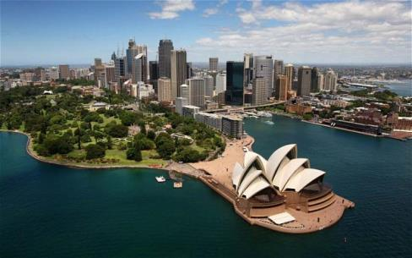
Why choose Australia
Growing Destination
Third most popular destination for international students (behind the US and UK)
High quality of education, and quality of life.
Seven of the top 100 universities in the world!
Five of the 30 best cities in the world for students based on student mix, affordability, quality of life, and employer activity.
Global Recognition
Schools and employers all over
the world recognize degrees from Australian schools.
Cost of living
International students are able to work part time while they study, allowing them to offset their living costs (max 20 hours a week).
Notes:
Ref: http://www.internationalstudent.com/study_australia/why_study_australia/

Slide 4
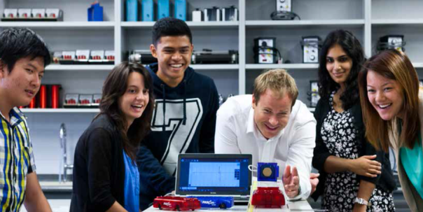


Why study in Australia
Global recognition of degrees
Multicultural
Forefront of new technology and innovation
Top-ranking universities
Post-study work arrangements
Study and work
Diversity of education options
Source: internationalstudent.com/study_australia/why_study_australia/

Slide 5
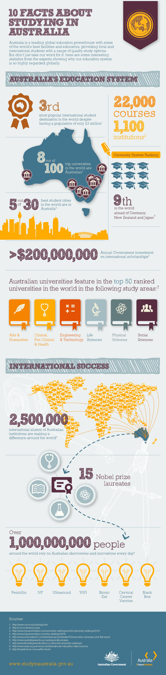
Did you know?
Source: studyinaustralia.gov.au/global/why-australia
Notes:
Ref: https://www.studyinaustralia.gov.au/global/why-australia

Slide 6
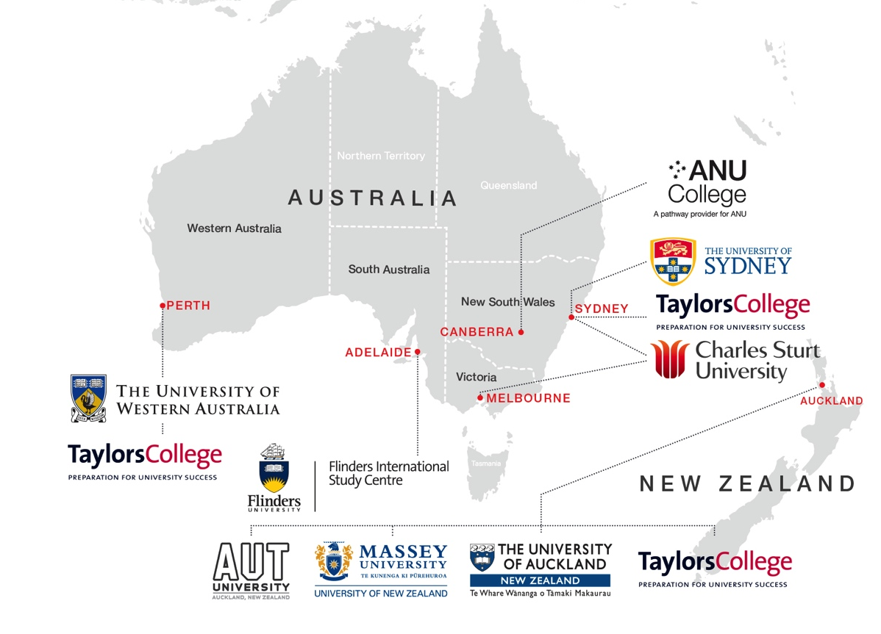








Our programs & brands
taylorscollege.edu.au/usfp
taylorscollege.edu.au
taylorscollege.edu.au/uwafp
anucollege.edu.au
csustudycentres.edu.au
isc.flinders.edu.au

Slide 7
Australian Universities World Ranking
Rank | University | State
25 | The Australian National University | ACT
33 | The University of Melbourne | VIC
37 | The University of Sydney | NSW
43 | The University of Queensland | QLD
48 | The University of New South Wales | NSW
70 | Monash University | VIC
89 | The University of Western Australia | WA
100 | The University of Adelaide | SA
254 | Macquarie University | NSW
257 | The University of Newcastle, Australia (UoN) | NSW
264 | University of Technology, Sydney | NSW
283 | University of Wollongong | NSW
285 | Queensland University of Technology (QUT) | QLD
304 | RMIT University | VIC
324 | Griffith University | NSW
331 | Curtin University | WA
333 | University of South Australia | SA
350 | James Cook University | QLD
360 | Deakin University | VIC
Rank | University | State
401-410 | La Trobe University | VIC
401-410 | University of Tasmania | TAS
471-480 | Bond University | QLD
481-490 | Flinders University | SA
551-600 | Charles Darwin University | NT
551-600 | Murdoch University | WA
551-600 | Swinburne University of Technology | VIC
651-700 | University of Canberra | ACT
651-700 | University of Western Sydney | NSW
701+ | Charles Sturt University | NSW
701+ | Edith Cowan University | WA
701+ | University of New England Australia | NSW
701+ | University of Southern Queensland | QLD
701+ | Victoria University | VIC
Source: QS World University Rankings 2014/15

Slide 8
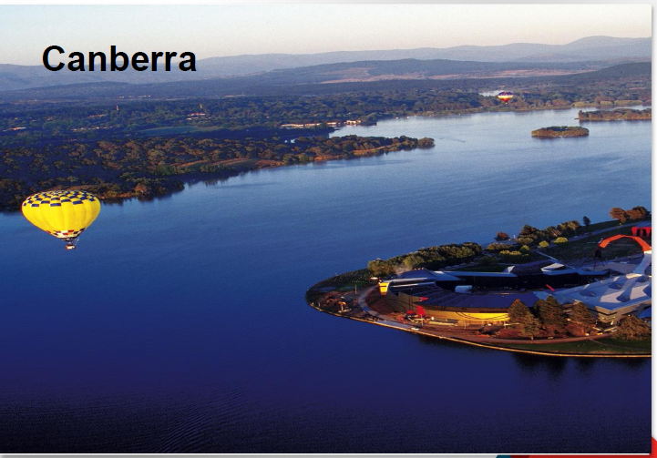

Slide 9


Slide 10


Slide 11
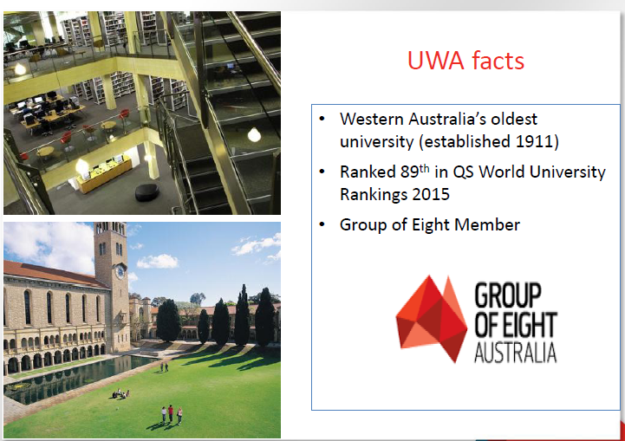

Slide 12
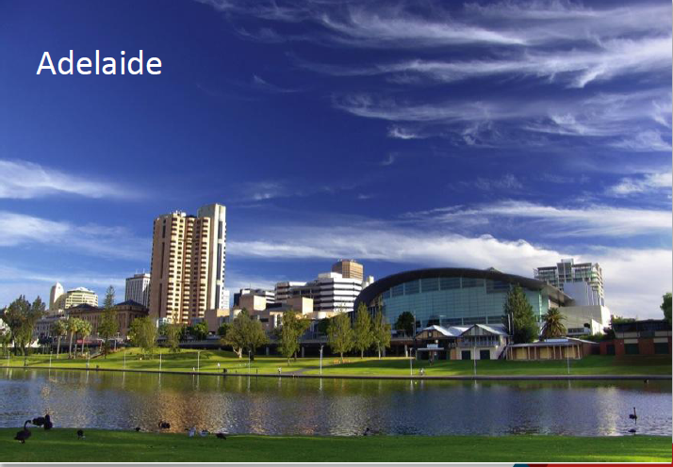

Slide 13
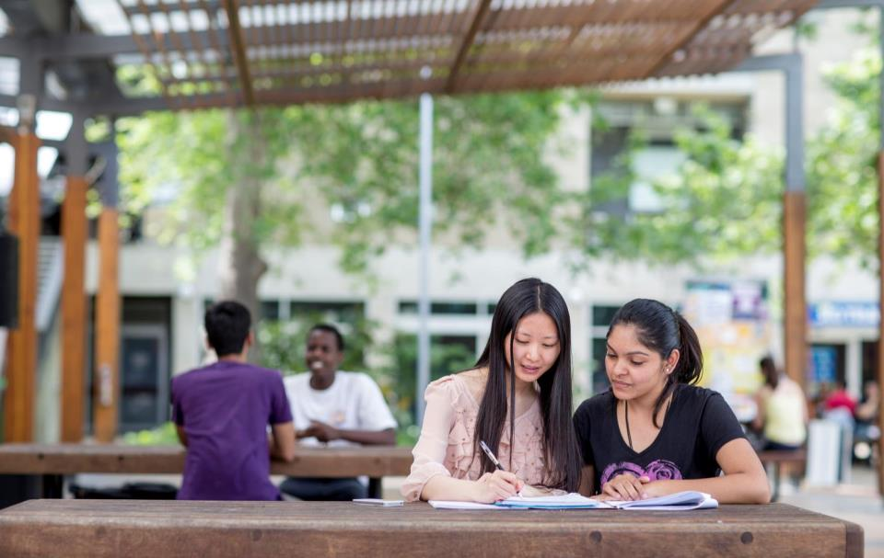
Flinders International Study Centre

Slide 14
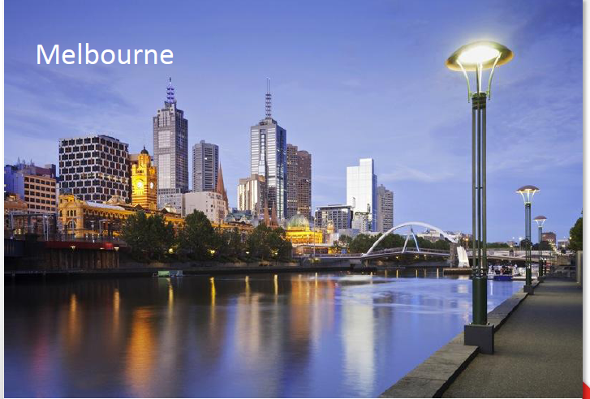

Slide 15
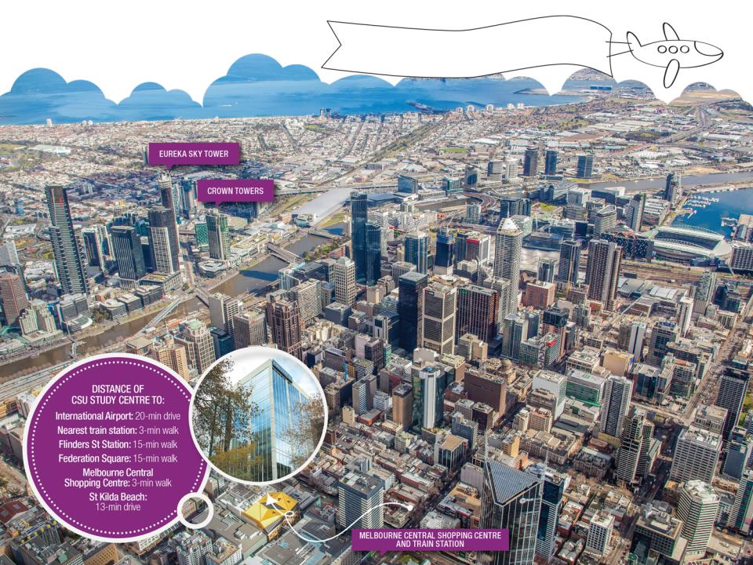
Campus Address:
30 Church Lane, Melbourne, VIC 3000, Australia
Melbourne
New location, new state-of-the-art facilities
Inner city locations

Slide 16


Slide 17
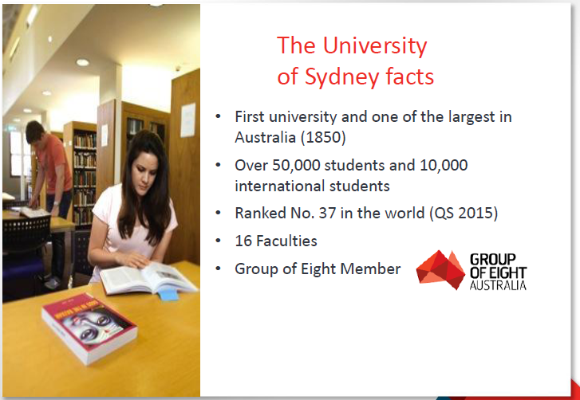

Slide 18
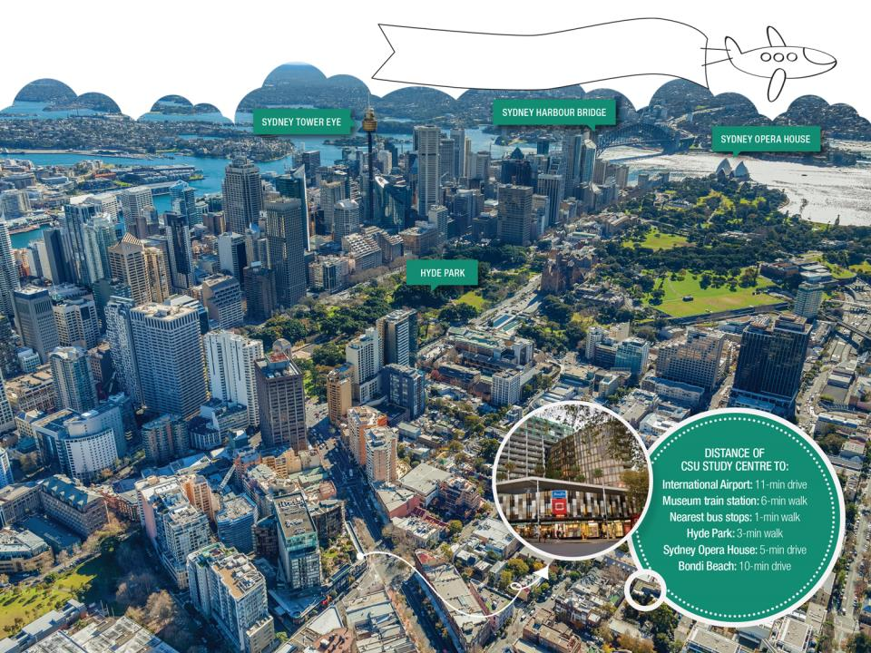

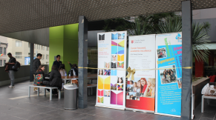
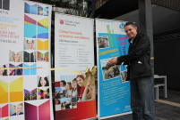
Campus Address:
Level 1, 63 Oxford Street, Darlinghurst, NSW 2010, Australia
Sydney
Level 2 just opened with new library & student common area (including a wonderful outdoor space)
Inner city locations

Slide 19


Career-focused courses
CSU deliver hands-on courses with a strong input from industry and professional groups to help students tackle real life situations and challenges in their chosen career.
CSU courses are accredited by industry and professional bodies such as CPA Australia and ACS (Australian Computer Society).
CSU staff are industry experts, they know the skills students need to work within the Accounting, Business and IT sectors.

Slide 20
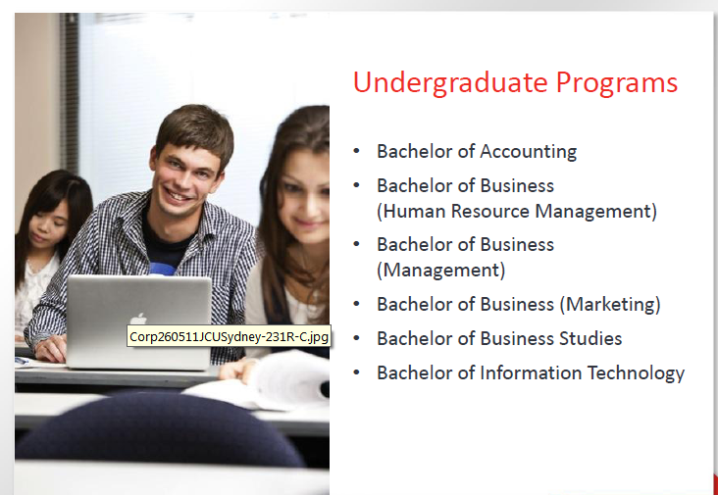

Slide 21
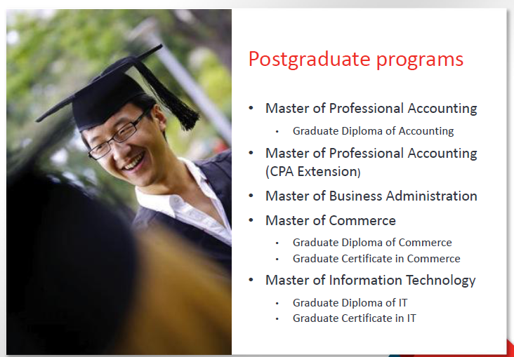

Slide 22
CSU Internship Program
Degrees are great but Internships make the difference!
CSU Study Centre students can apply for a graduate internship placement, and can commence after they complete their course.
Our Students Gain:
Australian work experience in relevant field of study
Explore their future career path
Develop their communication skills and confidence
Learn how a business works
Build business networks

Slide 23

High employability rate
REMOVE SLIDE IN NOT APPLICABLE
CSU has a high employment rate (84.3% compared with the average of 76.9% across all 40 Australian universities*). It shows that CSU is a proactive university dedicated to helping students thrive in their chosen career.
*This information is form the Australian Government website ‘My university’

Slide 24
Graduate outcomes
Graduate | Country | Degree | Role | Company | Industry
Jake Snabl | Czech Republic | BIT | DoubleClick Bid Manager Technical Specialist | Google | Internet-related products
Liang Han | China | MIT | Software Developer | TOPBUY.COM | e-Commerce
Diana Castrillon | Colombia | MBA | HR Advisor | Chris O'Brien Lifehouse | Health
Arpita Singh | India | BIT | Junior Web Developer | Schneider Electric | Electrical Manufacturing
Aakriti Pandey | Nepal | BBUS Accounting | General Manager | Via IP Pty Ltd | Telecommunications
Long Xuan Hoang | Vietnam | BBUS Accounting | Assistant Bursar | Study Group | Education
Kasha Shariati | Iran | BIT | Software Developer | Next Gen Gaming | Gambling and Casinos
Gehendra Acharya | India | BIT | Systems Admin Manager | Intersect Australia Ltd | Information Technology & Services (eResearch)

Slide 25
Thank you
Question?
20266A.04.15

