Slide 1
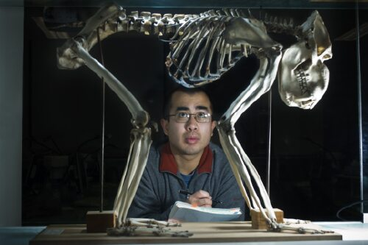


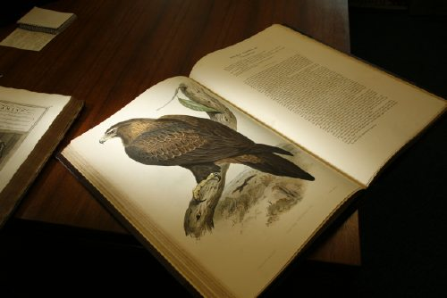


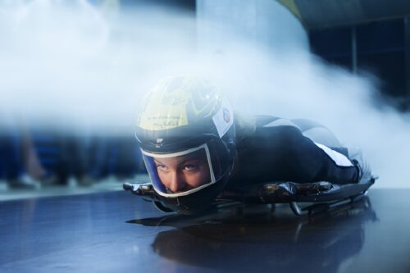

Monash Overview
Jim Zubic
Snr Manager Governance & Engagement
Office of the Associate Vice President
(Marketing, Communications & Student Recruitment)

Slide 2
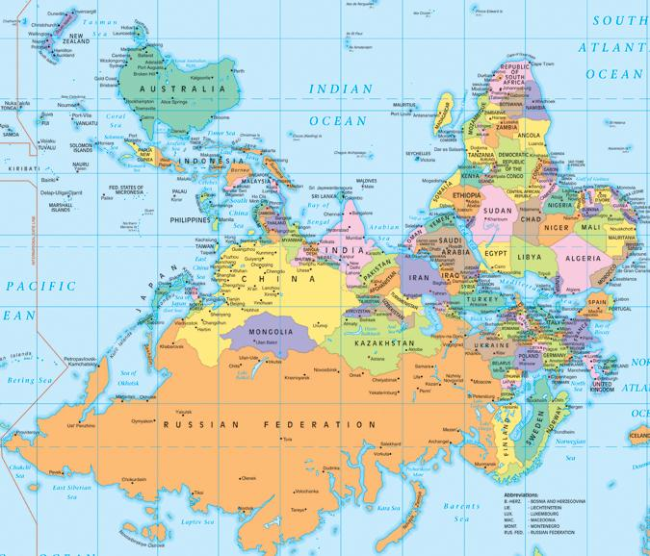



Slide 3
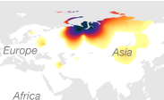

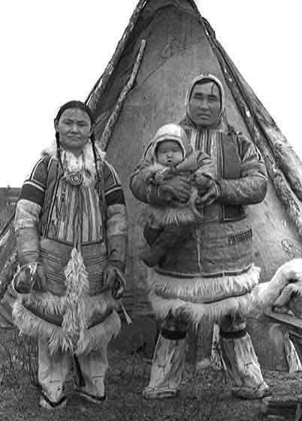
About Me
My Family Photo
Siberian…. Serbian background
Paternal Haplog N1b1 or N-P63
Found Northern Siberia and Urals
Rare outside of Siberia

Slide 4
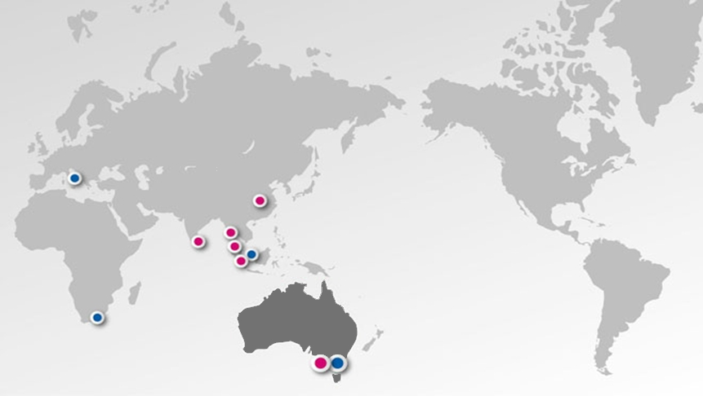
The Monash Global network
Monash University Campuses: Australia ■ Malaysia ■ South Africa
Monash University Centres: India ■ Italy ■ China
Monash College: China ■ Indonesia ■ Singapore ■ Sri Lanka

Slide 5
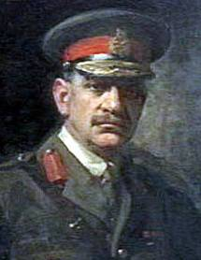

The University’s namesake
Sir John Monash
(1865-1931)
Engineer
Commander of the Australian & NZ forces in WW I
Vice Chancellor
"...equip yourself for life, not solely for your own benefit but for the benefit of the whole community."
Notes:
5
The university is named after him, not because of his fame but because of the many and important ways in which he contributed to the community.
Sir John truly detested war, its outbreak in 1914 forced a leadership role upon him.
He was in charge of the entire Australian Corps, and many historians consider him to be the foremost Allied military commander of the First World War.
By the age of 30 he had completed degrees in arts, engineering and law and had also qualified as a municipal surveyor, an engineer of water supply and a patent attorney. He set up in private practice as a civil engineer and in the following years became known as one of Australia's foremost experts in reinforced concrete for bridges, railways and other large construction projects.
He is remembered as a scholar, a man of action and an individualist -- a man who sought, above all, to use his education and abilities for the benefit of the community.

Slide 6

Faculties
Art Design & Architecture
Arts
Business & Economics
Education
Engineering
Information Technology
Law
Medicine, Nursing & Health Sciences
Pharmacy & Pharmaceutical Sciences
Science
Notes:
Globally, Monash ranks:
Times Higher Education (2011/12): 117th
ARWU (2011): 151-200
QS (2011/12): 60th
According to the 2011 QS World University Rankings, Monash is among:
the top 30 universities in the world for History
the top 30 universities in the world for Philosophy
the top 40 universities in the world for Geography and Area Studies
the top 40 universities in the world for Linguistics
the top 40 universities in the world for Medicine
the top 40 universities in the world for Psychology
the top 40 universities in the world for English
the top 50 universities in the world for Modern Languages
the top 100 universities in the world for Biological Sciences
In the top 75 universities for Chemistry (the Academic Ranking of World Universities).
The Times Higher Education World University Rankings 2011 rated us:
the top 40 universities in the world for Clinical, Pre-Clinical and Health
the top 50 universities in the world for Life Sciences

Slide 7

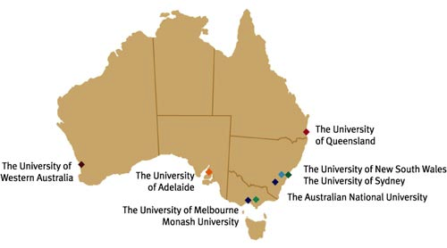
8 out of 39 Public
Universities
Australia’s leading research intensive universities
70% of all research income in Australia’s university system
Enroll over 50% of all PhDs in Australia
Notes:
In the Group of Eight - research intensive universities.
Go8 universities have nurtured every Nobel Prize winner educated at an Australian university.
They are the most research concentrated of all Australian universities and enrol over half of all higher degree by research students.
Three quarters of Australia’s highly cited university researchers (top 0.5% of all publishing authors in a given field) are from Go8 universities.
Go8 universities hold over 90% of US patents for inventions and generate 80% of spin-off companies created by Australian universities.
They contribute over 70% of the Fellows of the four Australian learned academies Go8 universities account for 70% of all research income in Australia’s university system, 72% of income from investments, 78% of income from donations and bequests and more than half of total university assets

Slide 8
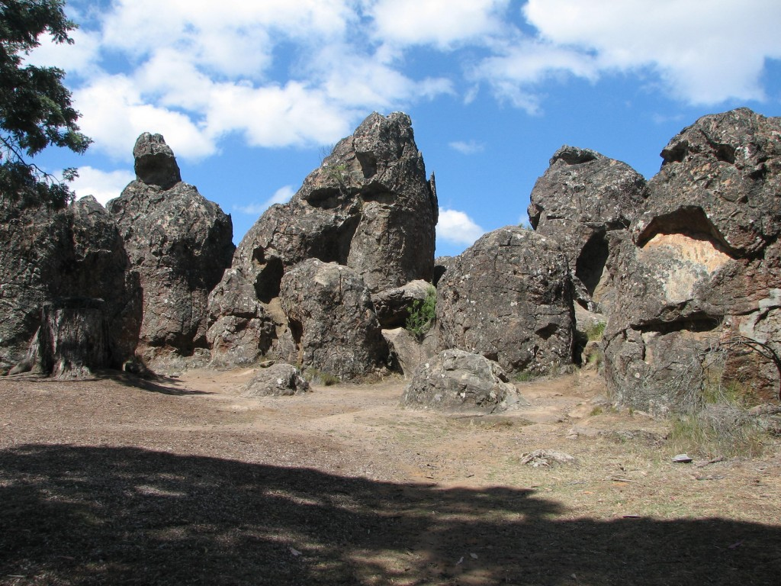
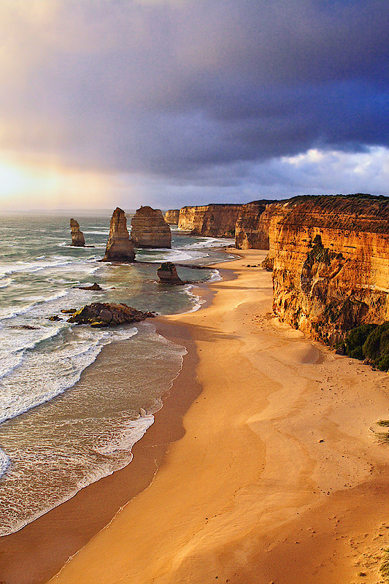
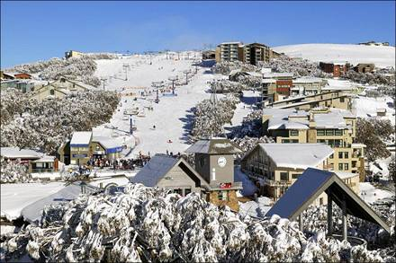
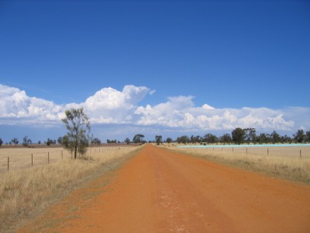
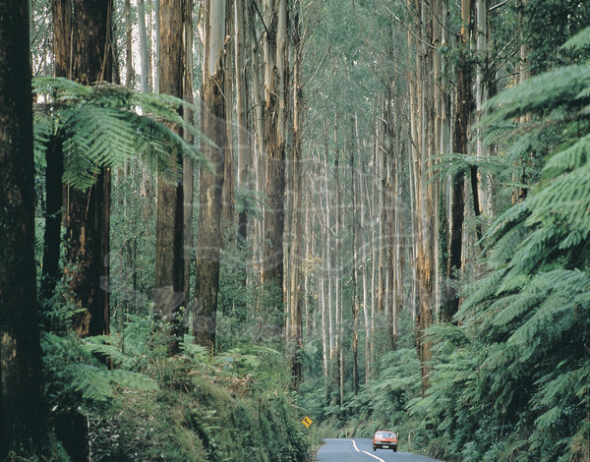
Australia: A Place of Contrasts

Slide 9

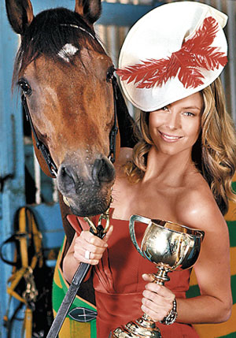
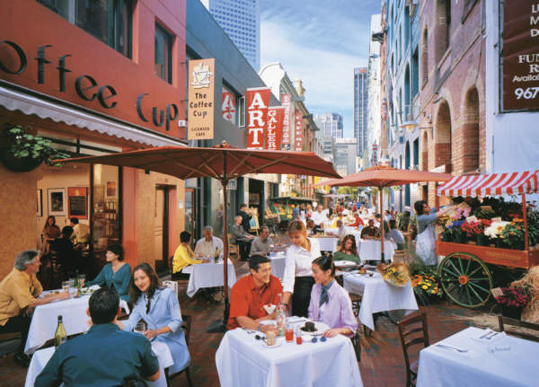

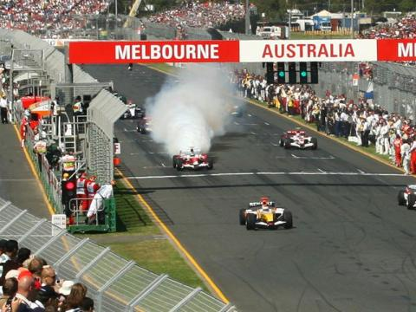

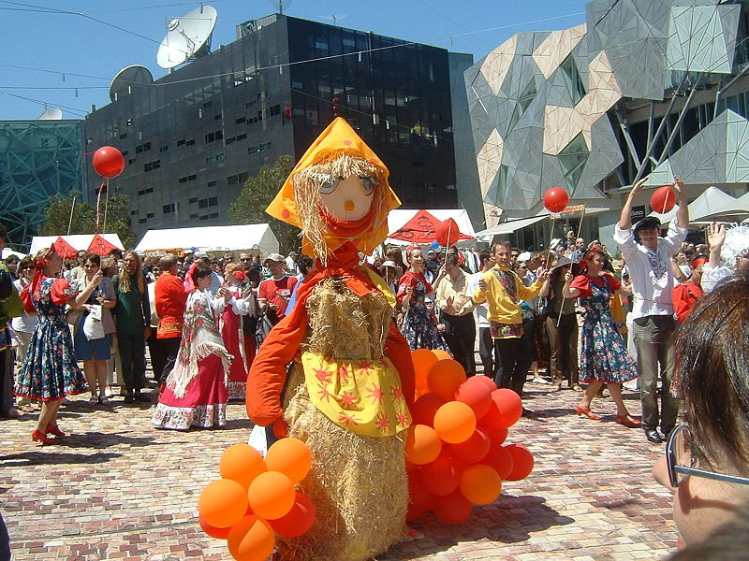

Melbourne
Worlds most liveable city
4.5 million people
Vibrant, multicultural
Temperate climate
Cultural capital
  Restaurants
  Festivals
  Concerts
  Sport
  Parks

Slide 10
Australia, Melbourne, Monash!
Australia
Human Development Index (HDI) #2 (UN report 2013)
Melbourne
Most livable city in WORLD (Economics Intelligence Unit 2015)
Monash
Rated as one of the Top 100 Universities in the world (THE 2015)
Top 50 Graduate Preference Survey (New York Times Oct 2012)
Member of the Group of Eight (Go8)
Only Go8 with triple crown accreditation AACSB, EQUIS & AMBA
QS Top 50 Subjects Areas (2015):
Accounting & Finance Business & Management Chemistry Chemical Engineering Civil & Structural Engineering | Communication & Media Studies Economics and Econometrics Law Medicine Mechanical Engineering

Slide 11
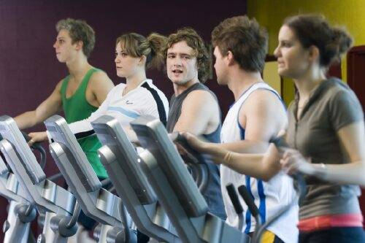
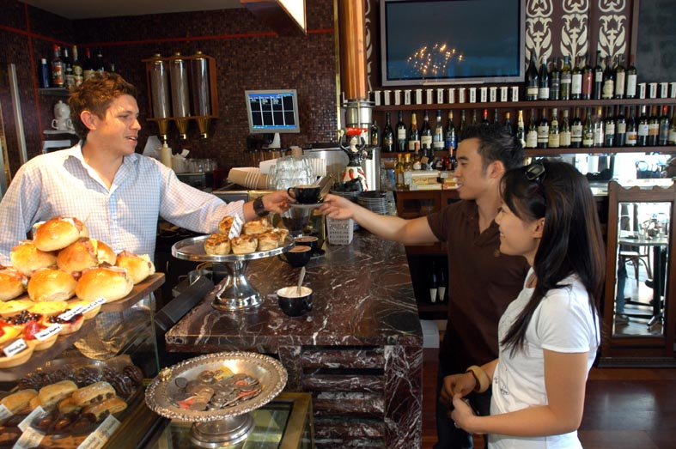
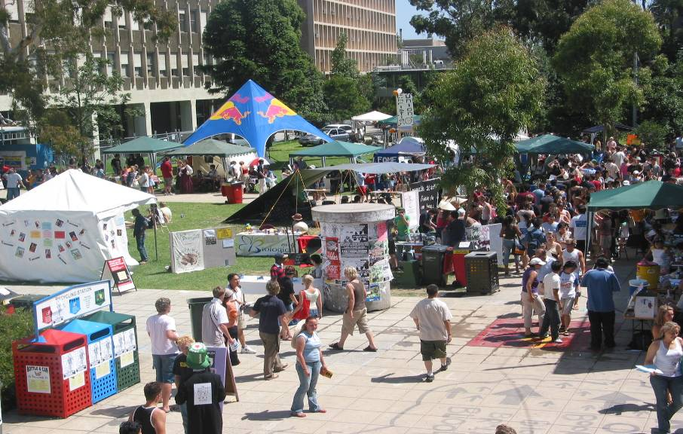
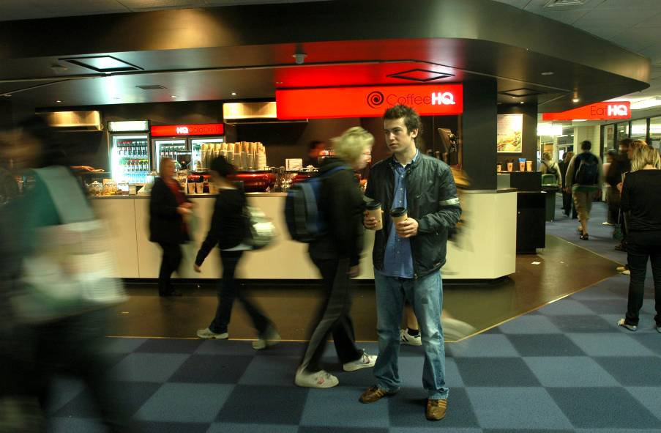
Monash Life

Slide 12
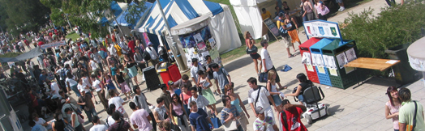
Academic Study Period
The academic year is split into 2 semesters:
  Semester 1: February to June
  Semester 2: July to October
  Optional Summer and Winter Semesters for some courses
A normal full time load per semester at Monash is 4 units (subjects or courses). Each semester has 13 weeks of classes and a 4 week exam period.
Course duration:
  UG 3-5yrs single degrees
  PG 1-2 yrs
  Research 2-4 yrs

Slide 13
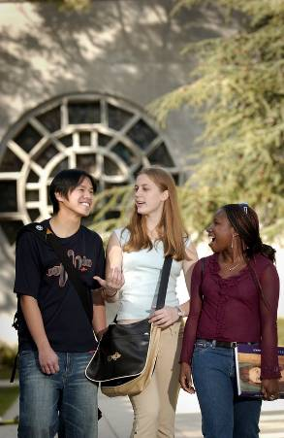
Undergraduate requirements
Completion
  Attestat o Srednem Polnom Obshchem Obrazovanii (Certificate of Secondary Complete General Education) can apply to Monash’s First Year University Undergraduate degrees.
Prerequisite Subjects
Extra Requirements
  Folio
  Audition
  Music grade
  Exams / Tests

Slide 14
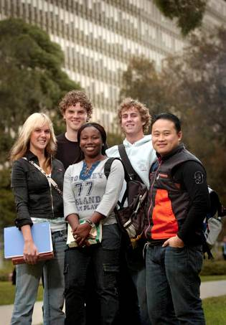
Postgraduate requirements
Coursework
Completion of min 4 year Russian degree
General (5 Point)* Pass grade = 3
General (5 point)* Credit average > 3.7
Work requirements
Research (eg PhD)
  Must have completed Thesis
  Publications
  High score
* Different institutions have different grading scales

Slide 15
Minimum English IELTS and TOEFL
Undertaken within 24 months prior to your study commencement date and have achieved the following results:
IELTS - Minimum overall test score required is 6.5 (no band less than 6.0).
TOEFL
  Paper-based test - 580 with a Test of Written English (TWE) score of at least 4.5
  Internet-based - 90 overall, at least 22 in writing and no section lower than 20.
Cambridge (CAE) - 'A‘ grade
Cambridge Certificate of Proficiency in English - 'C‘ grade
Monash College English programs (General English + IELTS & MEB)

Slide 16
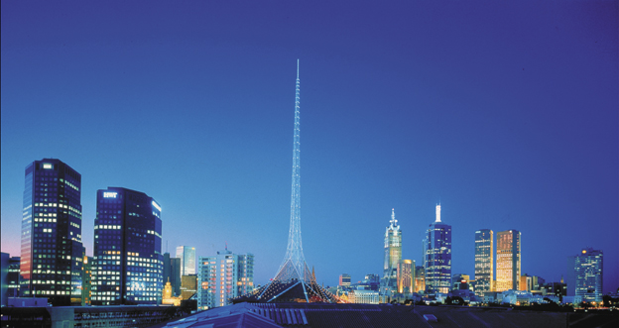
Costs
Living expenses approx AUD $22,900+
Course costs range and are listed in course guides and our web site
International students may work up to 20 hours per week during semester and work full-time during the holidays

Slide 17
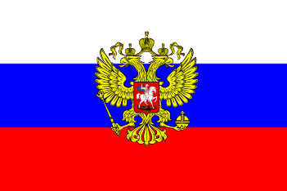
Russian Global Education Scholarship Program (RGESP)
Monash University is an RGESP approved participating university
Limited funding covers the cost of: Tuition fees and living expenses To apply applicants must receive an offer of a place at Monash University and then submit an online application to http://educationglobal.ru/ Next application deadline is November 8, 2015 | For specific Masters and PhD programs in: Science Management in Social Spheres Education Medicine Engineering and IT
Conditions: Must Return to work in Russia within 3 years of graduation and work at least 3 years in scholarship field Or pay back their scholarship fund within 3 years after graduation

Slide 18
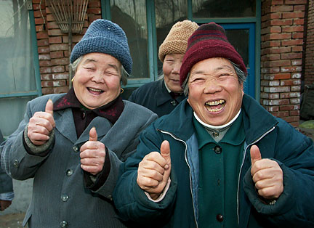
How to apply
Prospective students can apply through our trusted agents
Complete applications take approximately 2-3 weeks to assess, longer if credit has been applied or if further academic requirements such as interview and folio assessment are required.

Slide 19


Questions?

