Slide 1


Notes:
Introduction
Introduce yourself
Describe presentation and setup expectations (“Today we’ll be covering…”; “I will be answering questions at the end…”)
Setup “What Chapter” video (if it’s being used)

Slide 2

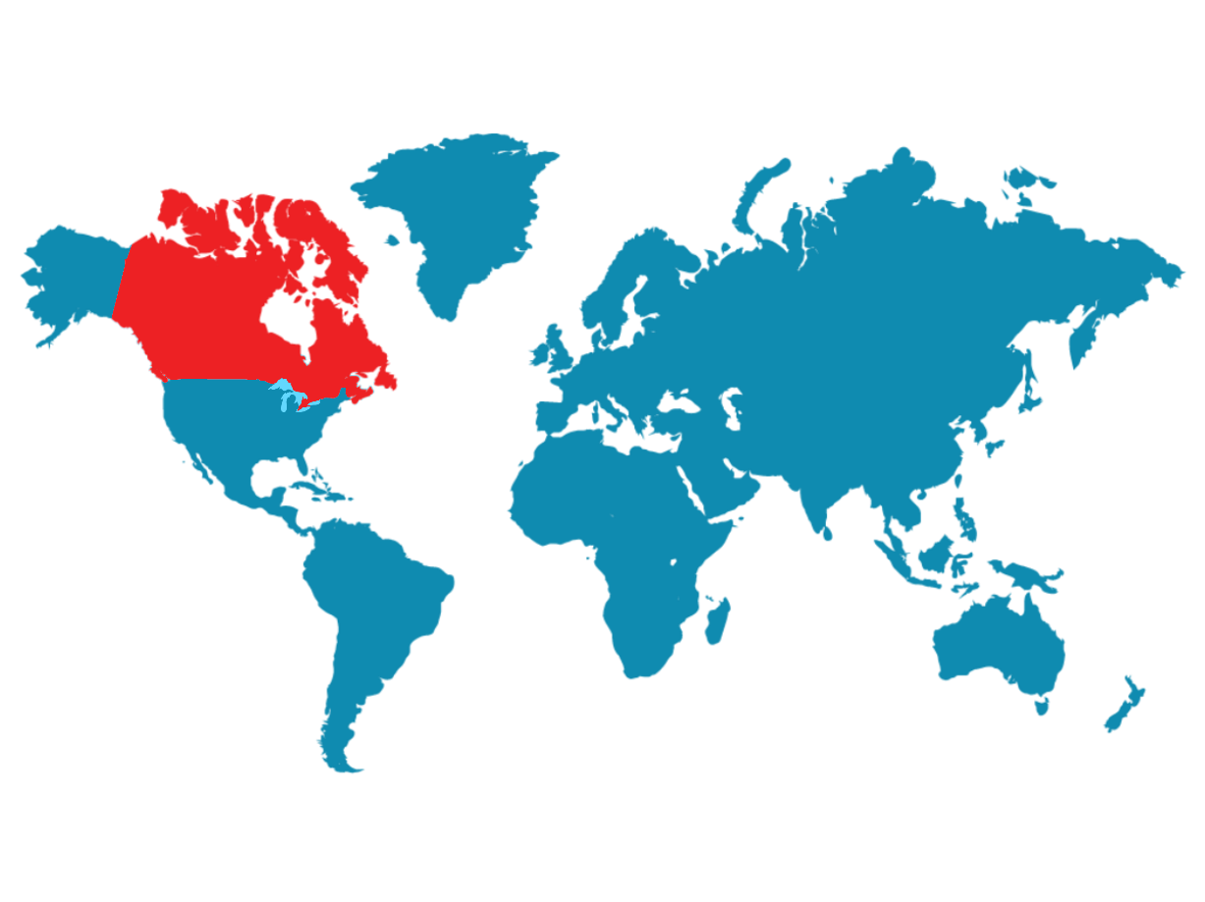
CANADA
Notes:
[Canada; content to come]

Slide 3
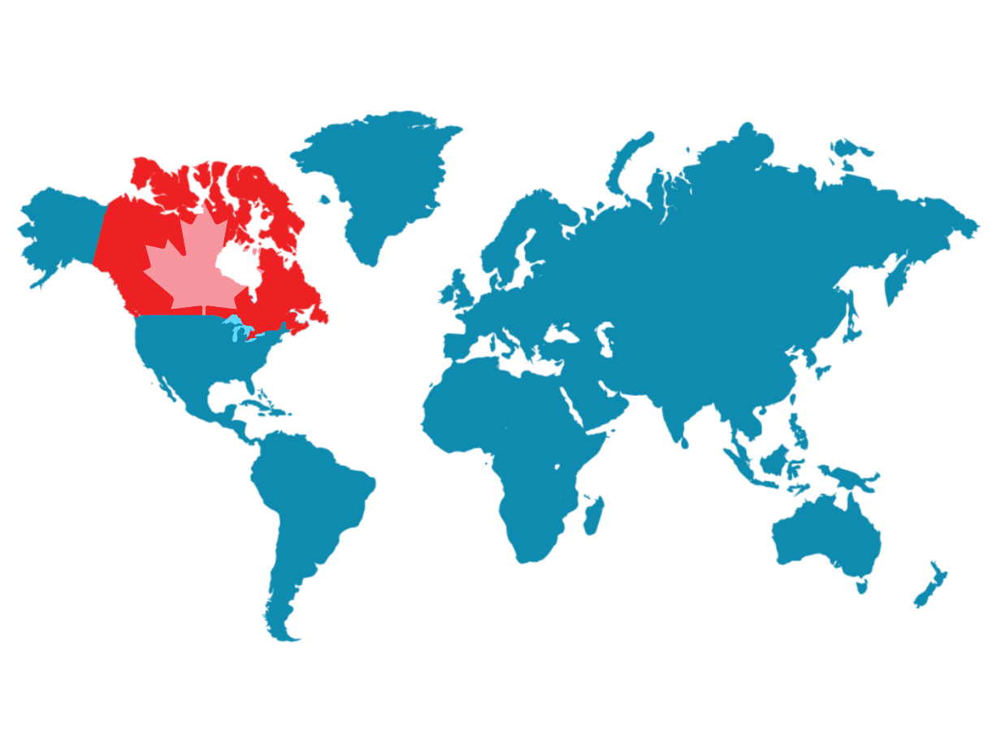
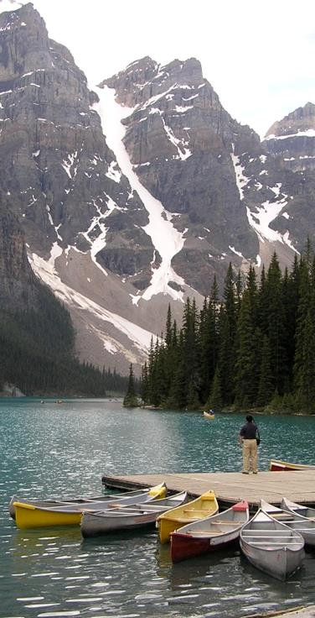
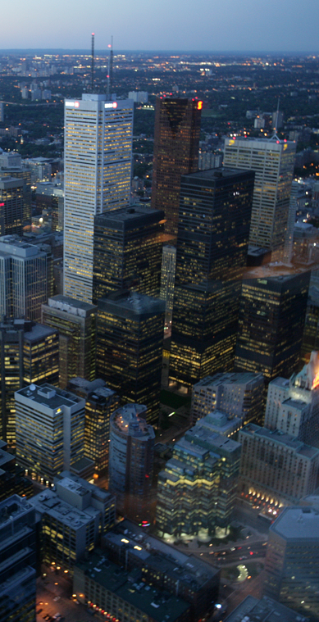
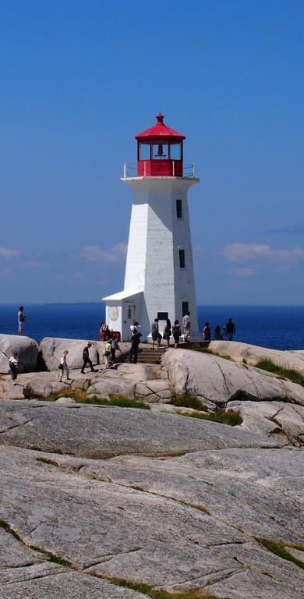
CANADA
Notes:
[Canada; content to come]

Slide 4
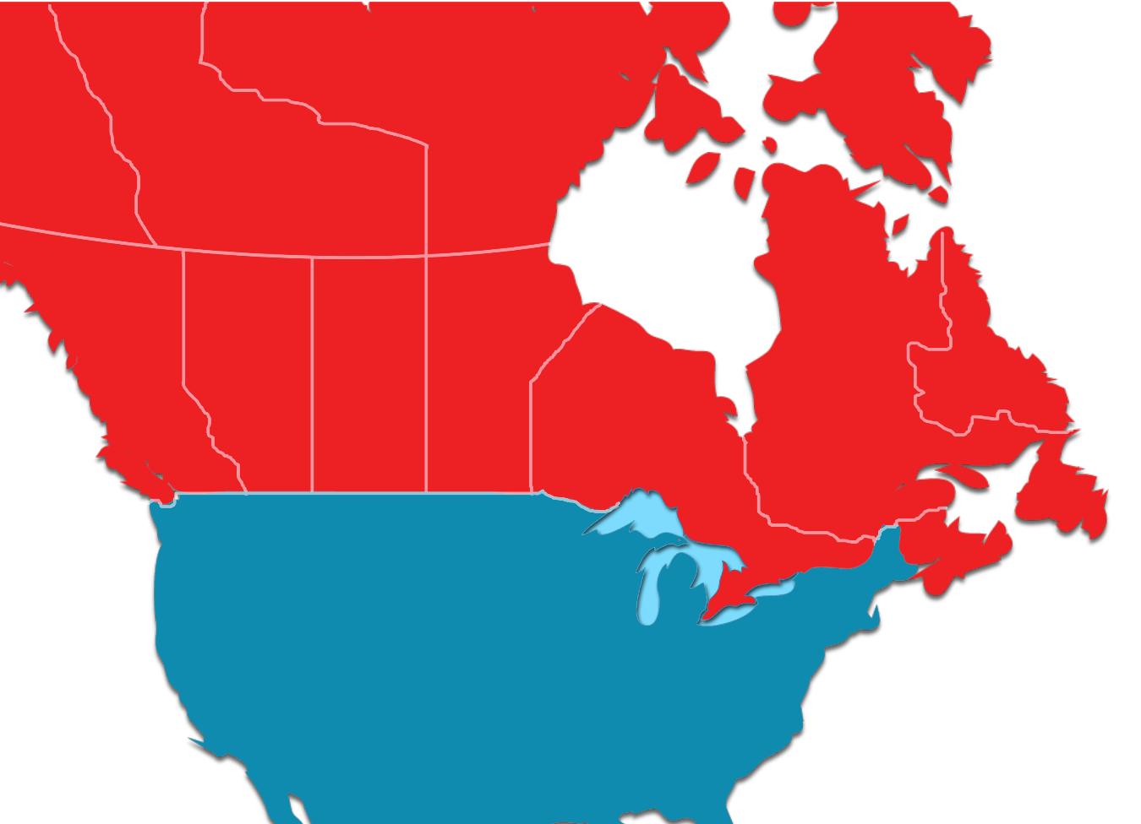


THE CITY OF TORONTO
Vancouver
500km
Montreal
Chicago
New York
Toronto
Washington DC
Notes:
[Toronto; content to come]

Slide 5
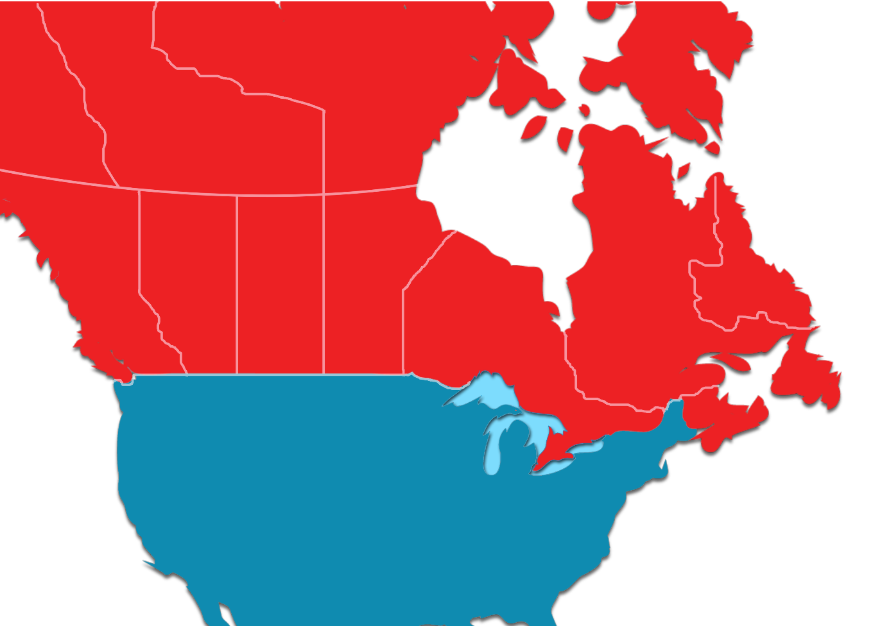

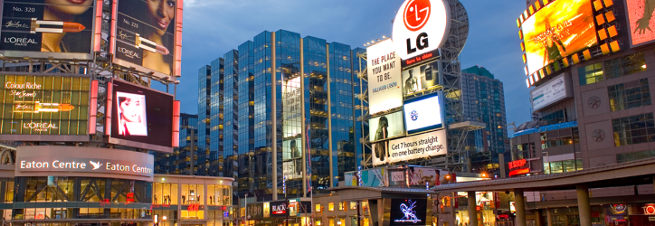
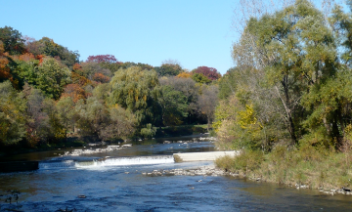
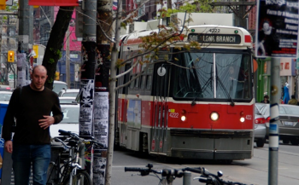

THE CITY OF TORONTO
Notes:
[Toronto; content to come]

Slide 6
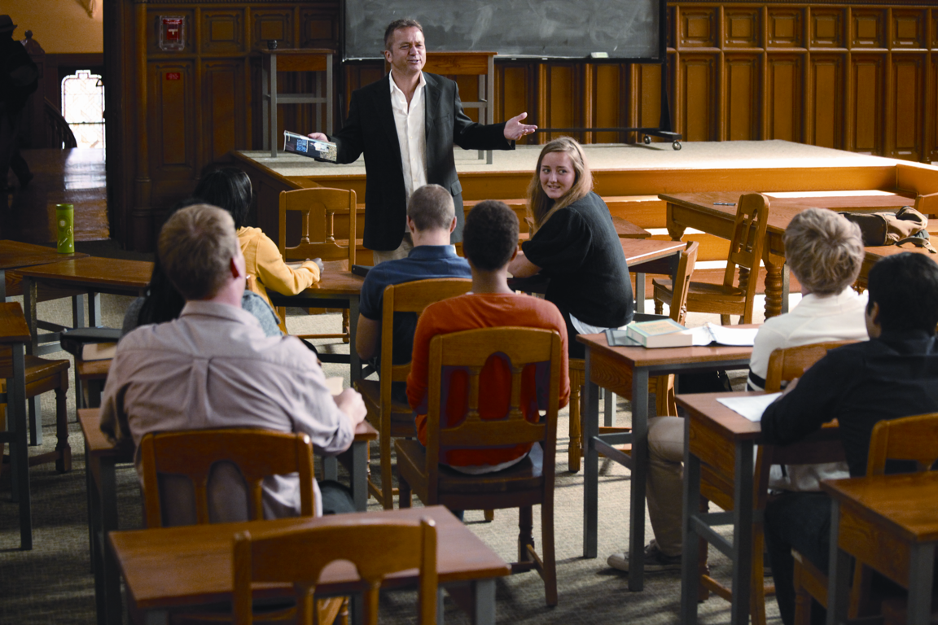



A WORLD-CLASS UNIVERSITY
Notes:
Excellence & Quality
Introduce excellence pillar – “U of T is a university with an incredible reputation for academics, faculty [shield “nobel laureates”], and research [shield “publication ranking”] and because of that, we attract the best and brightest students from all around the world [shield “international students”]
“A degree from the University of Toronto is recognized around the world. We are consistently ranked by several international publications as one of the institutions in the world, and the best in Canada.”
Diverse & multicultural institution in a dynamic setting (Toronto) – “…one of the most liveable cities in the world.”
Notes: If you’re referencing Nobel Laureates, be sure not to say Noble Peace Prize…Nobel Prize is okay (U of T Nobel Laureates have won two PEACE prizes, as well as prizes in Physics, Medicine and Chemistry)

Slide 7


A GREAT LEGACY
Notes:
Legacy
“U of T was established in 1827...”
“…in that time the University of Toronto community has gone on to do some incredible things. Our students, graduates and faculty have been responsible for ground breaking research and discoveries – Banting & Best discovery of insulin; Ron Deibert’s Citizen Lab that focuses on the internet security and human rights; Craig Keilburger’s youth empowerment movement Free the Children; etc.”
“And what does this mean for you? It means that you can join a community that has made great achievements and gives you an opportunity to learn from world-leading scholars. Whatever your goals are, when you choose U of T, we will give you all of the support you need to achieve them…”
Our faculty is not just focused on research, but teaching as well…” [click to Faculty Video]

Slide 8
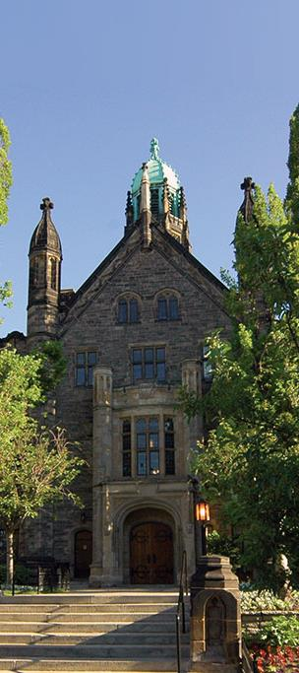
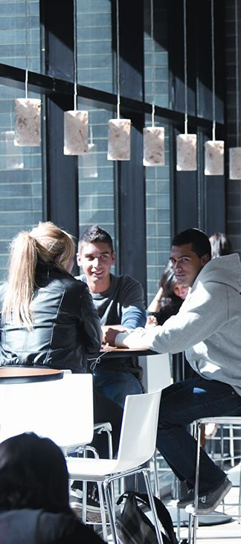
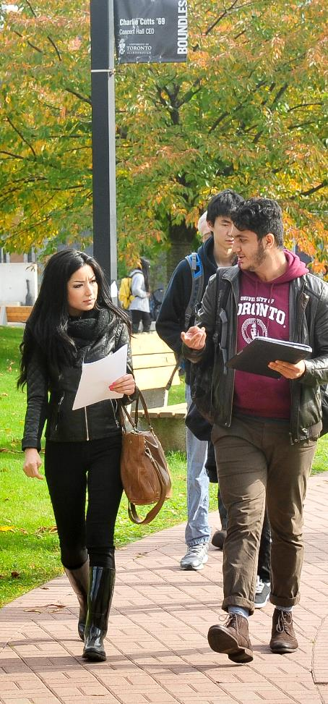
ONE UNIVERSITY THREE CAMPUSES
Notes:
Community
“U of T is a place of neighbourhoods – we are one university, with three distinct campuses.”
“Just like the entire Toronto area/Greater Toronto area, U of T is made up of diverse communities where everyone can find a home/place to belong.”
“…and no matter where your studies take you at U of T, you will graduate with the same, internationally-recognized U of T degree.”

Slide 9

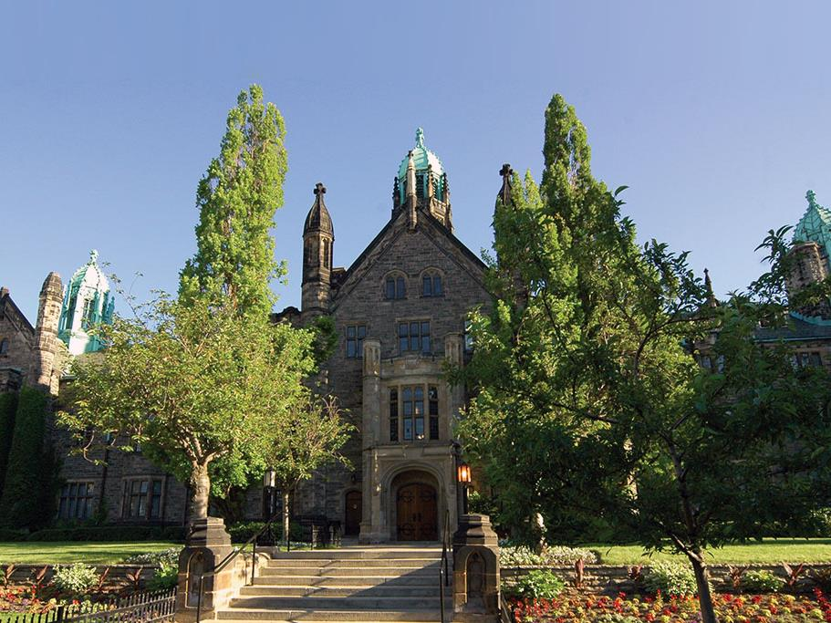
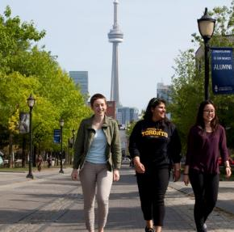
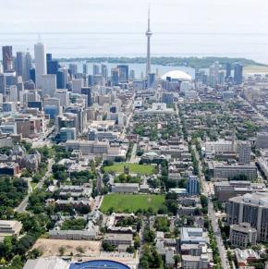
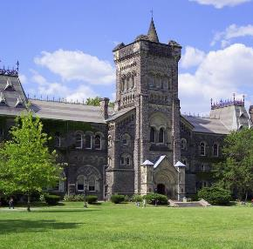
ST. GEORGE CAMPUS
Notes:
Community: St. George Campus
“U of T St. George is the original, founding campus of the university.”
“Located in downtown Toronto, U of T is a mix of old and new architecture.”
“It is the largest of the three campuses and has layers of communities to engage students…….[next slide]”

Slide 10

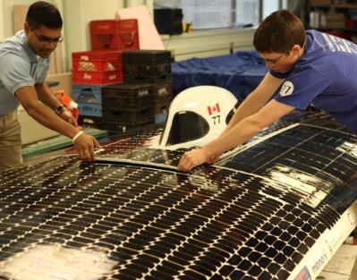
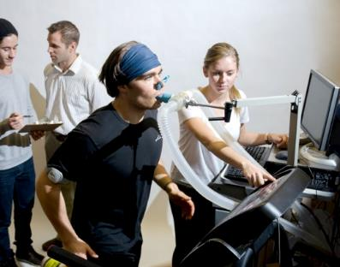
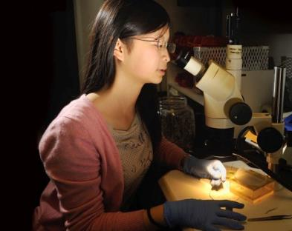
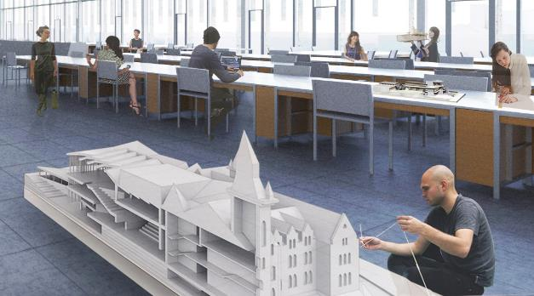
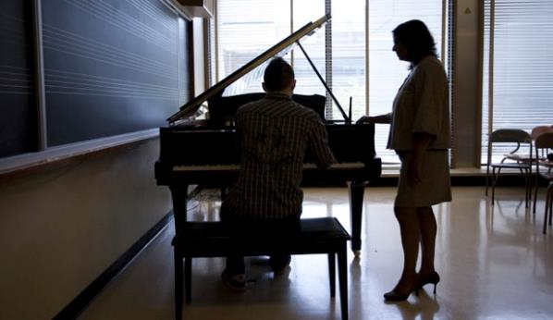
ENGINEERING
KINESIOLOGY
ARTS & SCIENCES
ARCHITECTURE, LANDSCAPE & DESIGN
MUSIC
ST. GEORGE ACADEMIC COMMUNITIES
Notes:
Community: St. George Campus – Academic Communities
“U of T St. George can be a large campus, but it’s broken down into smaller communities with their own support systems, resources and dedicated faculty and staff for you.”
“There are five distinct academic communities/faculties that you can be part of. The Faculty of Applied Science & Engineering, Faculty of Music, Daniels Faculty of Architecture, Landscape and Design and the Faculty of Physical Education and Kinesiology are all small, professional faculties with their own vibrant communities.”
“The Faculty of Arts & Science, the largest academic community/faculty, is further broken into smaller communities – the Colleges… [click to College System slide]”
NOTE: Emphasis should be on the communities and not the programs
NOTE: End on Faculty of Arts & Science

Slide 11
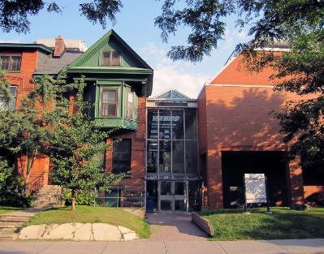
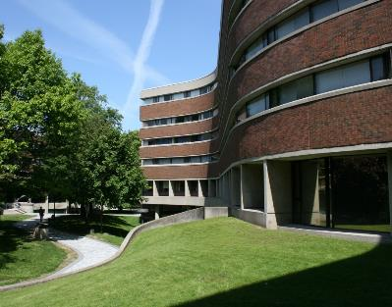
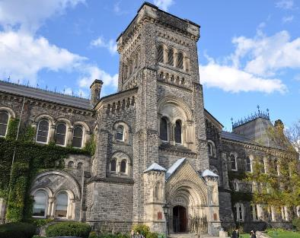
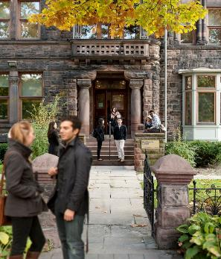
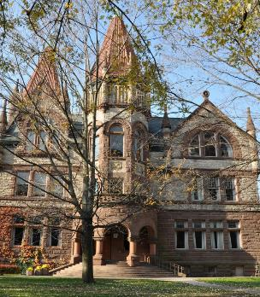
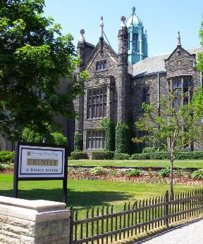
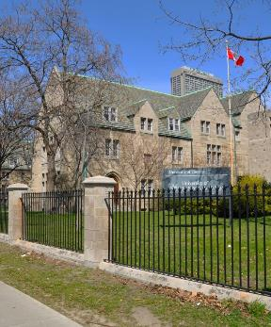
INNIS COLLEGE
NEW COLLEGE
UNIVERSITY COLLEGE
WOODSWORTH COLLEGE
VICTORIA COLLEGE
TRINITY COLLEGE
ST. MICHAEL’S COLLEGE
THE COLLEGE SYSTEM
Notes:
Community: St. George Campus – The College System
“The College System is unique to the Faculty of Arts & Science and an important aspect to life at U of T.”
“The Faculty of Arts & Science is a neighbourhood within U of T and the Colleges are all houses within that neighbourhood. Every student in the Faculty of Arts & Science belongs to one of our seven college communities. Each college provides residence, academic counselling, scholarships, orientation, clubs and social activities, but does not impact which program or courses you can choose. Your college will be your neighbourhood and home-base on campus.”
“If you’re interested in coming to the Faculty of Arts & Science, then we encourage that you learn as much as you can about the colleges (through our Viewbooks, the web, or better yet, by visiting us!) – because when you apply to the Faculty of Arts & Science, you’ll be asked to rank your choice of college on the application.”

Slide 12


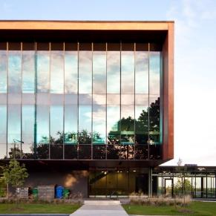
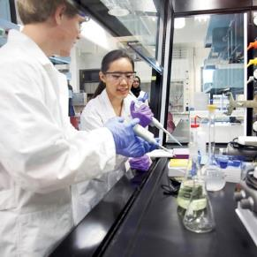
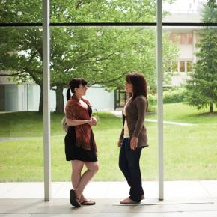
MISSISSAUGA CAMPUS
Notes:
Community: Mississauga Campus
“To the west of Toronto is the city of Mississauga, home to U of T Mississauga.”
“UTM is a beautiful campus, surrounded by acres of greenspace along the Credit River.”
“Grow Smart, Grow Green” is the banner for campus growth at UTM. That’s shown by green roofs, geothermal heating system and LEED-certified buildings.”

Slide 13
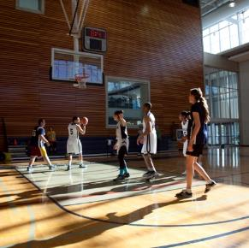
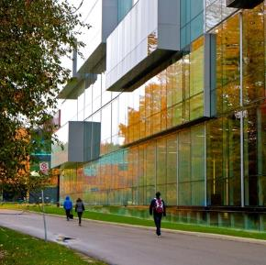
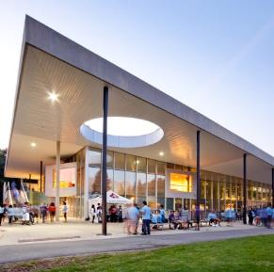
MISSISSAUGA CAMPUS
Notes:
Community: Mississauga Campus con’t
“UTM is a smaller campus that boasts a recently added innovation complex, instructional centre, and Deerfield Hall – all of which offer more student space.”
DID YOU KNOW:
UTM offered the first forensic science program in Canada. Today the program utilizes a crime scene house and “maggot farm” for hands-on learning;
There are blackberry trees along campus paths that bloom during the summer and offer a tasty snack on the way to class!
The wood on the exterior of the Hazel McCallion Academic Learning Centre is imported from Spain
The Hazel McCallion Academic Learning Centre was the first University of Toronto LEED certified building – it incorporates several environmentally-friendly features including a rooftop garden
Large areas of UTM’s 225 acre campus have been designated “Protected, Naturalized Research Space” and are protected against development
The annual UTM Arts Festival showcases over 100 works of student-created art and hosts a student performance showcase
Dr. Roberta Bondar, Canada's first female astronaut and the first neurologist in space, graduated from UTM
Don’t want to wait around for your laundry to finish? Don’t worry, UTM laundry machines will text you when they’re finished
The coat of arms for UTM has mostly green and gold representing the natural beauty of campus. The oak tree is from the U of T coat of arms and the blue and silver bars in the chevron signify the proximity of the campus to the Credit River
The radio station at UTM is CFREradio 91.9 and aired for the first time in 1970. Since then it has launched the careers of numerous individuals in broadcasting and music; Inside-Out: Prisons and Punishment is a course at UTM taught in penitentiaries where students are matched with a prisoner and work together on a final project throughout the term.

Slide 14

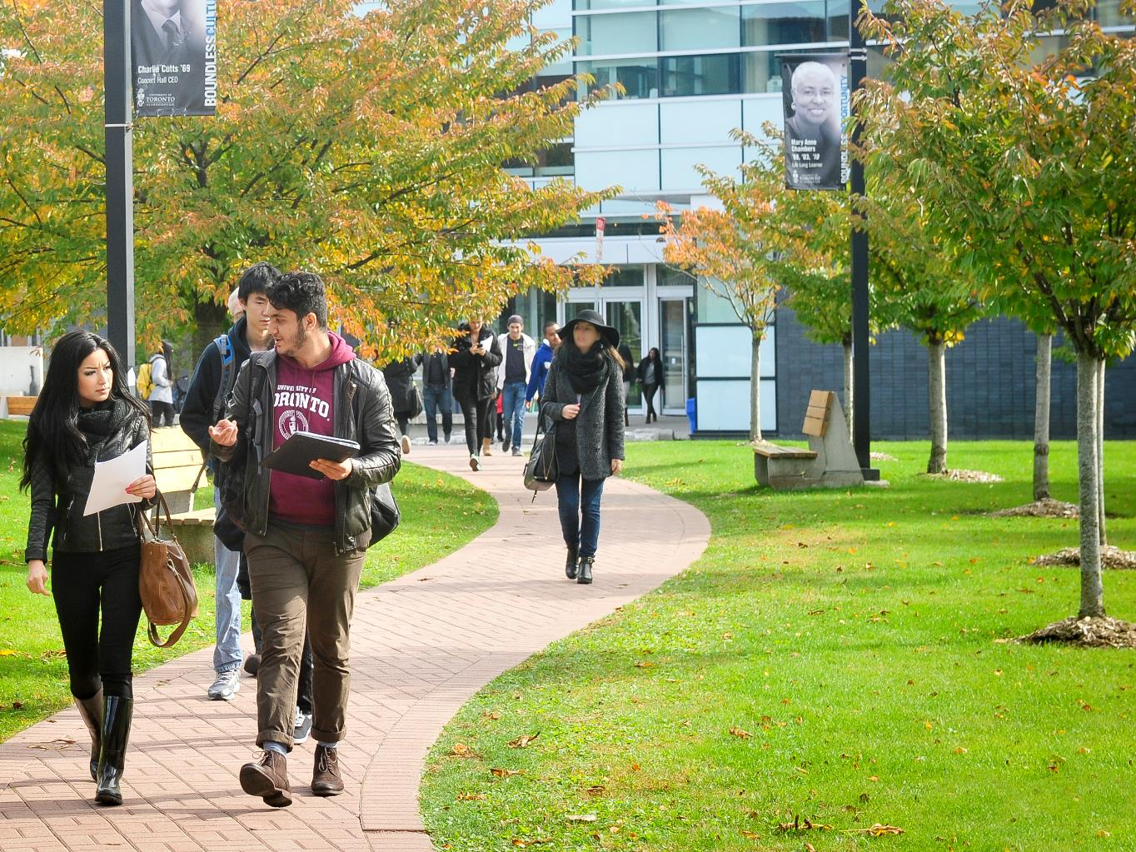
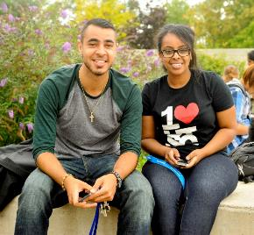
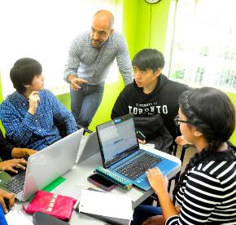
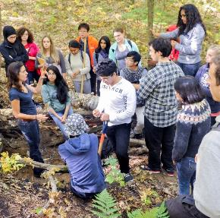
SCARBOROUGH CAMPUS
Notes:
Community: Scarborough Campus
“In Toronto’s east-end is UofT Scarborough.”
“The campus is set in the Highland Creek Valley with hiking trails and over 300 acres of parkland.”
“UTSC is a campus focused on experiential learning and is a great fit for students who learn best by doing.”

Slide 15
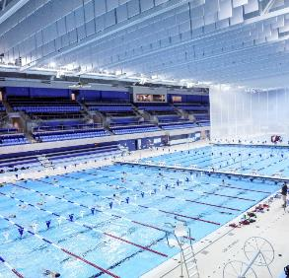

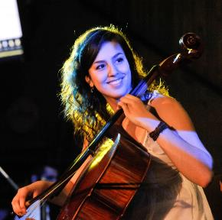
SCARBOROUGH CAMPUS
Notes:
Community: Scarborough Campus con’t
“UTSC recently opened a state-of-the-art Environmental Science & Chemistry Building and a world-class aquatic & athletic complex, which hosted the aquatic competitions for the Pan/Parapan Am Games in 2015.”
DID YOU KNOW: The original buildings were designed by John Andrews, the architect of the CN Tower; Varsity Blues baseball team plays here; [MORE TO COME]

Slide 16
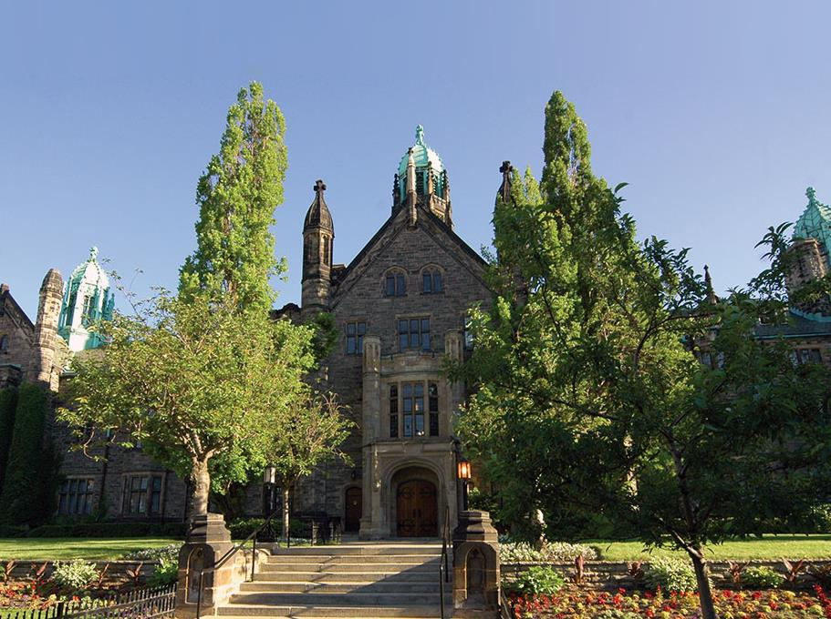

ONE UNIVERSITY THREE CAMPUSES
Notes:
Community: Summary
“One university, three campuses…and no matter where you choose to study at U of T you will receive the same high-quality education, be taught by some of the world’s leading educators, have access to all of our facilities and graduate with a U of T degree.”

Slide 17
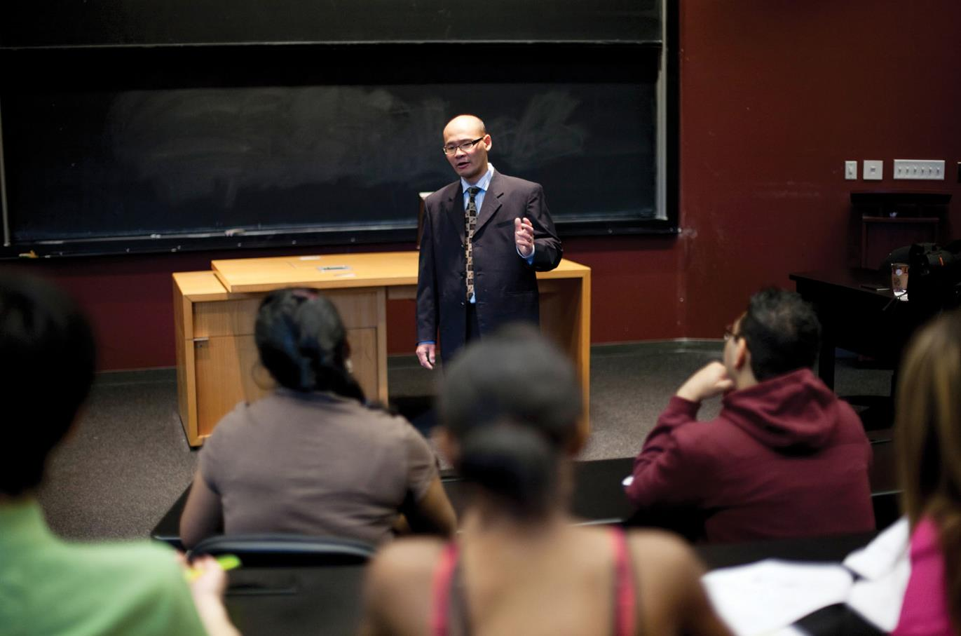

FIRST-ENTRY PROGRAMS
Notes:
Programs
Introduce the concept of first-entry programs.
“First-entry programs at U of T are those that you're applying to directly from high school. They’re your undergraduate, or bachelors, degree programs. Your first step in higher education.”
[Shield: 700 program options]
“We have incredible program options across all three of our campuses. Now, let’s talk about some of them...”

Slide 18
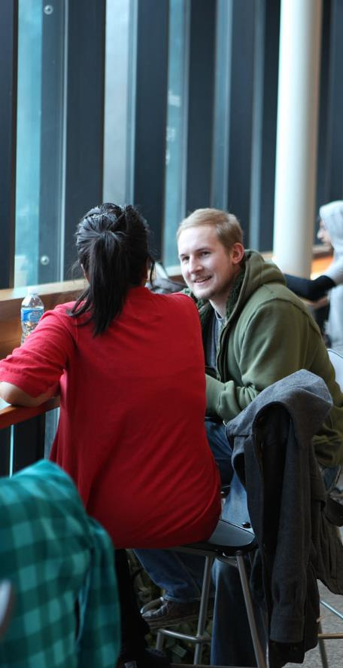

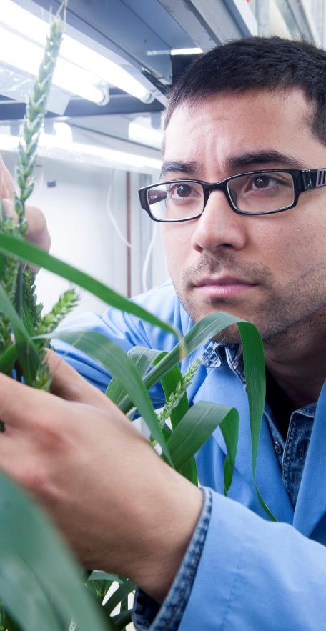



ARTS, BUSINESS & SCIENCE PROGRAMS
Notes:
Programs: Arts, Business & Science
“Programs in the Arts, Business and Sciences make up the largest set of academic options and exist across all three campuses.”
“U of T offers the largest program and course selection in Canada. This means that you have a lot of flexibility in building your degree in Arts & Science, through specialist, major and minor programs. You can build a degree that’s as diverse as we are! You could double major in Physics and English; or major in Biology, minor in French and Art History; specialize in Political Science – the options are nearly endless! And for most of our programs in the arts, business and science – you would actually choose what program you’re studying until your second year. That give you time to get to take some courses, meet professors and get to know all of the options at U of T.”
“Some of our programs are offered on multiple campuses, and some are unique to one campus. What you want to study may help you to decide which campus to apply to.”

Slide 19
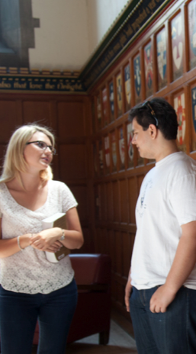
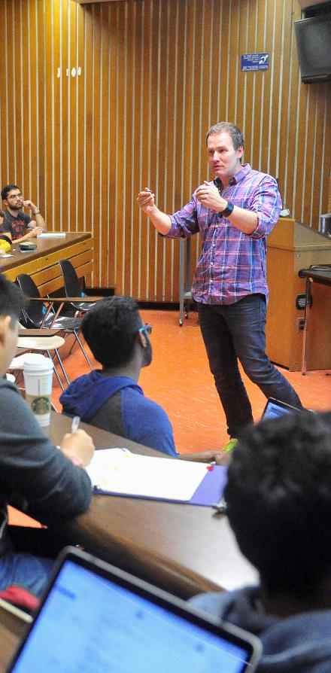

ARTS
Notes:
Programs: Arts
“Arts programs at U of T include options in humanities and social sciences – things like English, History, Languages, and Political Science.”
“Many of these options you will find across all three of our campuses, but there are a few programs that are unique to each campus...” [Highlight one or two from each campus] UTM: CCIT; Art & Art History; Theatre & Drama Studies UTSC: Journalism; New Media Studies; Public Law UTSG: 50+ languages; International Relations; Mediaeval Studies

Slide 20
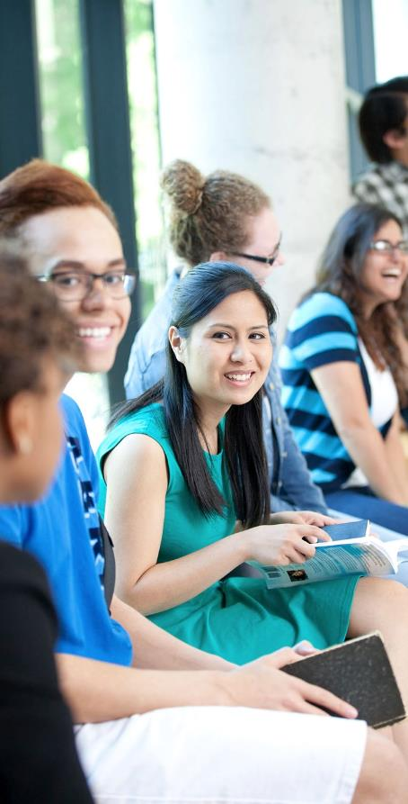

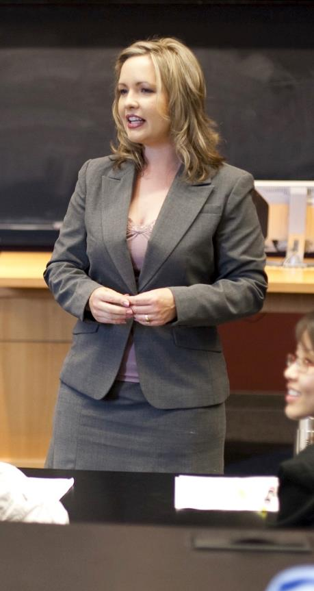
BUSINESS
Notes:
Programs: Business
“There is no better place to study business in Canada than in the economic hub of the country!”
[Highlight business options across the three campuses and both degree options, BCom and BBA]
“There are many different ways to study business, commerce and management at U of T. All of the key business courses are available on any of our campuses – the difference is in how they are taught. Commerce is a more theoretical approach, whereas management is more hands-on.”
“But regardless, whichever path you choose, you can be assured that you will have a world-class foundation in accounting, finance, marketing, human resources management, commerce and management.”

Slide 21



SCIENCES
Notes:
Programs: Science
“You can study science in many different ways at U of T – computer science, life science (living matter), physical science (non-living matter)…
“When you look through our program options (in our Viewbook or online), we encourage you to pay close attention to the categories at each campus. The categories will relate to the subject matter that you’re studying and sometimes they can be slightly different between campuses. This is also true for prerequisite courses.”
“You can study sciences at any of our campuses, but just like the arts and business, there are some unique programs...” [Highlight one or two from each campus] UTM: Forensic Science; Paleontology; Biomedical Communications UTSC: Mental Health Studies; Paramedicine; Environmental Geoscience UTSG: Pharamacology & Toxicologly; Actuarial Science; Pathobiology
Note: Categories and headings relate to the type of subject matter you’re studying.

Slide 22



ENGINEERING
CORE 8
GENERAL FIRST YEAR
ENGINEERING SCIENCE
Notes:
Programs: Engineering
“Like we mentioned before, some programs/faculties are only available on some campuses – let’s look at a few of our professional faculties on the St. George Campus”
“The Faculty of Applied Science & Engineering is Canada's top ranked school of engineering.”*
“Engineering at U of T is a hub of business and innovation. You will have design courses in your first year and have the option to specialize your degree with minors and certificates.”
“You have three ways to get into Engineering. If you know what you want to study, you can apply directly to one of our Core 8 programs [click] (which include civil, chemical, computer, electrical, industrial, mechanical, mineral and material).”
* http://www.engineering.utoronto.ca/about/the-faculty/facts-figures/

Slide 23
ENGINEERING
CHEMICAL
CIVIL
COMPUTER
ELECTRICAL
INDUSTRIAL
MATERIALS
MECHANICAL
MINERAL
CORE 8
GENERAL FIRST YEAR
ENGINEERING SCIENCE
Notes:
Programs: Engineering
“If you’re not sure yet which engineering is for you, you can enter a General First Year where you get the chance to explore all of your engineering options before choosing one for your second year. And because you’re still getting a foundation in your first year, this option does not add an extra year to your studies.”
“The third option is Engineering Science. This is an enriched program where students spend their first two years in high-level, multidisciplinary engineering courses. In years 3 and 4 students pursue one of 8 majors including: aerospace, robotics, finance, and energy systems.”

Slide 24


ENGINEERING
DESIGN
ENGINEERING MINORS
ENGINEERING SCIENCE

Slide 25



SPECIALIZED PROGRAMS
ARCHITECTURAL & VISUAL STUDIES
KINESIOLOGY & PHYSICAL EDUCATION
MUSIC
Notes:
Programs: Specialized Programs
“Some other unique programs/professional faculties offered at U of T St. George are Architecture & Visual Studies, Kinesiology and Music”
Architectural & Visual Studies: “If you’re interested in architectural studies and design, you may want to consider Architectural Studies or Visual Studies in the John H Daniels Faculty of Architecture, Landscape & Design. These programs offer studio time, access to Daniels faculty and a foundation in design thinking. They are great preparations for careers in architecture, urban planning, interior design and more.”
Kinesiology: “Kinesiology is the study of human movement. The Kinesiology program has a lot of opportunities to apply what you’re learning and get outside of the classroom (example sports practicum, community placements, etc.). Graduates from this program go into fields such as physical therapy, sports medicine, chiropractics and more.”
Music: “What better place to study music than in the heart of downtown Toronto! The Faculty of Music is the smallest faculty at U of T and specializes in one-on-one instruction on a weekly basis and unique ensemble opportunities. You can choose to specialize in composition, performance, and history & theory. You also have the option of taking courses in the Faculty of Arts & Science.”

Slide 26



FIRST-
YEAR LEARNING
Notes:
First Year Learning
“Now that you’ve heard a little bit about our diverse program options, let’s talk about our first year learning opportunities. We know that your transition from high school to university is going to be a significant change, but we’re here to help you.”
“First-year learning includes things like learning communities, small seminar courses, and transition workshops. These options will encourage you to engage with others, and help you get to know students and faculty, facilitating your success in your first year.
“We also have our exciting Ones programs.” [click to video]

Slide 27



EXPERIENTIAL OPPORTUNITIES
Field Courses & Service Learning
International students eligible for work study
Research Opportunity Program
Able to live & work in Canada for three years after graduating
Internships, Co-op & Professional Experience Year
Notes:
Experiential Learning
“Throughout your time at U of T, we encourage you to take what you're learning in the classroom and apply it in the real world. These are just a few ways you can get real-world experience…”
[updated content to come]
Field Courses & Service Learning: Service learning is where students go out into the community to address a specific need. These experiences are part of a course and allow students to learn by doing. These opportunities build a connection to the community, enhance critical thinking and encourage personal reflection.
Work Study: …
ROP: The Research Opportunity Programs give our students an opportunity to do real, meaningful research in as early as their second year. Working closely with faculty, students see how research is conducted at the university-level, while also earning a credit towards their degree.
Live & Work in Canada: …
Internships, Co-op & PEY: Internships are flexible ways to get career-specific training. Some opportunities are program related, while some you can find through our Career Centre. Often internships are paid, but they can also be on a volunteer basis. You will find internships in many different areas, often crossing disciplines. UTSC is our co-op campus. It offers co-op opportunities in over 50 programs (arts, science & management). Students go on 2 or 3 paid workterms that are typically four months in length. This gives our students exposure to different career options while still graduating in four years. The Professional Experience Year program lets students in Engineering, Computer Science and Commerce/Management get relevant, paid work experience. These are 12-16 month, full-time work terms where students become integral members of an organization. During a PEY term, students earn a competitive salary and return to their studies with experience and contacts in their field.
[SHIELD] ”And the experiences our students have don’t go unnoticed. U of T ranked first in Canada (13th in the world) in the 2014 Emerging Employability University Ranking. This is a ranking of universities who produce the best young graduates, according to international recruiters, CEOS and Chairpersons.”

Slide 28

GLOBAL LEARNING
Notes:
Global Learning
“You can also take your university experience even further by exploring the world…” [click]

Slide 29


GLOBAL LEARNING
Notes:
Global Learning con’t
“U of T offers exchange programs all over the world. This means that you can complete part of your studies at another university and return to home with new ideas and perspectives.” [SHIELD]
“We also offer a Summer Abroad Program. These are U of T courses taught by our professors somewhere else in the world. For example, you may study English literature in London, or business in Hong Kong.”

Slide 30


STUDENT SUPPORT
Notes:
Student Support
“While you're a student at UofT, it's important to remember that we are here for you. We are here to support you in reaching your goals. We do this through things like accessibility services, career services, financial aid counselling, health & wellness and academic advising.”
“A lot of our students take advantage of our services.” [SHIELD] “Over 91% of our students successfully continue from first year to second year. That's actually higher than the provincial average. That means that our first year learning initiatives and support programs are working.”

Slide 31



STUDENT LIFE
Notes:
Student Support
“In addition to offering terrific academic and learning opportunities, U of T has a lot going on outside the classroom.”
[SHIELD] “Our student clubs range from academic to cultural to political to social...and then there are those ones that are just for fun!” [The Nifflers (the U of T Quidditch team; U of T B.E.E.S (beekeeping enthusiasts); …]
[SHIELD] “Our Co-curricular Record will recognize your involvement in the university community. We’ll keep track of your involvement at the university and provide you with an official transcript of your extracurriculars. This will allow you to show future employers not only what you can do, but what you’ve already done.”

Slide 32



ATHLETICS & RECREATION
Notes:
Athletics & Recreation
“From ball hockey games at the RAWC, to soccer on front campus, to swimming at the TPASC, U of T students like to be active.”
[SHIELD] “We have one of the largest intramural sports programs in Canada, along with a Varsity sports team that has won every major Canadian title at least once. No matter your skill level or competitiveness, there are plenty of ways for you to have fun.”
[SHIELD] “U of T was honoured to have an important role in the Pan Am / Parapan Am Games. We hosted events in the Aquatics Centre and Field House and Tennis Centre at UTSC; and at Varsity Stadium and the PanAm/ParapanAm Fields at U of T St. George. And our students get to benefit from facilities left behind by the Games.”
DID YOU KNOW: [???] students/alum won medals at Toronto 2015.

Slide 33


RESIDENCE
8700+
Notes:
Athletics & Recreation
“Some people think of U of T as a “commuter campus”… [SHIELD] …but we actually have the largest population of students living in residence in Canada.”
“If you’re looking to live on campus, we offer a residence guarantee for incoming first-year students. If you’re interested in residence, indicate that on the OUAC application, submit your MyRes application before the deadline date and we’ll save you spot! Don’t worry – after you apply you’ll get more information about residence.”

Slide 34


SAFETY
Notes:
Safety
“Canada is recognized as one of the most peaceful countries in the world…”
“Recently the Economist ranked Toronto as one of the most liveable places to live…”
Talk about other safety resources on campus.

Slide 35

JOIN OUR COMMUNITY
Notes:
Join Our Community
“So...great university, unparalleled program options and exceptional student opportunities ... but how do you join our community?”

Slide 36

HOW TO APPLY
Apply Online
Some programs may ask for a profile or supplementary applications
Stay up to date
with Status Check
& Join U of T
Notes:
How to Apply
Briefly explain.
“Your first step is to apply online…”
“For admission, most programs will only need your high school grades. Some programs may ask you to complete a profile or a supplementary application, but they’ll send you information after you’ve applied.”
“Shortly after we’ve received and processed your application, we’ll send you an acknowledgement email with details of our Join U of T applicant website. This is a place where you can see the status of your application, ask questions and get more information about next steps.”
[more content to come]

Slide 37

REQUIREMENTS
Notes:
Requirements
Very general explanation of requirements adapted to the audience
“Admission requirements differ depending on program and campus.”

Slide 38
REQUIREMENTS – IB
IB Diploma (including English SL/HL)
Prerequisite courses must be SL/HL
Minimum predicted score of 27
High School Transcript
- including predicted IB scores
Supplemental Documents
*all documents must have a notarized English translation
Notes:
Requirements
Very general explanation of requirements adapted to the audience
“Admission requirements differ depending on program and campus.”

Slide 39




ENGLISH LANGUAGE PROFICIENCY
Other tests & more info
uoft.me/elp
Notes:
English Langauge Proficiency
“If English isn’t your first language, you may need to show us proof of English proficiency…
[more content to come]

Slide 40

INTERNATIONAL FOUNDATION PROGRAM
For students meeting academic requirements but not language requirements
Conditional admission to:
Faculty of Arts & Science
Faculty of Engineering
Faculty of Architecture
Faculty of Music
Notes:
English Langauge Proficiency
“If English isn’t your first language, you may need to show us proof of English proficiency…
[more content to come]

Slide 41


INTERNATIONAL FOUNDATION PROGRAM
Fall/Winter IFP
(Sept - May)
Summer IFP
(July & Aug)
63-99 (minimum 16 on writing)
Overall 5.0 – 6.5 (no band lower than 5.0, minimum 5.5 writing)
*87-99 (minimum 20 on writing)
*Overall 6.5+ (no band lower than 5.5, minimum 6.0 writing)
*complete academic history required, evaluated case by case, at the discretion of the Faculty
Notes:
English Langauge Proficiency
“If English isn’t your first language, you may need to show us proof of English proficiency…
[more content to come]

Slide 42
INTERNATIONAL FOUNDATION PROGRAM
for more information
ifp.utoronto.ca
Notes:
English Langauge Proficiency
“If English isn’t your first language, you may need to show us proof of English proficiency…
[more content to come]

Slide 43





ENGLISH LANGUAGE PROGRAMS
More detials at
discover.utoronto.ca/elp
Notes:
English Langauge Programs
[content to come]

Slide 44








APPLICATION TIMELINE
Recommended deadlines to send in online application
Fill out supplemental applications & send
in any required documents
Decisions are
Sent out by
U of T
Deadline
to respond to offers
Notes:
Application Timeline
[Needs to be updated]

Slide 45

IMMIGRATION
Learn more at
cic.gc.ca
Notes:
Immigration
[content to come]

Slide 46

HEAR FROM OUR STUDENTS
Notes:
Hear From Our Students
“Now that you’ve heard from me, let’s hear from some students about their experience at U of T…”
[click for video]

