Slide 1
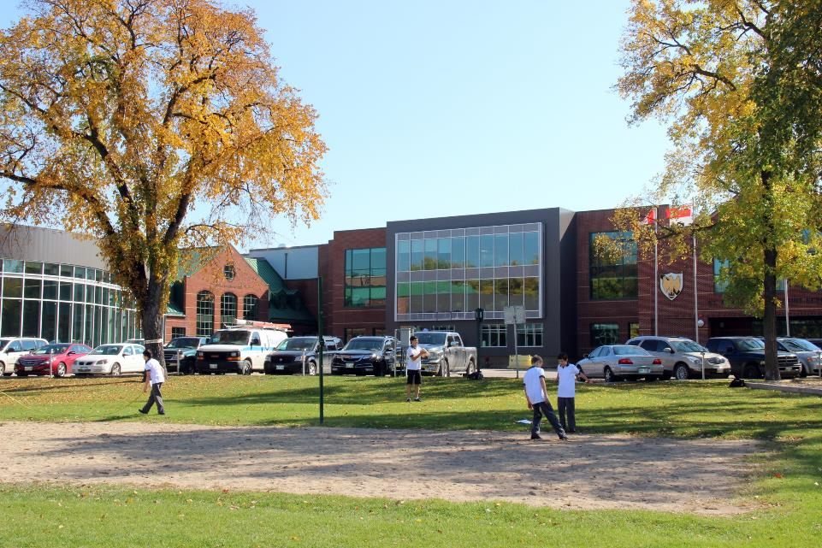


Slide 2
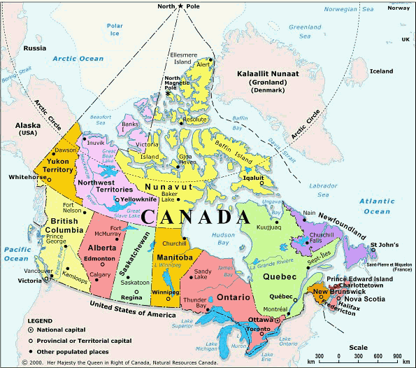
Winnipeg is located in the center of North America and is the gateway to Western Canada.

Slide 3
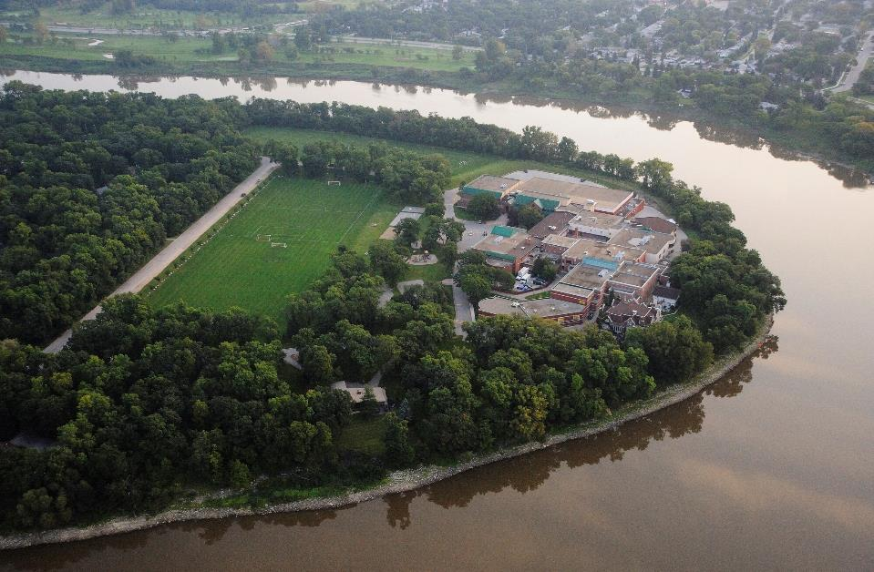
NATURE
Nestled among the trees at the bend of the Red River, SJR’s 23 acre campus offers plenty of room for an active lifestyle. The facilities have been improved continually over the years culminating in a new high school opening in the fall of 2014.

Slide 4
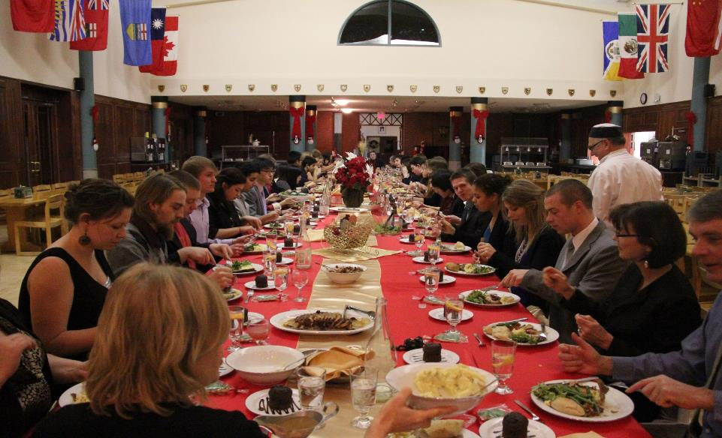
FAMILY
Small boarding means family. At SJR, we can accommodate 40 boarding students. That means, we only take approximately 10 students per year. Being small means you get to know everyone and they get to know you. Just one big happy family!

Slide 5
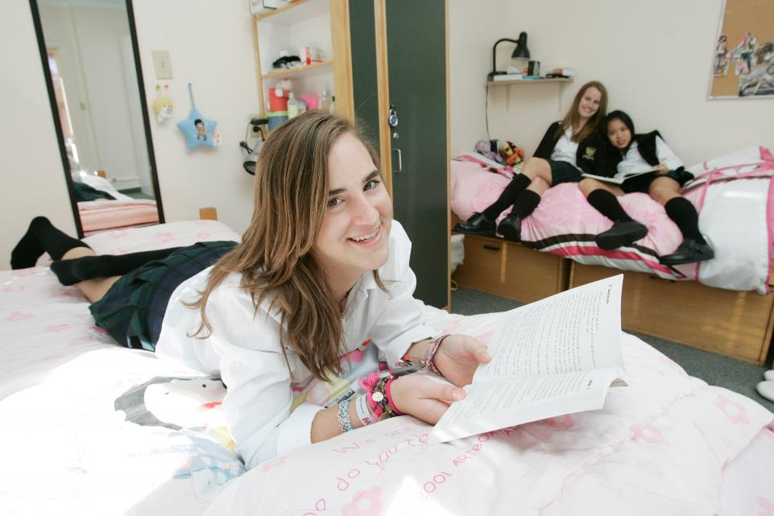
“Every parent is nervous about sending their child away to school. One visit to SJR and we knew it was right for our children. Here was a bright, lively, safe environment filled with friendly kids, caring staff and a wonderful opportunity for them to learn independence, develop essential life skills and be completely immersed in their academics. We’ve never looked back.”
BARBARA O’BEIRNE, SJR BOARDING PARENT, MEXICO

Slide 6
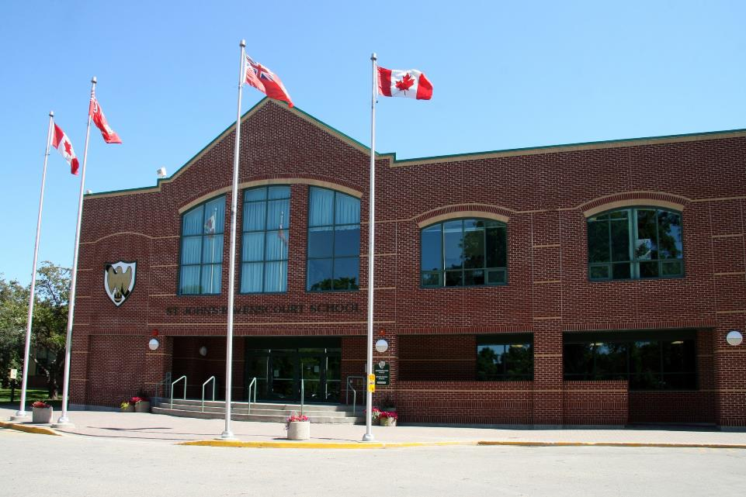
TRADITION
Founded in 1820, tradition guides and shapes who we are. Over the years, SJR students have demonstrated their commitment by winning national and international awards in debating, math and science. We have even produced 18 Rhodes Scholars and numerous leaders in the community.

Slide 7
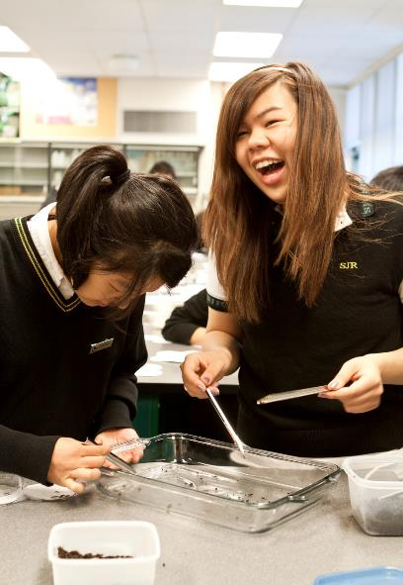
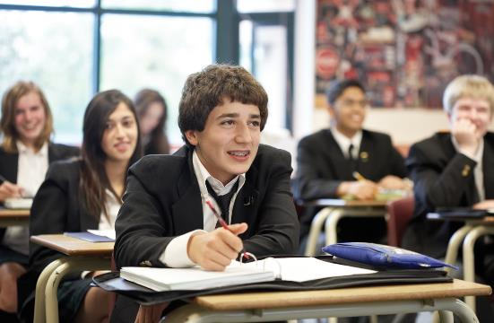
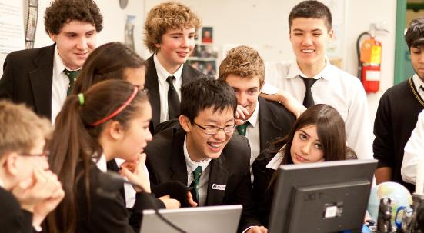
ACADEMICS
Academic excellence is expected and students live up to those expectations. 100% of graduates continue their studies after graduation. Thanks to our advanced placement classes, some students complete most of their first year credits while still in high school.

Slide 8
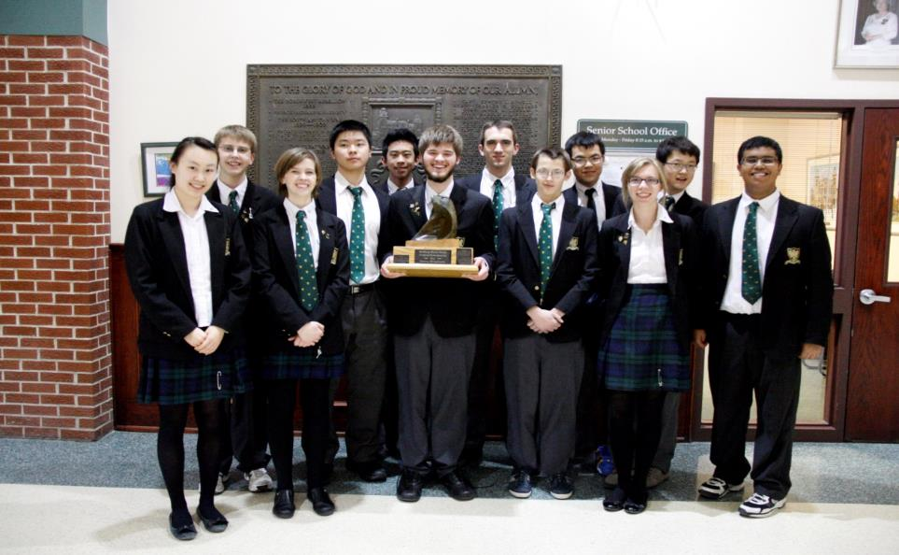
Debating
All students learn the art of debating and public speaking. It builds confidence and helps develop our students critical thinking skills. Over the last 28 years, SJR student have won 14 World Debating Titles and SJR has won every Canadian Debating Team title since 1983.

Slide 9
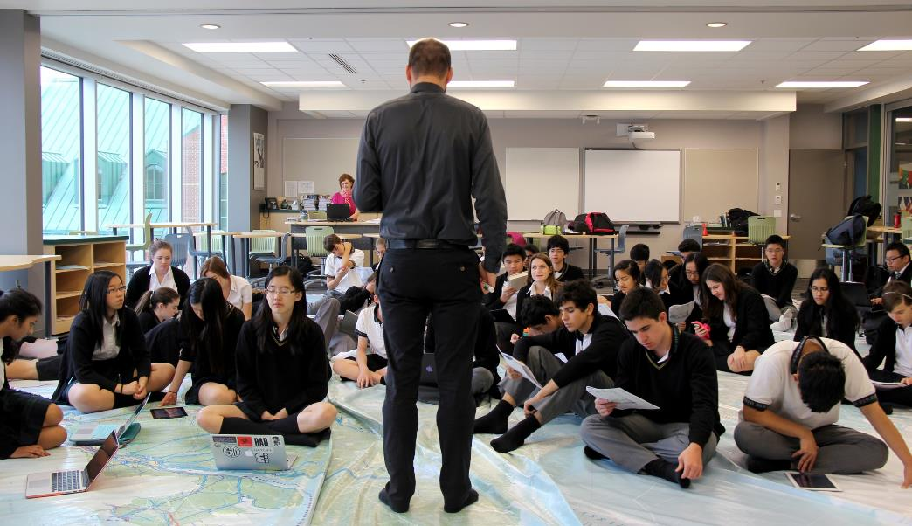
Collaboration
Students at SJR do not spend their days sitting at their desk listening to teachers and taking notes. They work with their peers in groups to synthesize information, to create projects and to conduct research.

Slide 10
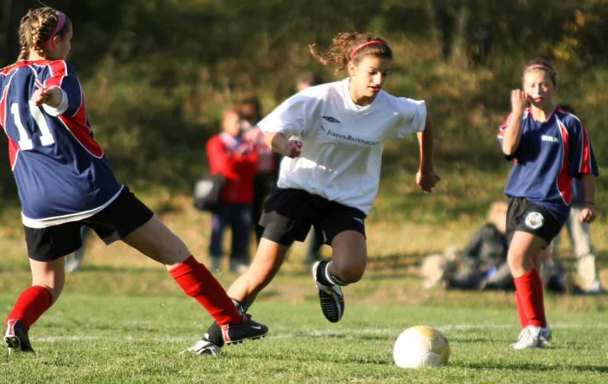
ATHLETICS
There is also time for fun. SJR has many Scholar Athletes who participate in two or more sports while retaining an average above 80%. Students enjoy team sports the most. You can play hockey, soccer, rugby, basketball, ultimate and badminton among others.

Slide 11
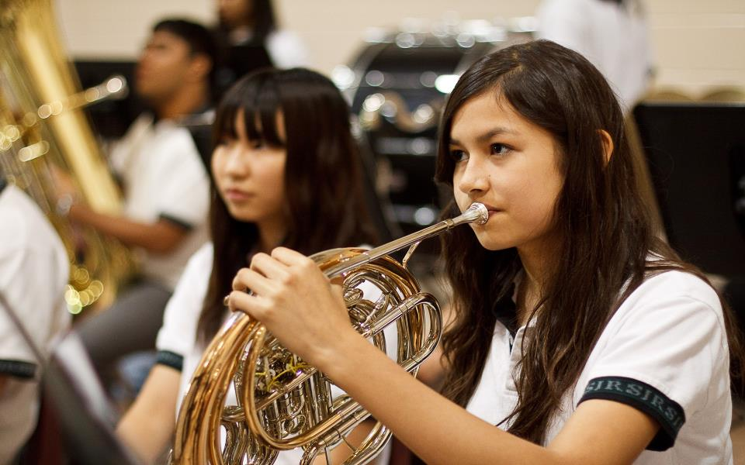
ARTS
Round out your education by exploring your creative side through music, drama and art. Students have the opportunity to explore different types of music and many are chosen each year to participate in the Provincial Honour Band.

Slide 12
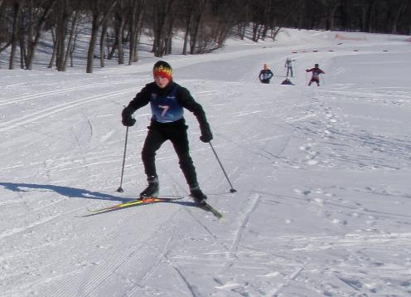
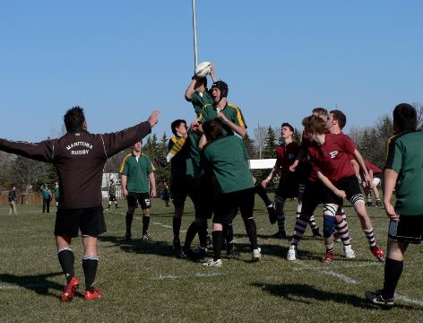
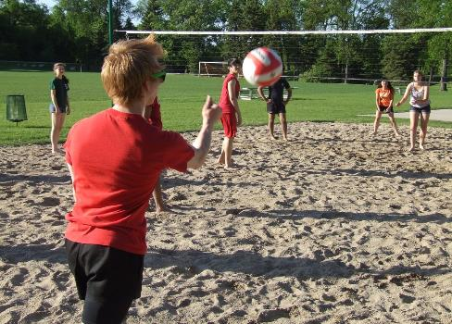
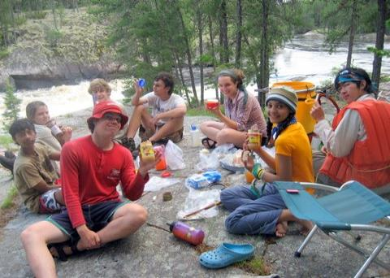
WINNIPEG
The great thing about living in Winnipeg is that you get to experience four very distinct seasons each with their own fun activities.

Slide 13
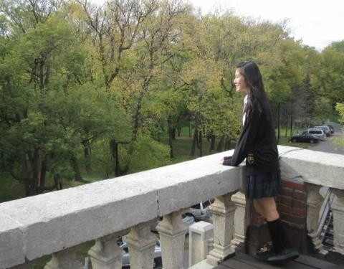
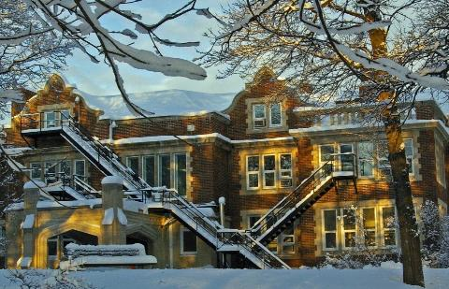
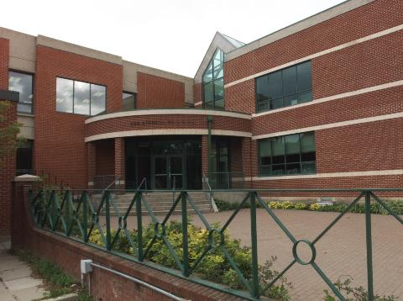
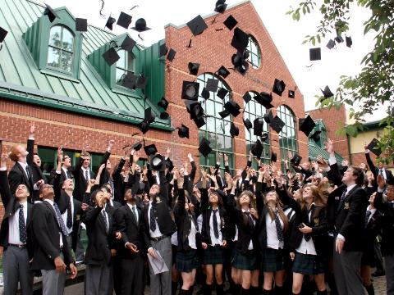
Apply online
www.sjr.mb.ca/admissions

