Slide 1
Study Group North America Higher Education
Юлия Казанская,
Региональный менеджер Study Group

Slide 2
Why North America?
International students in the U.S. hit record high at 764,495 in 2011/12
100,000+ in Canada in 2012, 6.5% growth from 2011
Academic excellence
“Best higher education system in the world.” Most universities ranked in the Global Top 200 of any country
Highest accreditation standards
Amazing facilities
Access to state-of-the-art facilities and cutting edge research
Providing an unmatched campus and student experience
Flexible education
Okay to change your mind
Double major, minor
Fast-track master’s degree

Slide 3
Why Study Group North America?
IT IS NOT A FOUNDATION
PROGRAM
Ability for international students to enter directly into year 1 of university and finish in
4 years

Slide 4
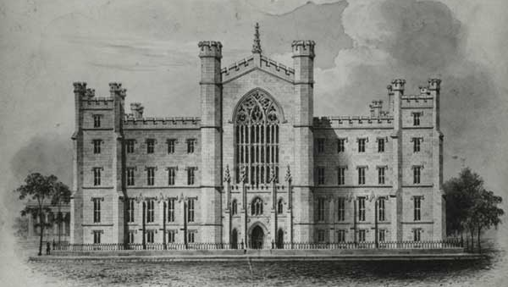
It’s not a foundation!
Other countries:
Study Group example:
4
University
Year 2-4
Int’l Year 1
3
Application to uni
2
2
Foundation year
1
Application to foundation
1
Application to
Int’l Year 1

Slide 5
Why Study Group North America?
IT IS NOT A FOUNDATION
PROGRAM
Ability for international students to enter directly into year 1 of university and finish in four years
Flexible application deadlines and entrance requirements for international students
Direct access to top universities

Slide 6
Benefits of direct admit to university
University
Direct access to a range of universities (incl. Top 100)
Some affordable choices as cheap as Comm. College
No need to move after 2 years, no risk of credit transfer
Full range of services to ensure student success

Slide 7
Why Study Group North America?
IT IS NOT A FOUNDATION
PROGRAM
Ability for international students to enter directly into year 1 of university and finish in four years
Flexible application deadlines and entrance requirements for international students
Direct access to top universities
Scanned documents now accepted
Much faster turnaround time (and getting better!)
No SAT required!

Slide 8
Study Group’s process is so much easier
The normal process…a long road
You complete your normal local coursework
You’re in!!!
2 years before : Study for SAT
1 year before : Take SAT
7-9 months before: You apply
Lots of essays
English test
Original documents
Application fee
Recommendations
No entry criteria
~4 months later: You get an answer!
Study Group process
You complete your normal local coursework
You’re in!!!
4-6 weeks before: You apply
One essay
English test
Photocopies of documents
Free application
Maybe one recommendation
Clear localized entry criteria
~1 week later : You get an answer!

Slide 9
Why Study Group North America?
IT IS NOT A FOUNDATION
PROGRAM
Ability for international students to enter directly into year 1 of university and finish in four years
Flexible application deadlines and entrance requirements for international students
Direct access to top universities
Scanned documents now accepted
Much faster turnaround time (and getting better!)
No SAT required!
English, academic and cultural support on campus exclusively for international students (or direct entry if you prefer that)

Slide 10
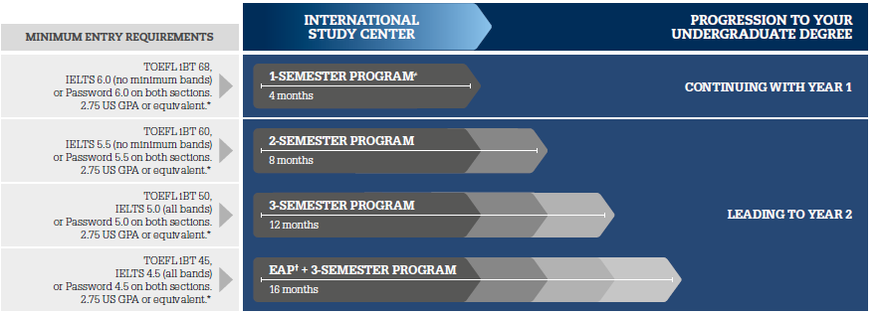
The International Year 1 Model
January, May and August intakes

Slide 11
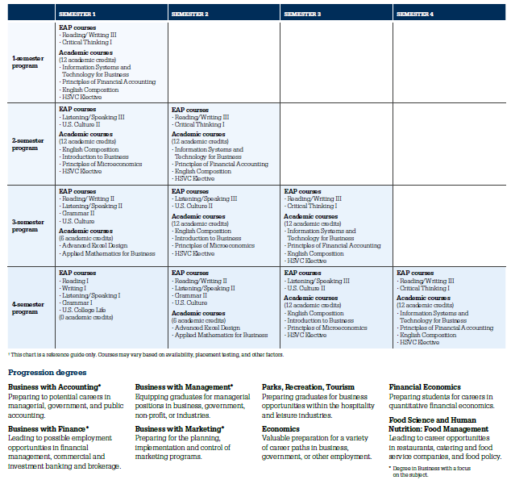
Curriculum includes English and cultural support, counseling and academics tailored to your needs
Example

Slide 12
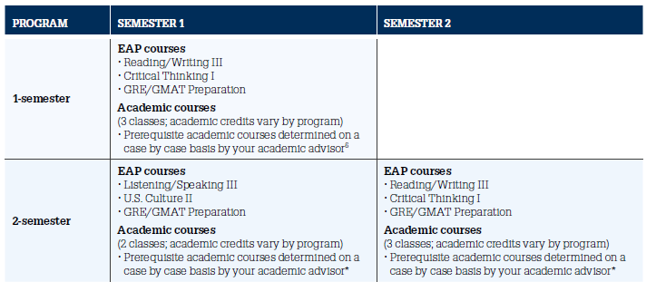
Pre-Master’s Program (PMP) - Grad

Slide 13
Why Study Group North America?
IT IS NOT A FOUNDATION
PROGRAM
Ability for international students to enter directly into year 1 of university and finish in four years
Flexible application deadlines and entrance requirements for international students
Direct access to top universities
Scanned documents now accepted
Much faster turnaround time (and getting better!)
No SAT required!
English, academic and cultural support on campus exclusively for international students (or direct entry if you prefer that)
Study Group has the best portfolio of universities in America

Slide 14
Location

Slide 15
Key factors
Degree
Type of institution
Academic programme
Location
Ranking
Unique selling points
Fees, discounts and scholarships

Slide 16
What’s the future like?...
Engineering
Computing
Nanotechnology
Biotechnology
Marketing and Sales
Service
Ecology
Genetics
Chemistry

Slide 17
The University of Vermont

Slide 18
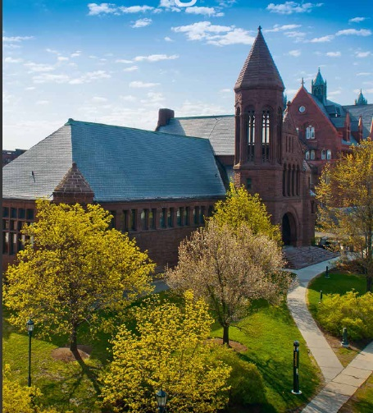
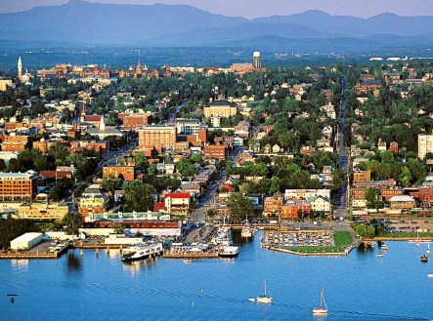
University of Vermont

Slide 19
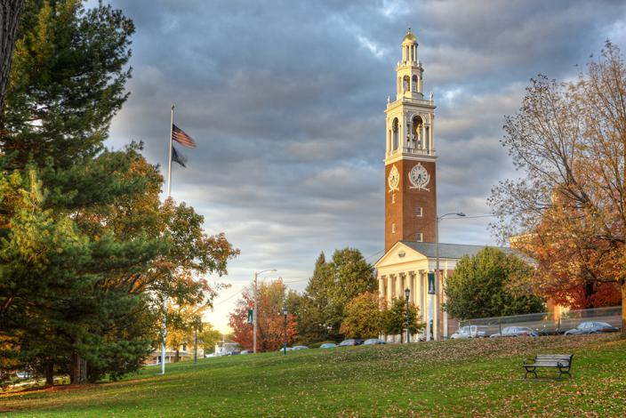

Slide 20
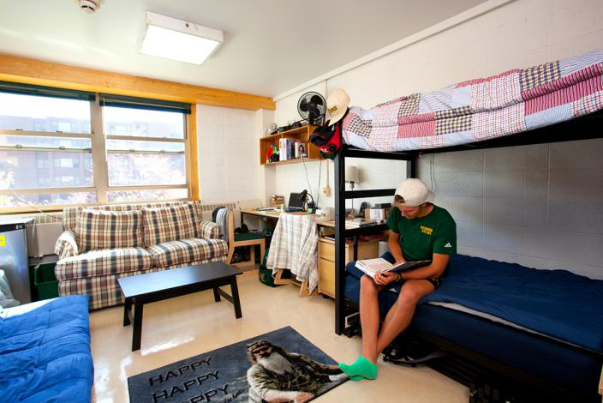

Slide 22
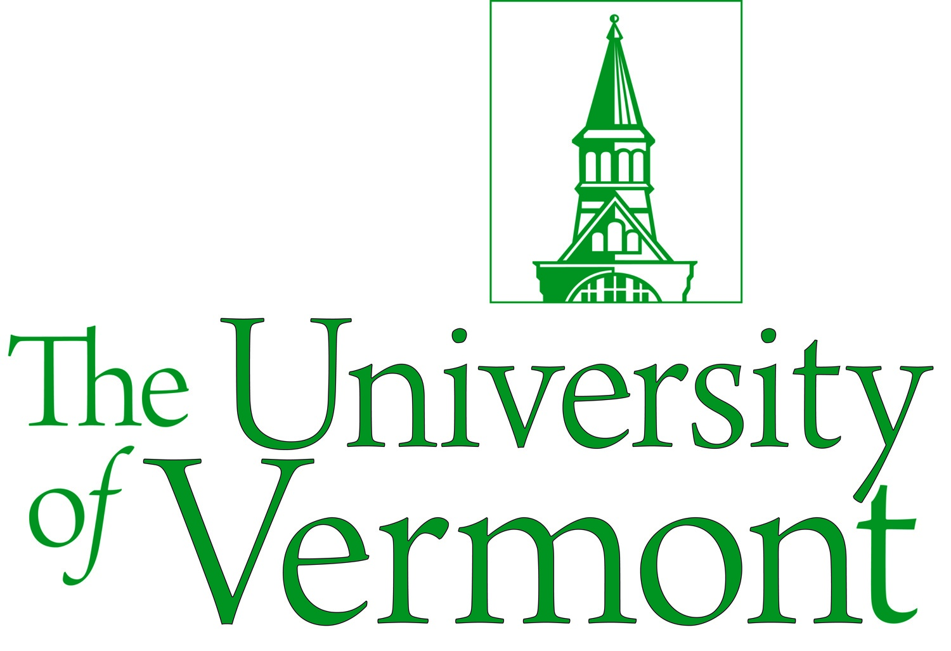
University of Vermont
Burlington, Vermont
Public, 1791
TOP 100 best US universities, TOP 350 best world universities
#85 National Ranking
#35 Top public schools in the USA
2nd safest state in America
Top Business and Engineering programmes
Pre-Med majors (Nursing, Biological Science)

Slide 23
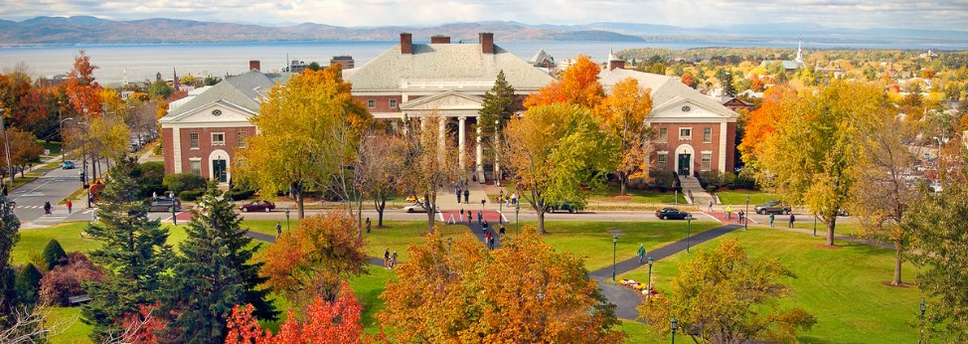
Vermont – up to 10,000 USD scholarships
Notes:
Scholarships are still available for the fall semester to qualified students.

Slide 24
Widener University

Slide 26
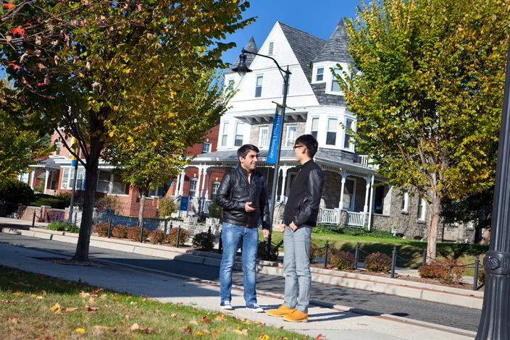

Slide 27
)

Slide 28
Widener University
Ranked top 200 in America nationally
Top 20 Hospitality and Tourism management program
Higher rank than UMass, USF and Marshall but with cheaper master degree programs
All master degree programs under 30,000$ and fully accredited
2,500$ scholarships

Slide 29
Questions?....

