Slide 1
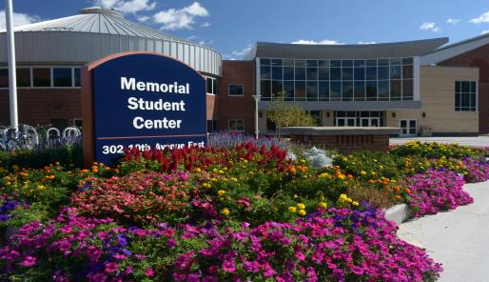
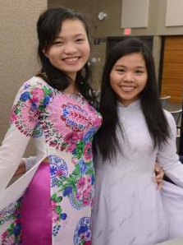

University of Wisconsin - Stout
Office of International Education and ESL Institute
OFFICE OF INTERNATIONAL EDUCATION Inspiring Innovation. Learn more at www.uwstout.edu/oie

Slide 2



UNIVERSITY OF WISCONSIN-STOUT
Menomonie, Wisconsin - USA
Named after a historic Native American tribe, Menomonie is a city of 16,000 people.
The community is safe, friendly and located just 96km east of the Minneapolis/St. Paul, Minnesota metropolitan area.

Slide 3
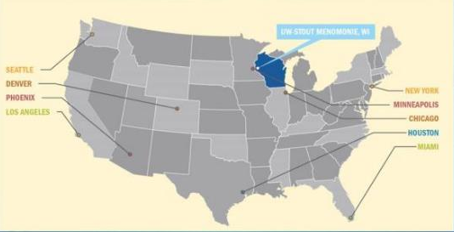

UNIVERSITY OF WISCONSIN-STOUT
Menomonie, Wisconsin - USA

Slide 4



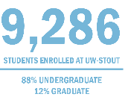

UNIVERSITY OF WISCONSIN-STOUT
Enrollment at a Glance
The University of Wisconsin-Stout is a comprehensive, career-focused polytechnic university where students, faculty, and staff use applied learning, scientific theory and research to solve real-world problems and serve society.

Slide 5

UNIVERSITY OF WISCONSIN-STOUT

Slide 6




UNIVERSITY OF WISCONSIN-STOUT

Slide 7



UNIVERSITY OF WISCONSIN-STOUT
Laptop Computers
WISCONSIN’S ONLY LAPTOP CAMPUS
Bachelor’s Degree and ESL students are given a new laptop during their student orientation. Students trade the laptop in after two years of use for an updated computer to use through their graduation. The laptops are integrated into classroom instruction.

Slide 8
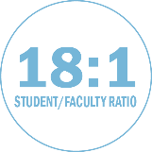

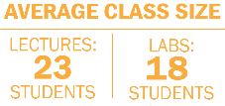

UNIVERSITY OF WISCONSIN-STOUT
In the Classroom
UW-Stout is proud to have nearly 500 faculty members teaching 99% of the course selections within four colleges and four schools.
ACADEMIC PROGRAMS
45 Bachelor’s Degree Programs
23 Master’s Degree Programs

Slide 9

UNIVERSITY OF WISCONSIN-STOUT
Popular Bachelor’s Programs
Applied Mathematics and Computer Science
Applied Science
Business Administration
Computer Engineering
Dietetics
Engineering Technology
Hotel, Restaurant and Tourism Management
Information Technology
For all offered Bachelor’s programs at UW- Stout go to: http://www.uwstout.edu/programs/ugrad.cfm

Slide 10

UNIVERSITY OF WISCONSIN-STOUT
Popular Master’s Programs
Applied Psychology
Food and Nutritional Sciences
Industrial and Applied Mathematics
Operations and Supply Management
Risk Control
Masters in Fine Arts in Design
For all offered Master’s programs at UW- Stout go to: http://www.uwstout.edu/grad/prospect/programs.cfm

Slide 11


UNIVERSITY OF WISCONSIN-STOUT
ESL Institute
Conditional Admission Available!
ESL Levels:
1 Pre-academic
8 Academic
Practice English Skills In:
Listening
Speaking
Grammar
Reading
Writing
For details visit www.uwstout.edu/esl

Slide 12
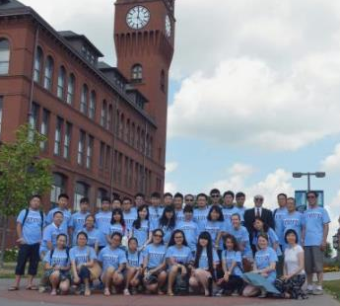
UNIVERSITY OF WISCONSIN-STOUT
ESL Institute
MORE THAN LANGUAGE LEARNING
In addition to year round, intensive English study, the ESL Institute offers the Summer American Culture and Language Program.
This program is full of excursions and activities designed to paint a more-complete image of American life for international students.

Slide 13
UNIVERSITY OF WISCONSIN-STOUT
2015 - 2016 Estimated Costs*
Expense | Bachelor’s 30 Credits* (Academic Year) | Master’s 18 Credits** (Academic Year) | ESL Institute 24 Credits (Academic Year)
Tuition and Fees | $17,609 | $15,745 | $10,407
Housing | $3,960 | $3,960 | $3,960
Food/Living Expenses | $3,100 | $3,100 | $3,100
Books, Supplies, Other Costs | $225 | $225 | $0
Health Insurance | $1,427 | $1,427 | $1,427
Total | $26,321 | $24,457 | $18,894
*15 credits per semester **9 credits per semester
Student tuition is calculated per credit I Graduate tuition credit varies from program to program
Current costs are available online at www.uwstout.edu/oie/iss/finances.cfm

Slide 14

UNIVERSITY OF WISCONSIN-STOUT
Scholarship Opportunity
Undergraduate Students
$5,000 per academic year GPA: 3.51 and greater
$4,000 per academic year GPA: 3.0 - 3.5
$3,000 per academic year GPA: 2.75-2.99
Graduate Students
$7,000 for the FIRST academic year GPA 3.5-4.0
$6,000 per academic year GPA 3.0-3.49 (or 4.0 after first year)
$5,000 per academic year GPA: 2.75-2.99
*Dependent on availability

Slide 15

UNIVERSITY OF WISCONSIN-STOUT
Academic & Support Services
Help students explore different majors
Writing Center
Guidance for transfer students
Career counseling
Internship opportunities
Corporate career conferences
Graduate school information

Slide 16



UNIVERSITY OF WISCONSIN-STOUT
International Student Services
Orientation program
Class registration
Immigration status
Resident Hall check-in
Health insurance
Friendship Family Program
American culture immersion course

Slide 17



UNIVERSITY OF WISCONSIN-STOUT
International Student Activities
Trips – festivals, fairs, malls and more!
Activities – holiday events, potlucks, community events, films, soccer . . .
International Week
English conversation hours
International Relations Club
Participate in one of the 145
student clubs or start
your own!

Slide 18

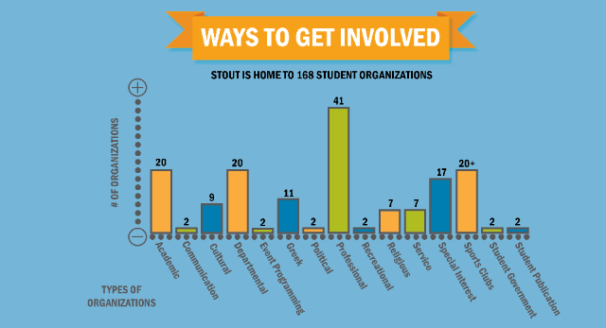
UNIVERSITY OF WISCONSIN-STOUT

Slide 19

UNIVERSITY OF WISCONSIN-STOUT
Campus Housing
OPEN ALL YEAR ROUND
Convenient to:
Classrooms
Cafeterias
Student center
Athletic facilities

Slide 20
UNIVERSITY OF WISCONSIN-STOUT
How To Apply
Complete the International Student Application for Admission
Application fee
Proof of English proficiency through a TOEFL or IELTS score
Or successfully complete studies at the University of Wisconsin - Stout English as a Second Language Institute
Bank statement to use as documented evidence of sufficient financial resources
Official transcripts (translated into English)
Apply Online: apply.wisconsin.edu

Slide 21

UNIVERSITY OF WISCONSIN-STOUT
Required Language Scores
BACHELOR’S DEGREE REQUIREMENT
Minimum TOEFL score of 70
Minimum IELTS score of 6.0
Remedial English course required
MASTER’S DEGREE REQUIREMENT
Minimum TOEFL score of 70
Applicants with TOEFL scores under 79 will be required to take at least one advanced level language course through UW-Stout's English as a Second Language program
Minimum IELTS score of 6.5

Slide 22
UNIVERSITY OF WISCONSIN-STOUT
Conditional Admission
Students can apply for conditional admission if they submit all required documents except for the TOEFL or IELTS.
Students can retake the TOEFL/IELTS until they meet the minimum score required
Students can complete studies at the English as a Second Language Institute
* Please note that not all graduate programs offer conditional admission. For details, please review the graduate program's specific website or consult with the graduate admissions office at gradschool@uwstout.edu.

Slide 23

UNIVERSITY OF WISCONSIN-STOUT
Contact Us!
Office of International Education
200 Main Street East
Menomonie, Wisconsin 54571
Phone: (715) 232-2132
OIE email: globaled@uwstout.edu
ESL email: learnesl@uwstout.edu

