Slide 2







YOU MAY BE FAMILIAR WITH SEVERAL
STEREOTYPES ABOUT CANADA

Slide 3







DID YOU KNOW THAT CANADA IS A LAND
FULL OF OPPORTUNITY?

Slide 4








RECOGNIZED WORLDWIDE FOR SOME OF ITS
FAMOUS BRANDS…

Slide 5

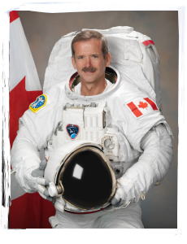


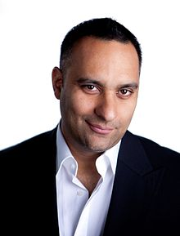



AND WELL-KNOWN THANKS TO CANADIAN
PERSONALITIES WHO HAVE LEFT THEIR MARK
AROUND THE WORLD!
Chris Hadfield
Wayne Gretzky
Russell Peters
Rachel McAdams
Notes:
5

Slide 6
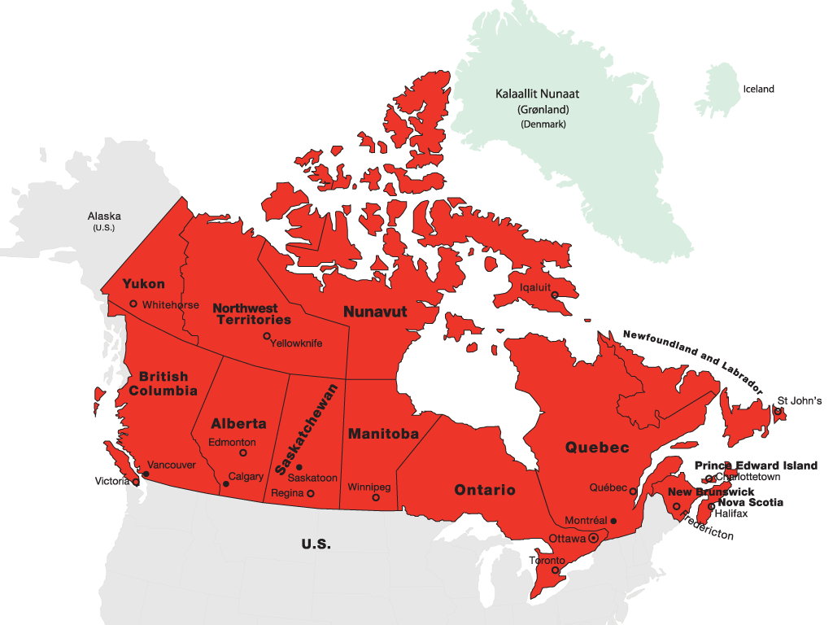



Slide 7



35 million people in 10 provinces and 3 territories
Stable parliamentary democracy
Officially bilingual (English and French)
More than 200 languages spoken
First in the G-7 for overall living conditions and quality of life

Slide 8



Ranks in the top 10 entrepreneurial economies in the world
Ranks #1 in the G7 as “the best place to invest and do business”
Ranks #1 in the G7 as “the easiest place to start a business”
Soundest banking system in the world
One of the least corrupt societies in the world

Slide 9


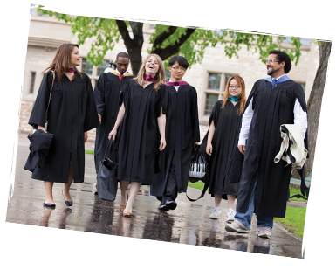

Among the top 3 OECD countries in spending per capita on public postsecondary education
Consistent high quality of education across the country
Academic credentials valued worldwide
Stimulating and innovative research environment
“Canada hosted over 300,000 international students in 2013”

Slide 10


EDUCATION EXCELLENCE
Three Canadian universities ranked in the Top 50 of the 2014/2015 QS World University Ranking and 20 in the Top 500.
Four Canadian universities ranked in the Top 100 of the 2014 ARWU Ranking and 21 in the Top 500.
Four Canadian universities ranked among the Top 100 of The Times Higher Education’s 2014/15 World University Rankings and eight in the top 200
Five Canadian MBA schools in the Top 100 2014 Financial Times Global MBA Rankings
Canada’s secondary school students excel in science, reading, and mathematics

Slide 11




More than 15,000 undergraduate and graduate programs at more than 100 universities and university degree-level colleges
Institutions range from large, research-intensive to smaller undergraduate campuses
Caring and supportive professors
Cutting edge technology and research labs
Co-operative education and internship options
Opportunities to work on and off campus

Slide 12


Three levels of degrees:
Bachelor’s: generally three or four years of undergraduate study
Master’s: one or two years of study after the bachelor’s degree, including a thesis, practicum, or research paper or course-based
Doctoral or PhD: three years of study including a thesis, usually after the master’s degree
N.B. Certificate or diploma courses at the undergraduate, graduate or diploma level, as well as short career-focused programs, are also available.

Slide 13

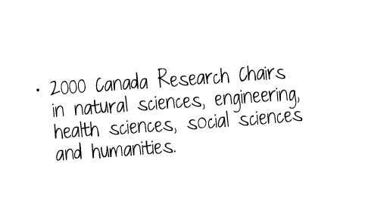


Home to flat-screen technology, SMART boards and IMAX film
Highly innovative research in nanotechnology, environmental technologies, nutraceuticals, biotechnology, renewable energy, health care, agri-foods, and high-performance computing
Ongoing R&D collaboration between Canadian business and academic communities

Slide 14



POST-SECONDARY EDUCATION:
COLLEGES, INSTITUTES AND CEGEPS
Campuses in 1000 communities across Canada offer over 8000 programs
Program length varies from a few months to four years
Practical programs meet the needs of specific industries and employers
Work placements available through co-op education and internships
Cutting-edge technology enables flexible program delivery
Average of 90% of college graduates obtain employment within 6 months of graduating

Slide 15



POST-SECONDARY EDUCATION:
COLLEGES, INSTITUTES AND CEGEPS
Colleges may also be known as:
Institutes of technology • Community colleges
Polytechnics • Colleges of applied arts and technology
In Quebec, Collèges d’enseignement général et professionnel (CÉGEPS)
Credentials include:
Certificates • University transfers
Diplomas • Bachelor or Applied degrees
Apprenticeship programs
Combined programs (joint degrees) with a university partner

Slide 16


INVEST IN YOUR FUTURE
Average full-time annual fees to study in Canada
 | K-12 (Public) | Language* | College | University
Tuition and student fees | $5,000 - $14,000 | $14,000 | $5,500 - $15,000 | $7,000 - $29,000**
Accommodation and food | $5,500 - $9,000 (Homestay) | $7,000 to $13,000 | $7,000 - $13,000 | $7,000 - $13,000
Personal & health Insurance | $400 - $800 | $1,000 to $3,000 | $500 - $2,500 | $500 - $2,000
Books | $100 - $200 | $100 to $500 | $800 - $1,500 | $1,000 - $2,000
TOTAL (CDN) | $11,000 - $24,000 | $22,100 to $30,500 | $13,800 - $32,000 | $15,500 - $46,000
Notes: These figures will vary across Canada according to fees at selected institutions and programs, as well as housing options and individual spending habits.
*Based on $320 per week average tuition and 44 weeks per year, the maximum yearly study length
** Not including specialized degrees such as Executive MBA’s, which cost significantly more in annual tuition fees.

Slide 17
COMPARING COSTS
Comparing the range of international student tuition fees at the university undergraduate level around the world
Country | Average Annual University Fee (USD) | Average Annual Cost of Living (USD) | Average Annual Cost Total (USD)
Australia | 24,081 | 18,012 | 42,093
Singapore | 18,937 | 20,292 | 39,229
United States | 24,914 | 11,651 | 36,564
United Kingdom | 21,365 | 13,680 | 35,045
Hong Kong | 13,444 | 18,696 | 32,140
Canada | 16,746 | 13,201 | 29,947
France | 247 | 16,530 | 16,777
Tuition fees vary between institutions and programs of study and length of study. On an international scale, Canada offers consistent quality education at a reasonable cost.
Source: HSBC, Value of Education: Springboard for success, September 2014

Slide 18
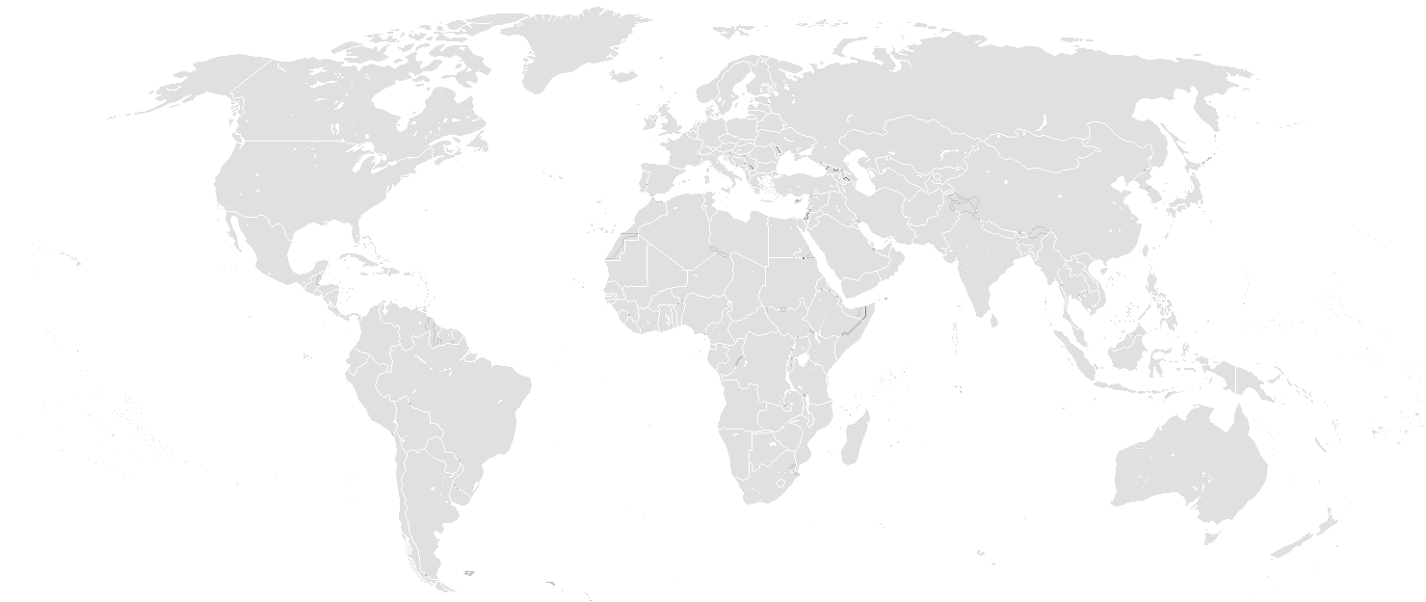
COMPARING COSTS
The 2014 Cost of Living Rankings compares top cities around the world
Stockholm
#38
Calgary #125
Montreal #123
London
#12
Vancouver #96
Toronto #101
Paris
#27
Tokyo
#7
Los Angeles #62
New York #16
Shanghai
#10
Hong Kong
#3
Singapore
#4
Rio de Janeiro #65
São Paulo
#49
Sydney
#26
Melbourne
#33
Canada’s largest and most expensive cities are relatively more affordable than many other cities around the world.
Source: Mercer, 2014 Cost of Living Rankings

Slide 19
WHAT YOU NEED TO STUDY IN
You need a Study Permit to study in Canada for six months or longer.
You need the following documents to apply:
Proof of acceptance
Valid Passport
Proof of financial support
Letter of explanation
There are two ways you can apply:
Apply online
Apply on paper
Find more information on eligibility and the application process as well as how to prepare for your arrival in Canada on the Citizenship and Immigration Canada website at www.cic.gc.ca under the Study section)

Slide 20
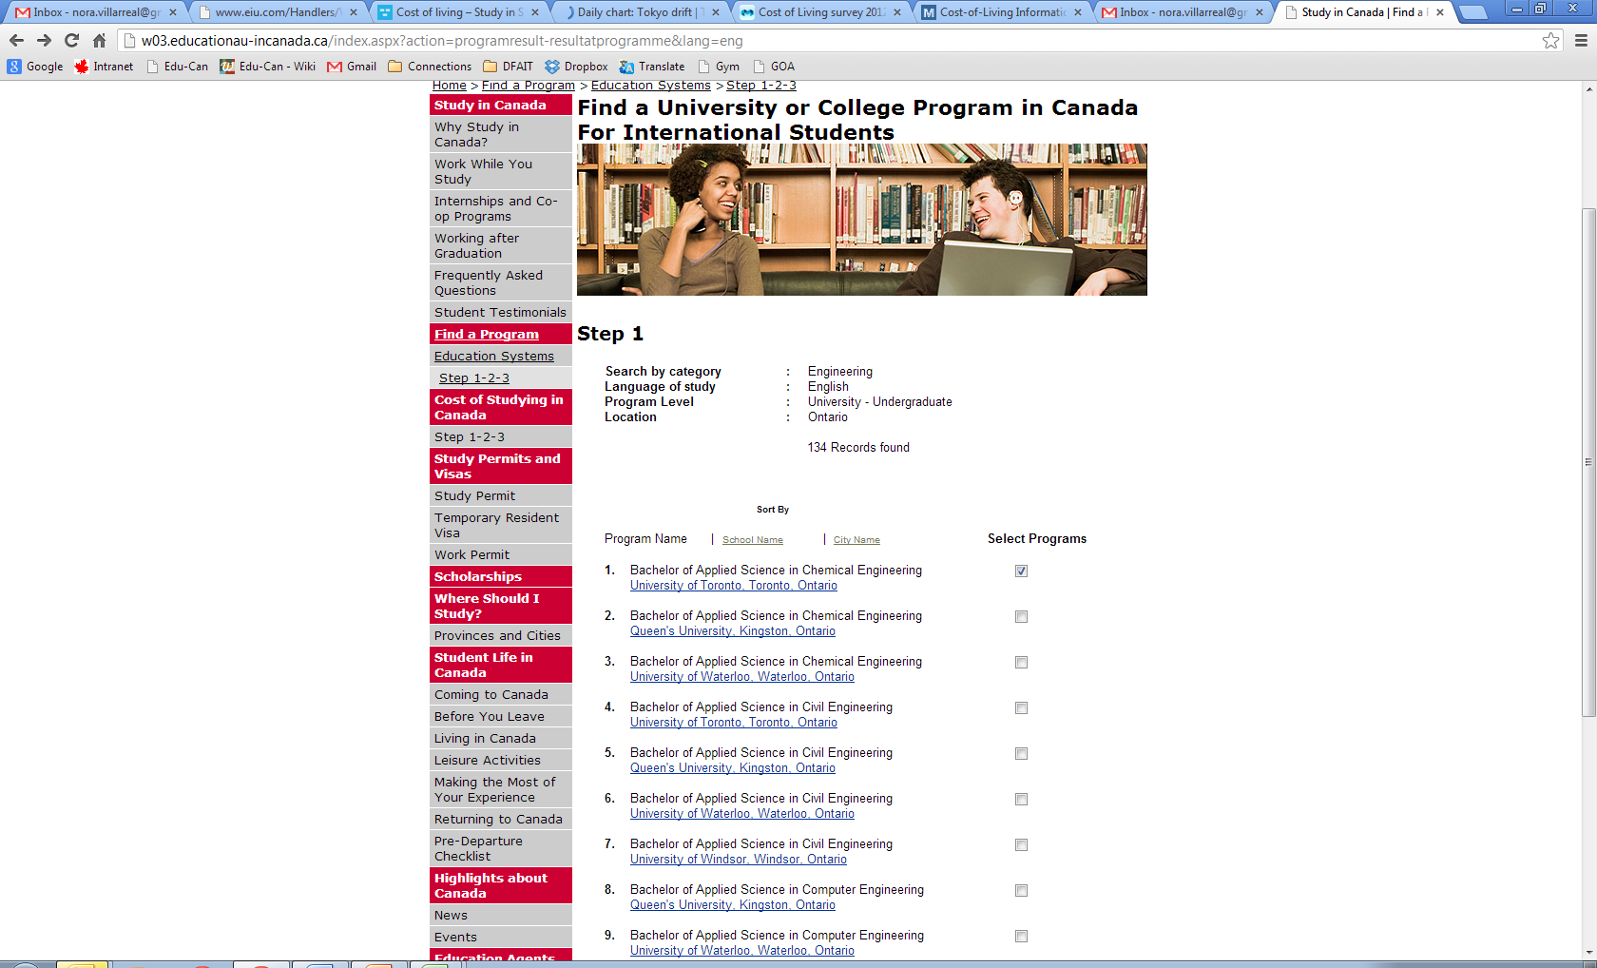
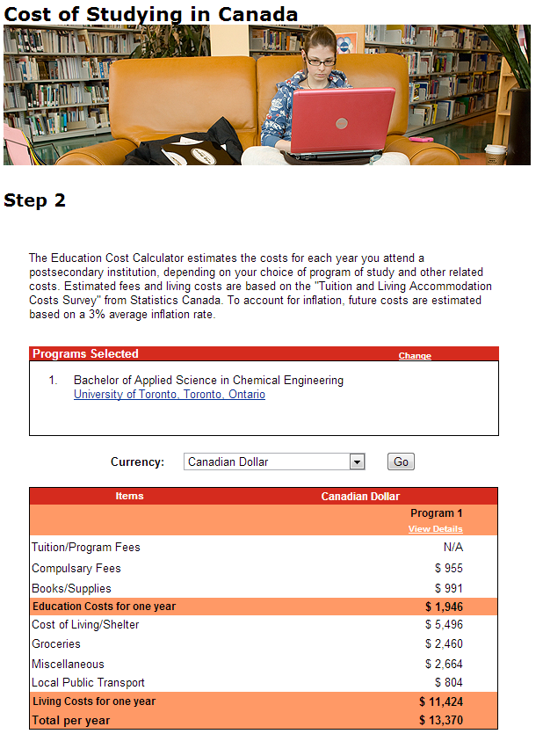
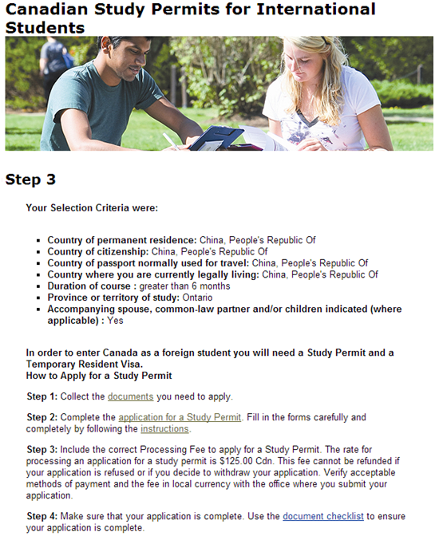
GET MORE INFORMATION
Follow Steps 1-2-3 of the Cost of Studying in Canada Guide to see an estimate of your expenses while studying in Canada.
Visit Educationau-inCanada.ca

Slide 21


APPLICATION GUIDELINES FOR POST-SECONDARY ADMISSION
Study all year: programs offered in fall, winter, spring and summer
Apply early: at least 8 months before term starts
Submit official academic transcripts and language test scores (if applicable)
Acceptance is based on academic merit
Apply by mail or online

Slide 22


Research availability of scholarships at your host institution and check what your government may offer
Entrance scholarships are generally based on academic merit
Bursaries or grants by institution/government may also be made available once studies are underway
Scholarships offered by the Canadian government www.scholarships.gc.ca
Vanier Scholarships for graduate students ($50,000/year over three years)
Banting Postdoctoral Fellowships ($70,000/year for two years)

Slide 23



Great campus life and support
Academic advisors provide guidance to international students
Assistance programs offer counselling, support for the disabled and student health services
Athletics activities and student clubs connect you with other students
Career development services and alumni networks help you meet your goals

Slide 24


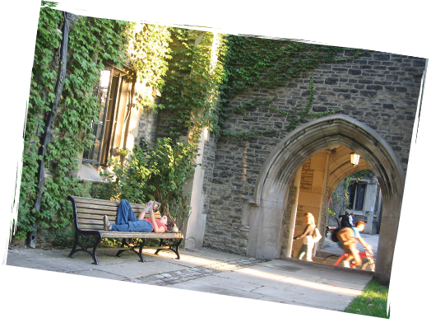
Impressive academic credentials
Stimulating multicultural experiences
Flexible academic pathways
Affordable tuition and living costs
Safe and welcoming academic environment focused on you!

Slide 25


Official Study in Canada portal……………………………….. Program finder, cost calculator and study permit information. Links to provincial, territorial and individual school information.
Canadian Information Centre for International Credentials…
Association of Universities and Colleges of Canada..………
Colleges and Institutes Canada……………….……………...
Canadian Bureau of International Education…………………
Canadian Accredited Independent Schools……………….
Canadian Association of Public Schools – International……
Languages Canada……………………………………………..
Polytechnics Canada……………………………………………
www.educationau-incanada.ca
www.cicic.ca
www.aucc.ca
www.collegesinstitutes.ca
www.cbie.ca
www.cais.ca
www.caps-i.ca
www.languagescanada.ca
www.polytechnicscanada.ca
Notes:
Official Study in Canada portal
www.educationau-incanada.ca
Includes a program finder, cost calculator, study permit information, and links to provincial, territorial and individual school information.
Canadian Information Centre for International Credentials (CICIC)
www.cicic.ca
Provides the only Canadian online and authoritative directory of universities, colleges and schools recognized and authorized by Canada’s provinces and territories. This site includes information on foreign credential evaluations and qualification recognition.
Association of Universities and Colleges Canada (AUCC)
www.aucc.ca
Represents 97 Canadian public and private not-for-profit universities and university-degree level colleges.
Colleges and Institutes Canada
www.collegesinstitutes.ca
Represents colleges and institutes to government, business and industry, both in Canada and internationally.
Polytechnics Canada
www.polytechnicscanada.ca
Polytechnics Canada is a national alliance of the leading research-intensive, publicly funded colleges and institutes of technology dedicated to helping colleges and industry create high-quality jobs for the future.
Canadian Bureau of International Education (CBIE)
www.cbie.ca
CBIE is focused on fostering international education opportunities with a membership of over 150 education providers nationwide bridging the interests of all learning levels, from K-12 to postgraduate, and engaging both the public and private sectors.
Canadian Association of Independent Schools (CAIS)
http://www.cais.ca/
Represents 95 Canadian elementary and secondary independent schools from across Canada, some of which offer boarding to international students.
Canadian Association of Public Schools – International (CAPS-I)
www.caps-i.ca
Represents +90 Canadian public school districts/boards that recruit international students at the elementary and secondary levels.
Languages Canada
www.languagescanada.ca
Canadian language schools accredited under an internationally recognized quality-assurance mechanism.

Slide 26
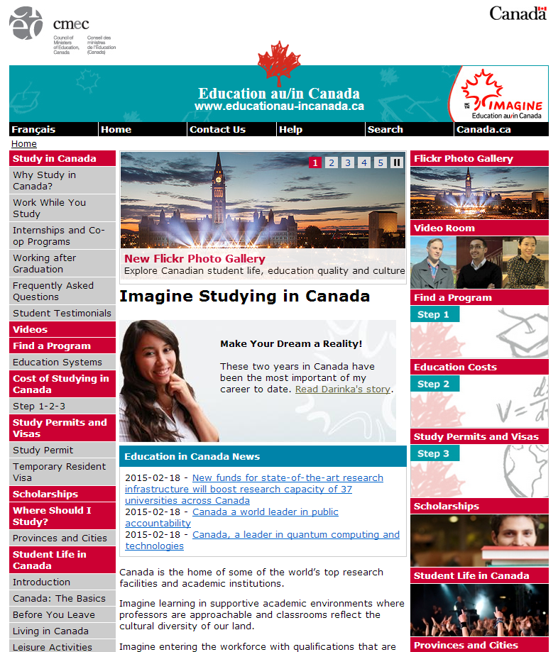
Contact Us
Video Room
Program Finder
Testimonials
Scholarships
Study Permits & Visas
News

Slide 27





www.educationau-incanada.ca

Slide 28
Adam Jacques
Адам Жак Second Secretary (Commercial) and Trade Commissioner Второй секретарь по торговым вопросам Embassy of Canada to Russia
Посольство Канады в России
119002, Россия, Москва, Староконюшенный пер, 23 adam.jacques@international.gc.ca
(+7 495) 925 6126

