Slide 1
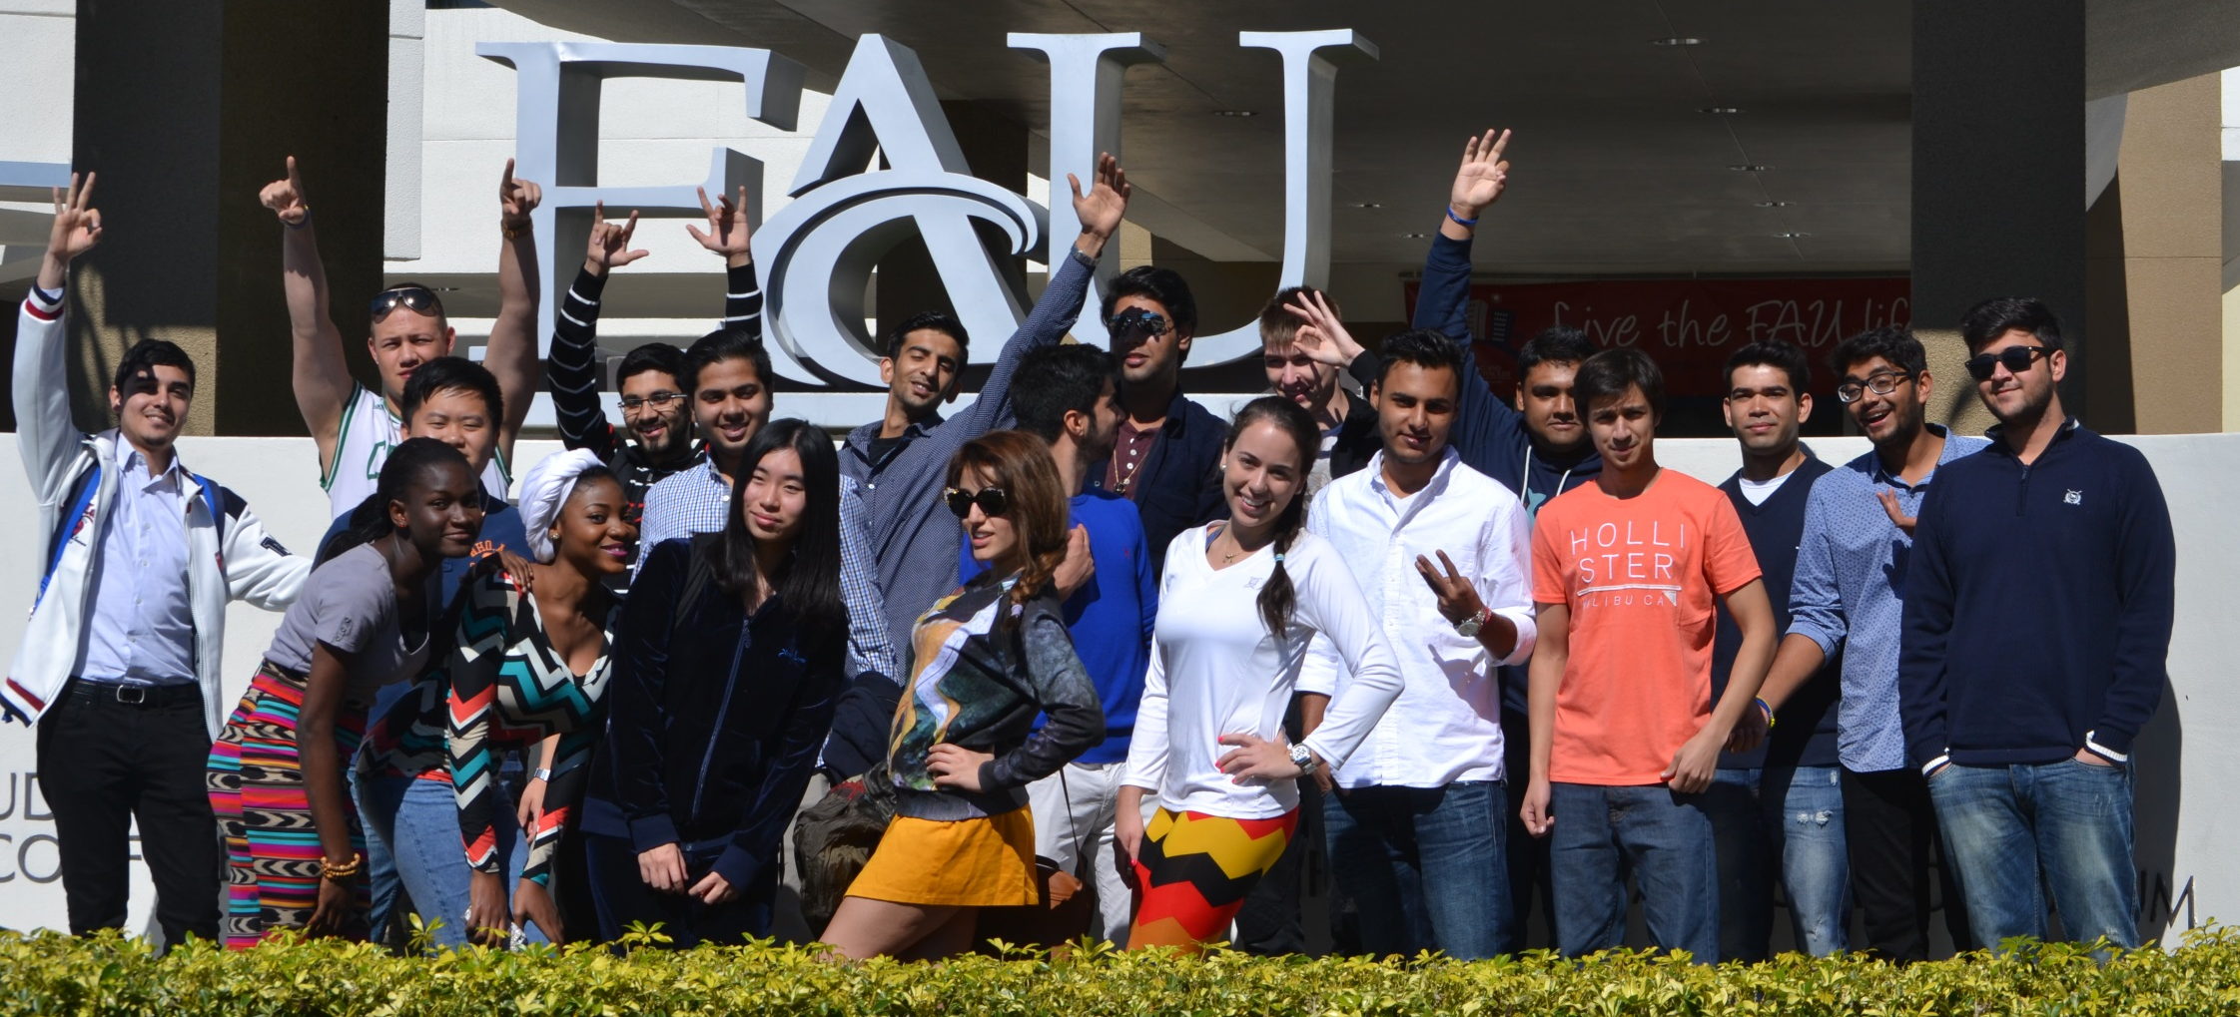
Navitas at FAU
An introduction to
Boca Raton, Florida, USA
Notes:
T

Slide 2
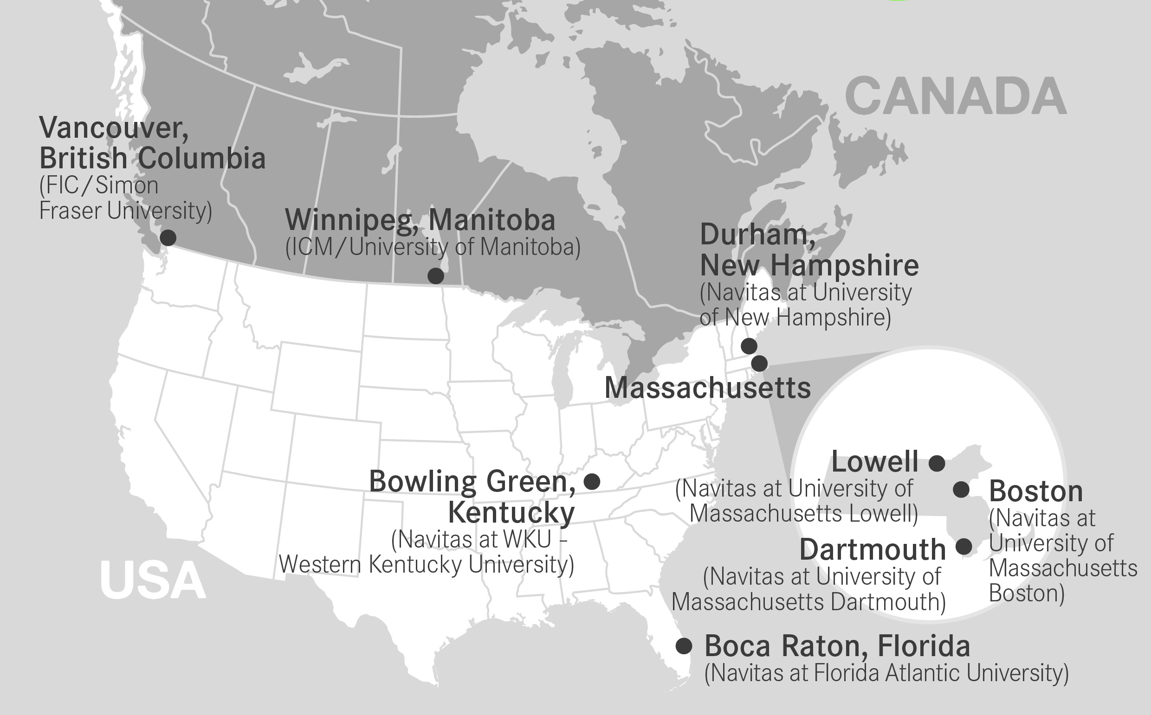



Notes:
Talk about my background and where I am located.

Slide 3
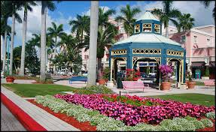


A LOCATION TO CALL ‘PARADISE’
Warm weather year-round: 231 sunny days per year; average 22C - July 32C and January 15C
One hour from Miami, 30 minutes from West Palm Beach or Fort Lauderdale
Modern, safe, multi-cultural lifestyle ~ shopping is plentiful- outlets to luxury!
Outdoor resort-style living: Golf, tennis, swim, kayak, boating, cycle, run are very popular in Boca Raton, Florida.
Notes:
Every dream quest starts somewhere. And getting a good education is a great foundation to start. But it’s not just all about the studies, it’s all about your entire experience, not just the studies. If you are going to live somewhere away from all your friends and family, why not pick an amazing location?
Talk about Dishit – movie like, felt like a celebrity.. Beautiful cars, palm trees, etc…

Slide 4
Boca Raton is a beautiful city surrounded by wealth – Higher per capita income than any other competing universities’ cities!
What does that mean to you?
SAFETY
LOW TRAFFIC
FRIENDLYNESS
GREAT SERVICE
AMAZING RESTAURANTS
BEAULTIFUL CLEAN AND RICH CITY!
Source: Data is from the 2010 United States Census Data and the 2006-2010 American Community Survey 5-Year Estimates
Notes:
The higher per capita income has direct implications to your lifestyle – talk about swimming in the ocean and not worrying about your bag being stolen, or the higher socio economic level of Boca residents – retirees and university students… Talk about how you can get around in a bike and not be worried about traffic or how you can have access to gorgeous libraries and other public facilities.

Slide 5
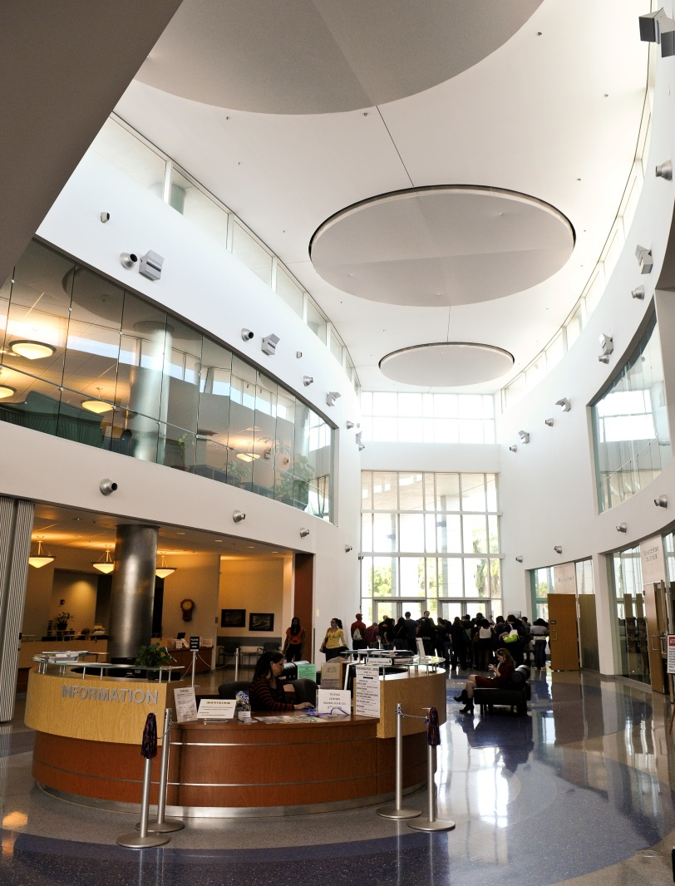
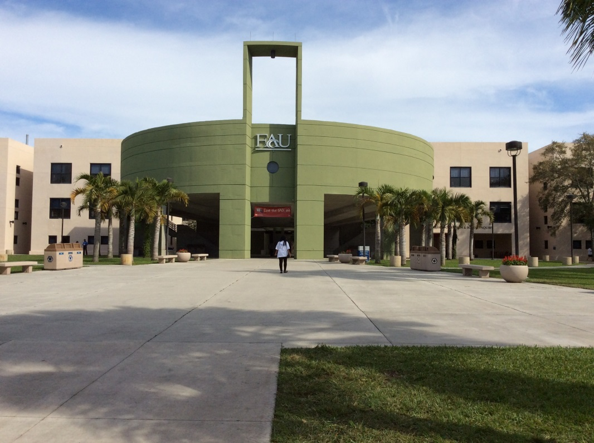
Beautiful campus environment with state of the arts facilities!

Slide 6


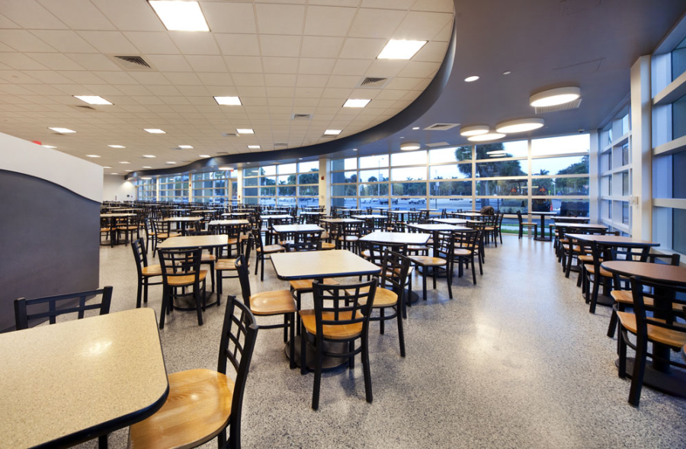

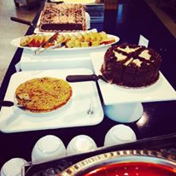
Notes:
– Starbucks, Chick fil A, buffet style cafeteria with something for everyone!

Slide 7

Movie Theater with restaurant service inside and the most amazing seats, food and service!!!
Notes:
Perfect for a night to relax with friends or with a that special someone!

Slide 8


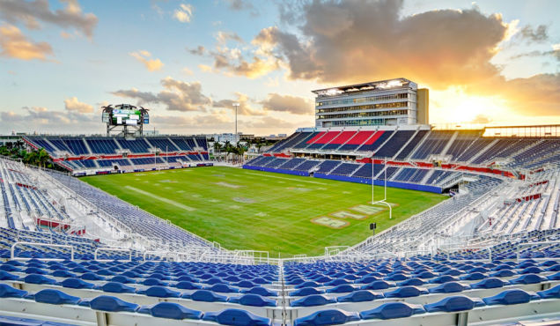
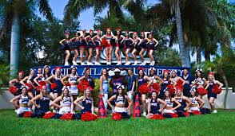
Football Stadium with amazing tail gating parties
Notes:
Talk about how the football stadium has dramatically changed the life on campus. There is always something going on, not only we host our own sporting events, but sometimes we host other major events as well. The tail gating parties are super fun!

Slide 9
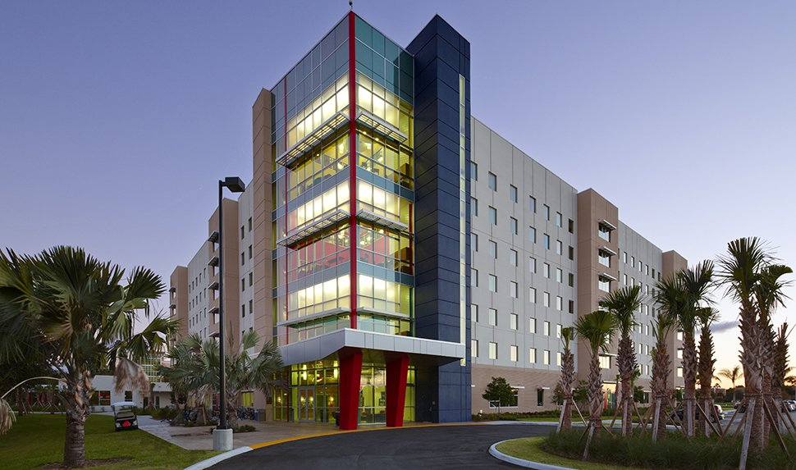
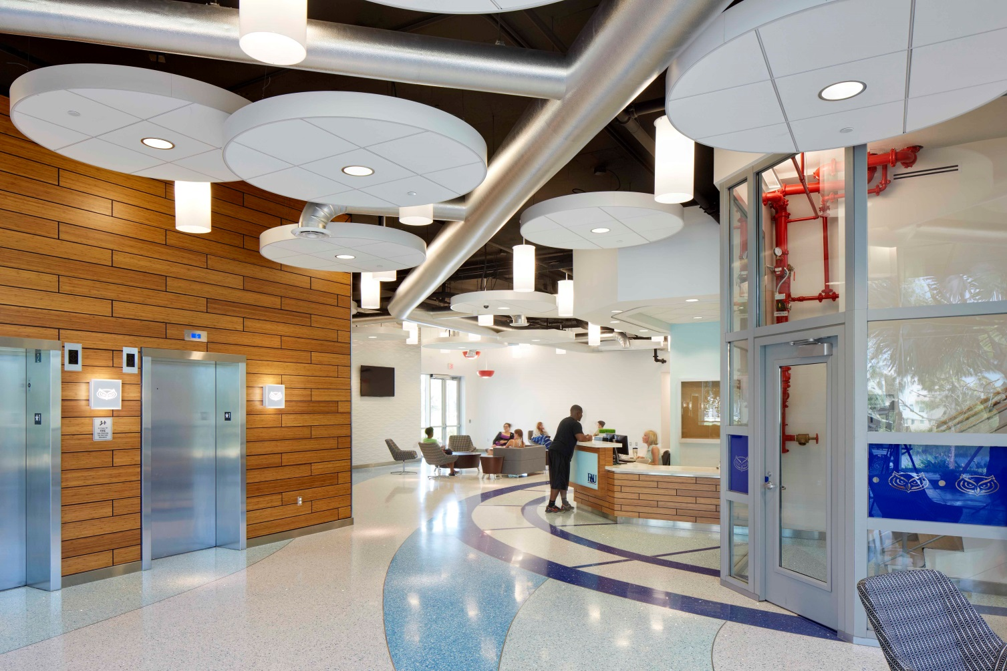

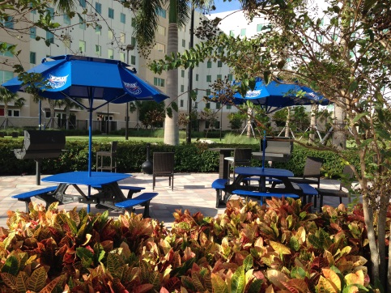
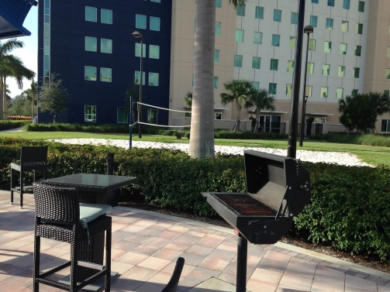
Resort-style living facilities!
Single room available – privacy!
Study room, computer lab and meeting rooms
Fitness center
Library
Multi-purpose room for social gathering, with flat screen TV and full kitchen
Volley ball courts outside
Barbecues outside
Notes:
These pictures don’t even do justice to how nice these facilities are!!!

Slide 10

Now on to the serious stuff….
Accredited & recognised: FAU is a comprehensive national, public university, accredited by Southern Association of Colleges and Schools and AACSB.
Large diverse student population: 30,000 students at sites throughout Southeast Florida, from all 50 states, and more than 180 countries.
Ten distinguished colleges offer more than 180 degree programs
Outstanding faculty: more than 1,000 accomplished scholars and researchers, known for their excellence in teaching and mentoring.
FAU has its own official recording label – Hoot/Insight music. Participating students can receive hand-on experience in music production, record promotion, audio recording, publicity, marketing, graphic design, and event planning
Notes:
Instead of federal say United states government.

Slide 11





Options are endless…
We have something for EVERYONE – Arts, Music, Multimedia, Accounting, Business, Finance, Marketing, Computer Science, Computer Engineering, Urban Design, Criminal Justice, all sorts of Science/Biology/Pre-med majors, Civil, Electrical, Mechanical Engineering and so much more!!!! Just tell your counselor what you want to study, and we will find a program that fits your needs.
Notes:
The School of Accounting program is ranked 6th in the USA- CPA exams pass rate
• The Department of Finance programs is ranked 35th in the world, (based on published research in 16 core financial journals, 2nd in the nation for published research in financial education) – 30 million dollars in grants per year.
• The Barry Kaye College of Business' Entrepreneurship Program was included in the top 50 in the country by Success Magazine.

Slide 12

Плюсы программы поступления navitas в FAU
Navitas at FAU offers high quality educational programs in a supportive environment on campus at FAU
Navitas at FAU students will benefit from the individualised attention and dedication of an outstanding team of staff and faculty.
Small class sizes – more contact with teachers
3 trimesters as opposed to 2 semesters – which makes it much easier to keep up!
NO SAT test!!!!!! That’s right, no SAT test required!!!!
We help you with all of your paperwork, so you can just focus on studying!
We monitor your grades, attendance and well being
We have FUN – we show you the city, take you to the mall, to the beach and have monthly (if not more) activities to keep you engaged
You will be in a class with other international students from various countries – making friends all over the world!
NAVITAS is your FAMILY away from home! You will ALWAYS have someone to rely on while away from your loved ones

Slide 13
Список документов для поступления в FAU:
Бакалавриат
Аттестат – 3.0 GPA
Магистратура
Диплом – 2.5 GPA
Паспорт
Паспорт
Тест на знание Английского языка
IELTS: 5.5 или 4.5 для Integrated
Pearson Versant: 50 или 46 для Integrated
TOEFL (Paper/iBT): 525/69 или 59 для Integrated
Тест на знание Английского языка
IELTS 6.0
TOEFL 71
Мотивационное письмо
Резюме
Notes:
Talk about how our requirements never change – just another advantage of the Pathway program – we process applications in 48 hours so you don’t have to be nervous and wait.

Slide 14
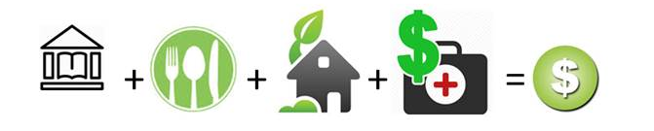
СТОИМОСТЬ ОБУЧЕНИЕ
Магистратура: приблизительная стоимость обучения в течении ДВУХ триместров: PMP
Обучение | Питание (meal plan) | Проживание | Мед. страхование* | Общая стоимость
$18,750 | $3,800 | $6,600 | $1,350 | $29,650
Бакалавриат: приблизительная стоимость обучения в течении ТРЕХ триместров: UPP
Обучение | Питание (meal plan) | Проживание | Мед. страхование* | Общая стоимость
Standard $23,200 | $5,700 | $10,200 | $1,350 | $40,450
Integrated $27,120 | $5,700 | $9,900 | $1,350 | $44,370
Intensive English: приблизительная стоимость обучения на курсе ESL за ОДИН семестр
Обучение | Питание (meal plan) | Проживание | Мед. страхование* | Общая стоимость
$5,720 | $1,900 | $3,300 | $1,350 | $11,850
*Medical insurance is compulsory paid one-time annually for 12 months coverage.

Slide 15
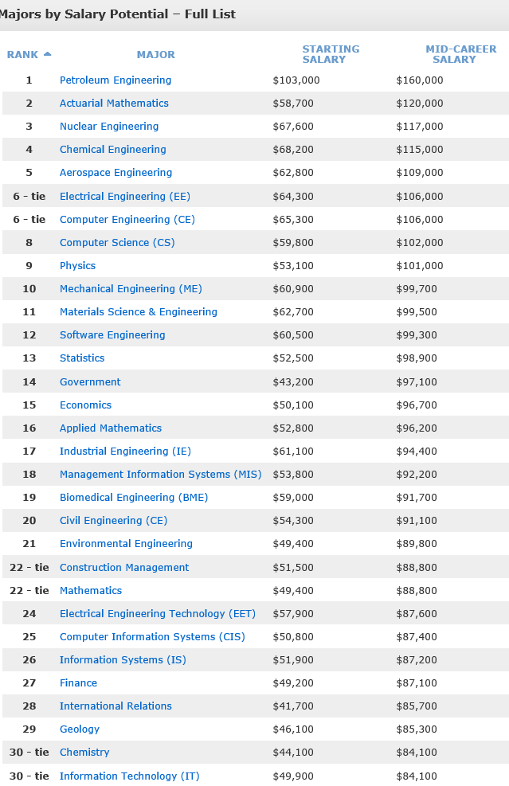

Source http://info.exactsource.com/blog/bid/287103/Engineering-Salary-Trends-2012-2013; http://www.payscale.com/college-salary-report-2014/majors-that-pay-you-back
Notes:
USA data 2014 – Not that I want you to think about money.. Money is a consequence of a job well done, and in order to do a good job, you need to love what you do. This is just to give you an idea of what is out there so you can have realistic expectations.

Slide 16


