Slide 1
Your Pathway to the University of Manitoba
Winnipeg, Canada

Slide 3
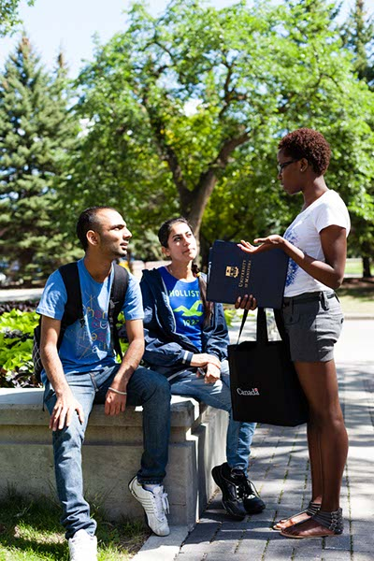
Overview
Winnipeg, Manitoba, Canada
The University of Manitoba
ICM – The Navitas Advantage
Admission Requirements
Programs
How to Apply
Accommodations

Slide 4
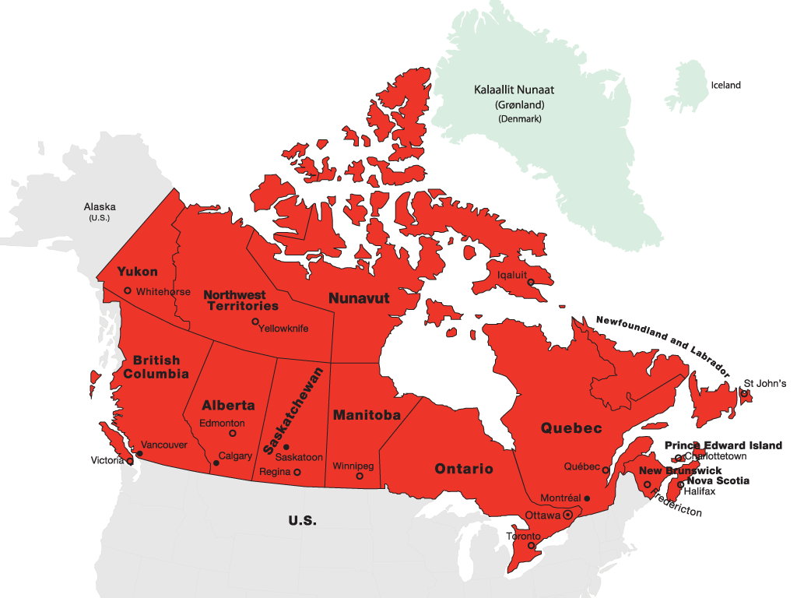


34 million people in 10 provinces and 3 territories
Stable parliamentary democracy
Officially bilingual (English and French)
More than 200 languages spoken
Among the top 10 countries in the United Nations Quality of Life Index since 2004

Slide 5

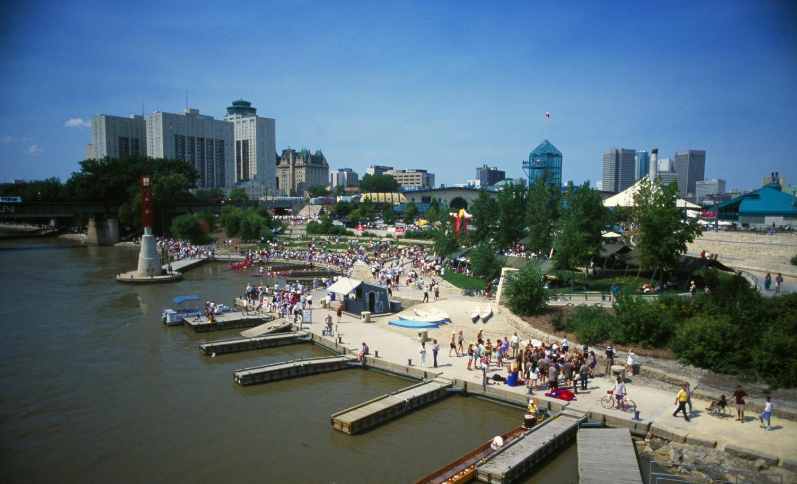
Manitoba offers a high standard of living, steady
economic growth and high employment.
Notes:
Why Manitoba?
ICM is located in the city of Winnipeg, Manitoba, Canada
Manitoba currently has a population of 1.2 million living in the province and 750,000 live in Winnipeg (as per 2009)
Manitoba is at the centre of Canada and the most culturally diverse province in Canada. Over 100 different languages spoken.
Manitoba has a high standard of living, steady economic growth, diversified industry, and high employment
Manitoba has a well-established financial and insurance services sector
Manitoba boasts the most competitively priced tuition fees within in Canada and throughout the world
Manitoba offers the friendliest immigration policies across Canada
Manitobans celebrate hundreds of multicultural events per year, in fact there are over 265 festivals per year

Slide 6
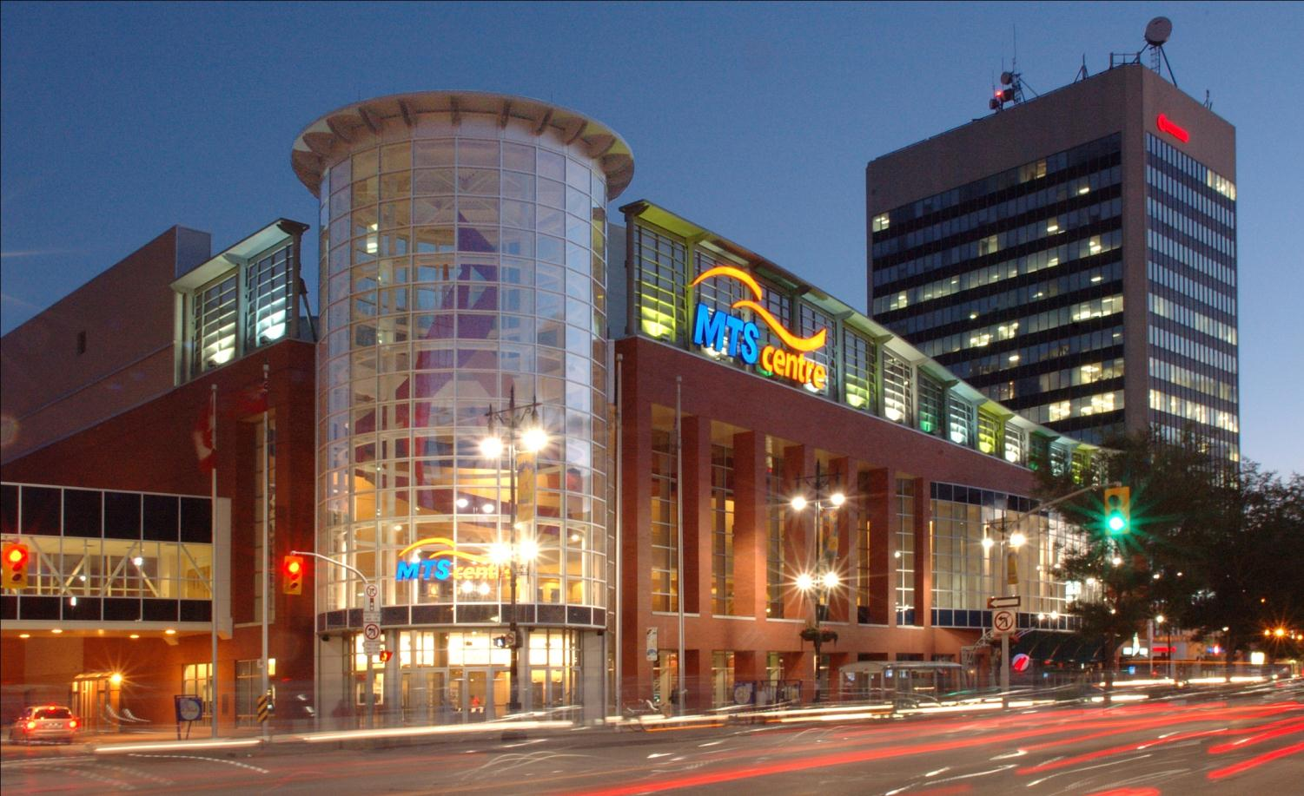
Winnipeg offers a community with a cosmopolitan
international flair, and a warm welcoming spirit.
Notes:
Why Winnipeg?
Winnipeg is the vibrant capital of Manitoba, the geographical centre of North America, and the multicultural capital of Canada
Winnipeg is very culturally diverse. Manitobans will warmly welcome immigrants from all corners of the world
“Our cost of living is affordable and our standard of living is high.” Manitoba Excellence in Education.pdf page 5
The current immigration policy allows international students to work immediately upon graduation
In addition, the Manitoba government currently promotes a 60% Tuition Fee Tax Rebate
The City of Winnipeg hosts 130 festivals per year
The largest and longest running ethnic and multicultural festival - Folklorama
The internationally acclaimed - Winnipeg Folk Festival
The longest running Canadian country music festival - Dauphin Countryfest
The Truly Canadian - Festival du Voyageur
Medical/health insurance is covered for all international students studying in Manitoba

Slide 7

The University of Manitoba (U of M)
Western Canada’s First University
Manitoba’s largest research-intensive university
Over 28,000 students studying at the U of M
More than 3,000 international students from over 100 different countries
Top 400 university in the world
Ranked #1 in Canada for the highest growth in international students
98 Rhodes Scholarship recipients
More U of M alumni lead more Fortune 500 companies than any other western Canadian university’s alumni
The Asper School of Business dominates international business planning competitions with 46 first-place wins since 1995
Notes:
10 things you need to know about the University of Manitoba
Founded more than 135 years ago, the University is Western Canada’s first university.
The University has produced 98 Rhodes Scholars — the pinnacle of academic achievement — which is the most of any university in Western Canada.
University of Manitoba alumni lead more Fortune 500 companies than any other western Canadian university’s alumni.
The Asper School of Business dominates international business planning competitions with 46 first-place wins since 1995.
The university community consists of over 26,000 students, 8,000 faculty and staff and 185,000 alumni.
9% of current students are international and represent nearly 100 different countries.
Internationally recognized for ground-breaking research in the areas of HIV/AIDS, global public health, functional foods and Arctic climate change.
Access to 183 exchange programs in 33 countries.
Over 200 summer research jobs available to UM students each year.
The University has 110 on-campus student groups.

Slide 8
ICM students receive focused instruction inside the classroom…
Small class sizes – average class has 30 - 35 students
Majority of instructors also teach at the U of M and many have won awards for teaching
Extended time for instruction
Instructors hold office hours and are available by email and upon request
Web based Student Portal and online resources
All courses and programs are monitored and approved by the U of M
An ICM education is customized for international students

Slide 9

… and also receive ICM specific academic support
Integrated Learning Skills
Students Helping Students
Conversation Club
Subject Specific Support Tutorials and/or Mandatory Labs
Advising Workshops
Academic Skills Workshops
UM Admissions and Transition Information Sessions
REBOOT – top support students who are in need
Safety nets to help ensure student success

Slide 10
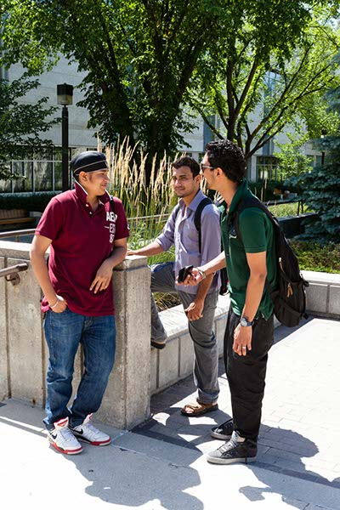
Outside the classroom they have the full U of M experience
All ICM Students have a U of M student ID giving them access to:
Libraries
Computer Labs
Bookstore
Career Counseling Services
Personal Counseling
Health Centre
Admissions and program advising
International Centre for Students (ICS)
Recreational Facilities
Students are integrated into campus life

Slide 11








ICM students build their own communities
ICM and student run social activities help the students make friends and adjust to university life as an international student.

Slide 12
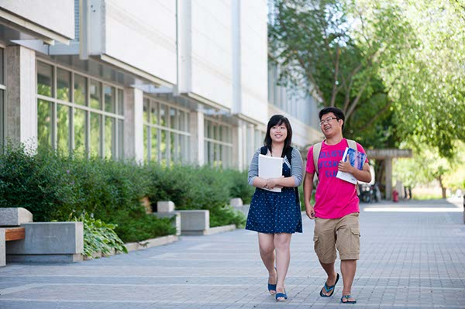




We have now reached a milestone in our student population
As of January 2015 over 1,400 students have completed the ICM program and progressed to the UM
And over 1,000 more are currently enrolled.
ICM has seen over 2,000 students through the program

Slide 13
ICM Program Information

Slide 14
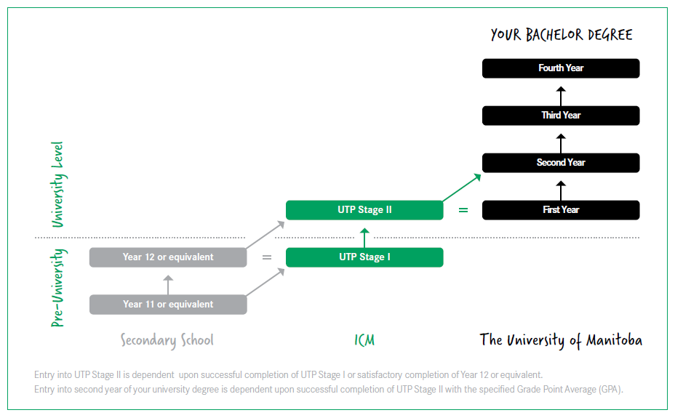
International College of Manitoba
$14,593– 12 months
$14,179 – 8 months
Notes:
Q: What is the relationship between ICM and the University of Manitoba?
A: ICM is a pathway program for international students to successfully transition to the University of Manitoba. ICM offers first year courses, which are applicable towards the UM degree. The Letter of Offer is a joint offer letter between ICM and the UM.
ICM offers programs in Arts, Business, Engineering and Science that are equivalent to the first year of a University of Manitoba degree
Provided you meet the required GPA for entry, you will be able to transfer into the second year of your degree at the University of Manitoba
Supporting Statistics:
95% of graduates are satisfied with their ICM program
95% of ICM graduates progress to the University of Manitoba
96% of current ICM students are satisfied with the overall quality of teaching
98% of current ICM students are satisfied with the level of customer service

Slide 15
Undergraduate Programs Offered by ICM
UTP Stage II: Engineering
Areas of Study: Biosystems, Civil, Mechanical, Computer and Electrical Engineering
Year 2: Faculty of Engineering
UTP Stage II: Business
Areas of Study: Accounting, Finance, Marketing, International Business, Actuarial Sciences
Year 2: Faculty of Business
UTP Stage I: Foundation
UTP Stage II: Science
Areas of Study: Biological, Computing, Physical, Chemistry and Mathematical Sciences
Year 2: Faculty of Science
UTP Stage II: Arts
Economics, Political Studies. Languages, Psychology, History and Philosophy
Year 2: Faculty of Arts
Notes:
Engineering Facts:
At least 95% of all University of Manitoba Engineering graduates get jobs in their related field of study after graduation.
A co-operative education program is available to students.
The only Canadian university to have an NSERC Chair in Design Engineering as an Associate Dean.
Take cool courses such as: Robotics, Introduction to Artificial Intelligence and Air Pollution Assessment & Management
Programs are accredited in Canada and recognized internationally.
Business Facts:
The University’s Asper School of Business is recognized among the top 5 business schools in Canada.
Ranked #1 in the world for first place finishes at international business competition.
Home to the largest co-op education program on campus
Accredited by AACSB International, less than 5% of the world’s business schools have earned this distinguished hallmark of excellence in management education
One of the oldest and most successful actuarial programs in North America with a long history of graduating the top actuaries in the world.
Science Facts:
Largest co-op program in the province.
Home to 7 Canada Research Chairs in Science, which means you will learn from national and international leaders in their field.
Faculty of Science offers 50 distinct programs.
Undergraduate research opportunities.
Take cool courses such as: Forensic Science, Medicinal and Hallucinogenic Plants, Stars and Human-Computer Interaction.
Arts Facts:
First of its kind in Canada, the Faculty of Arts is home to the Centre of Creative Writing and Oral Culture.
The region’s largest research intensive university.
Internationally-acclaimed, Guy Maddin is the filmmaker-in-residence.
Undergraduate research currently being conducted at archaeological excavations in Israel and the Arctic.

Slide 16
Admission Requirements – Russia
Program | English | Russian
UTP II | Certificate of Secondary Education or Upper Secondary Education with minimum 3.5 | Аттестат о среднем образовании со средним баллом 3,5
Engineering | Certificate of Secondary Education or Upper Secondary Education with a minimum average of 75% (4) in Math, Physics and Chemistry with no grade less than 70% | Аттестат о среднем образовании со средним баллом (75%) 4 по Математике, Физике и Химии и не менее 70% по каждому предмету
UTP I | Certificate of Secondary Education Grade 11 with a 3.0 average | Аттестат о среднем образовании со средним баллом 3

Slide 17
Co-operative Education Opportunities
Co-op is a partnership between the university, employers and students, whereby students complement their academic study with paid full-time work experience in their field of study
Offered by several faculties on campus:
Business
Engineering
Science
Offered to students who completed 2nd year of studies
Notes:
Engineering - http://umanitoba.ca/faculties/engineering/programs/coop/index.html
Business - http://umanitoba.ca/faculties/management/programs/undergraduate/coop/future_students/index.html
Science - http://umanitoba.ca/faculties/science/undergrad/entry/826.html

Slide 18
Applying and Accepting
Applying
Submit Application through your Consultant
Agents certify documents and attach to online application
Admission granted within 24 hours
Letter of Offer emailed to agent directly
Accepting Offer
Student organizes bank transfer of 50% of fees to ICM
Official Letter of Acceptance, Letter of Offer, and payment receipts will be sent by PDF
Print coloured copies of documents and submit with visa file

Slide 19
Important things to know about accommodations
Students must arrange their own accommodation
Decide on your preferred accommodation option
On-Campus
Homestay
Off-campus
Be aware of application deadlines
Apply online
Pay the deposit
Check move-in dates
More information available in appendix section of presentation
QUICK TIPS
BOOK AS EARLY AS POSSIBLE – DON’T WAIT UNTIL THE LAST MINUTE!
IF THE STUDENT IS UNDER 17 YEARS OF AGE AND REQUIRES CUSTODIANSHIP APPLY THROUGH POLAR TRAILS
BE PATIENT
DEAL DIRECTLY WITH THE RESIDENCE OFFICE OR THE HOMESTAY OFFICE BUT COPY ICM IN ALL COMMUNICATIONS

Slide 20
Summary
High quality education
Affordable tuition and low cost of living
Great support designed for international students
High academic success rates
Excellent co-op programs
Fantastic post-graduation opportunities

Slide 21



Join the ICM Community
Want to learn more about ICM, then join our social media groups…
Join our network at WWW.ICMANITOBA.CA
ICM LIVE!

