Slide 1
Discover.Maine

Slide 2
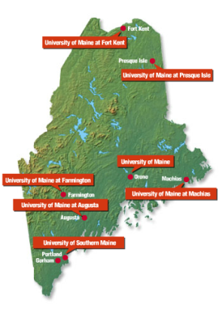
7 unique universities. 1 amazing state. 7 ways to discover Maine.

Slide 3
Outstanding universities.
Affordable education.
Unique offerings.
Maine is a leader in Maine is a leader in environmentally conscious research and living, and one of America’s most sought after recreational destinations.
Just a few recognitions across the state of Maine:
‘Top 100 national university’
‘Top 100 public research institution in the U.S.’
‘Top Regional Public Colleges in the North’
‘Great Affordable Eco-Friendly College’
‘Best Northeastern College’
‘College of Distinction’
‘15 Top Public Schools in the North’
‘Top 5 Regional Colleges in the North for graduates with least debt’
‘Top ROI University’
Direct admissions through Study Group offered at all 7 campuses.
The International Study Center is offered at The University of Maine in Orono for IY1 and PMP students.
The English Language Bridge (ELB) program is offered at the University of Southern Maine for undergraduate students.

Slide 4
Experience Maine.
Explore and discover.
Maine is America’s #1 safest state
Affordable Living
Most affordable state in New England (Vermont, New Hampshire, Massachusetts, Rhode Island, Connecticut, and Maine)
Stunning destination
Beautiful surroundings
#1 safest state in America
#6 happiest state in America

Slide 5
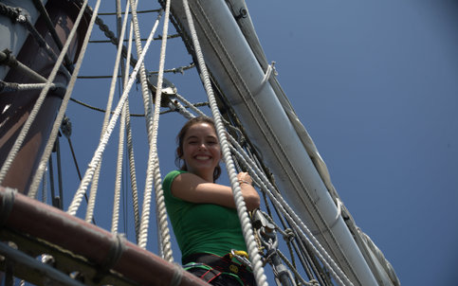
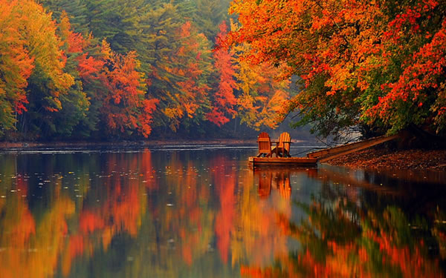
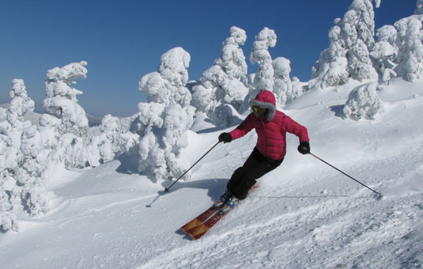
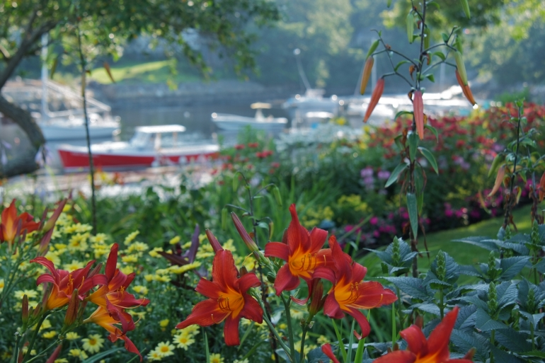
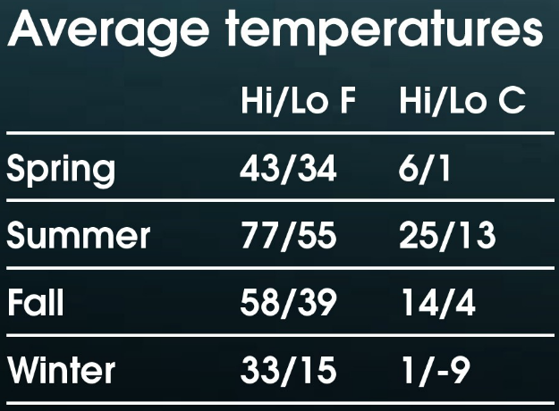
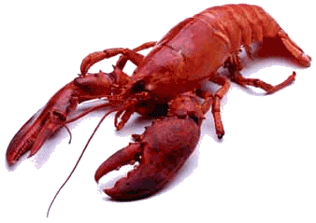
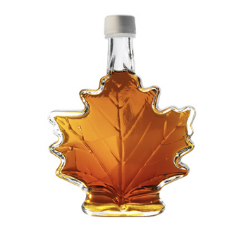
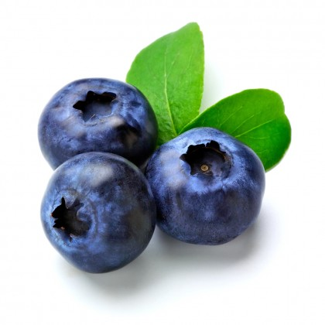
Maine – a top destination
Offering 4 seasons for exploration…
Summer sailing
Fall colors
A range of climates throughout the state.
In summer, expect temperatures around 27º C (80º F) along the coast and up to 32º C (90º F) inland.
In winter, the snow-covered northern regions provide some of the best skiing and winter sports in the world.
Winter skiing
Spring flowers
Some of the best food comes from Maine…

Slide 6
Study. Ski. Run. Kayak. Hike. Go. Snowboard. Rafting. Bike. Swim. Dine with friends. Shop. Explore. Meet classmates. Learn. Live. Grow.

Slide 7
Maine activities.
Come explore.
The great outdoors
Acadia National Park, Ranked #1 in America by the TV show “Good Morning America”
Rugged coastline
Mount Katahdin
Breathtaking forests
Foodie Destination
#1 distributor of lobster in America
Ranked #2 Best State to eat local food by Takepart.com
Ranked #10 as top food state by Thrillist.com
Arts and Culture
Art galleries
Music festivals
Monthly ‘art walks’ featuring local artists and restaurants

Slide 8
Maine – a top destination
Offering 4 seasons for exploration…
Summer sailing
Fall colors
A range of climates throughout the state.
In summer, expect temperatures around 27º C (80º F) along the coast and up to 32º C (90º F) inland.
In winter, the snow-covered northern regions provide some of the best skiing and winter sports in the world.
Winter skiing
Spring flowers
Some of the best food comes from Maine…

Slide 9
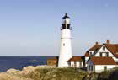
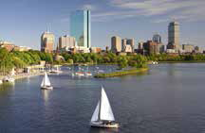
New England living.
Weekend opportunities abound in Maine. And beyond.
New York City shopping, a hike along mountain trails or a lobster lunch on the beach – what will you experience this weekend?
It’s where the rich & powerful want to live…
City | Travel Time* | Method of Transportation | Highlights
Portland, ME | 2 hours | Car or bus | Top foodie destination, arts, culture. Old Port--Maine's historic port city; nationally acclaimed dining; Maine's largest, most urban city; general shopping; international airport
Freeport, ME | 90 minutes | Car or bus | Boutique outlet shopping--Allen-Edmonds, American Eagle, Brooks Brothers, Coach, Cole Haan, Dooney & Bourke, J. Crew, L.L. Bean, Nike, Nine West, Polo Ralph Lauren, Tommy Hilfiger, The Body Shop, The North Face
Boston, MA | 4 hours | Car or bus | America's 10th largest metropolitan area; home of some of America's "firsts"--like the first subway system and institution of higher education
New York City, NY | 55 minutes* | Plane | “The Big Apple”, America's largest city -- a commerce, finance, media, art, fashion, research and entertainment hub; home to Times Square (“The Crossroads of the World”), Broadway, the New York Stock Exchange, Rockefeller Center, and SoHo
Bar Harbor
Acadia National Park, Ranked #1 in America by the TV show “Good Morning America”
Rugged coastline
Mount Katahdin
Breathtaking forests
Sugarloaf ski area and resort
Acadia National Park, Ranked #1 in America by the TV show “Good Morning America”
Rugged coastline
Mount Katahdin
Breathtaking forests
Acadia National Park
Acadia National Park, Ranked #1 in America by the TV show “Good Morning America”
Rugged coastline
Mount Katahdin
Breathtaking forests
*Based on distances from Bangor, near the middle of the state.

Slide 10
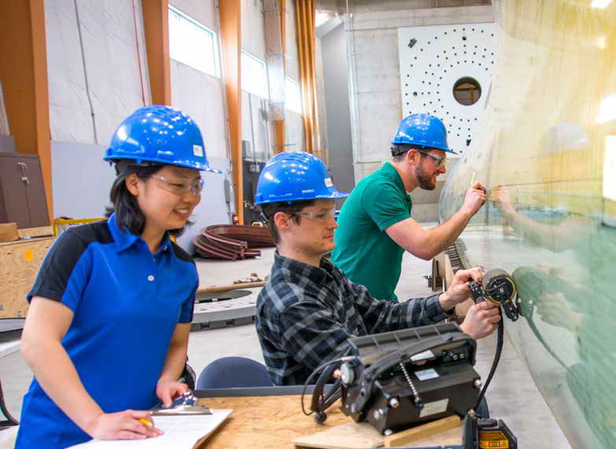
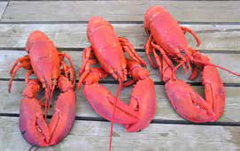
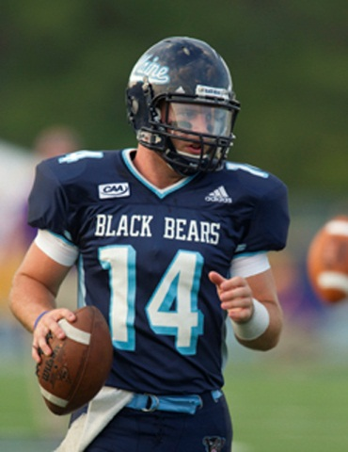
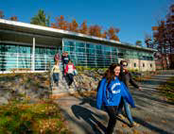
Student life in Maine.
A wonderful place to live and study.
Quality education. Creative minds.
Safe and friendly communities.
A fantastic lifestyle.
Just a few of the reasons international students choose to live and study in Maine.
It’s where the rich & powerful want to live…
Bar Harbor
Acadia National Park, Ranked #1 in America by the TV show “Good Morning America”
Rugged coastline
Mount Katahdin
Breathtaking forests

Slide 11
Liberal Arts and Sciences
Education
Produces highly employable graduates
3 professors have been honored by the U.S. President with the Presidential Award for Excellence in Mathematics and Science Teaching
Science and Mathematics
Biology, Environmental Science, Geology, Health Information Systems, Actuarial Science, and its UMF Pre-Med and Pre-Chiropractic tracks provide students with the research experience and problem-solving skills to
advance to graduate school, medical school and
outstanding professional careers. UMF students regularly go on to the finest medical schools and research institutions in the U.S.
Human Services
UMF offers a broad range of helping programs: Psychology, Counseling 3+2, Rehabilitation Services, Community Health Education and more—all with field work and graduate school level research opportunities.
Arts
The Farmington area is the cultural center of
the region, and home to an active community
of artists, musicians, poets, actors, writers,
filmmakers, comedians and more.
UMF has hosted performances by nationally and
internationally known performing artists; along
with exhibits by renowned artists; readings
by Pulitzer Prize winning poets and renowned
authors; and more. UMF provides a truly rich
and creative environment for students.

Slide 12
A small an friendly university with nursing programs open to international students. Nursing UMFK Nursing students begin taking nursing courses in their first semester, and take at least one nursing course every semester thereafter.
During their education, students will also be integrated into hospital settings where they will work closely with patients and participate in their care.
UMFK graduates consistently achieve the highest passing scores statewide on the National Licensing Examination for Registered Nurses each year.
Applied Forest Management and Environmental Studies Well-rounded, hands-on approach to gain marketable skills. Access to the area’s multiple water systems, abundant forests, UMFK’s own biology park, and the Elmer Violette Wilderness Camps near the Allagash Waterway.

Slide 13
A specialist university
Diverse culture, a close-knit community
Named a Best Northeastern College for the tenth year running by The Princeton Review, 2015
Named a Top Public College in the North by the U.S. News & World Report 2015
Entry and Costs
Direct/Undergraduate:
TOEFL 61 / IELTS 5.0
2.75+ GPA
$10,098 per academic year

Slide 14
Wide range of opportunities
Unique approach Academic Program The Colleges of Arts & Sciences, Professional Programs, and Education work with students to develop their academic passions and employability skills for careers as educators, lawyers, doctors, counselors, writers, artists, law health care professionals, and more.
The wide range of programs include Art, Athletic Training, Biology, Athletic Training, Biology, Business Administration, Criminal Justice, Education, English, Environmental Science, History & Political Science, Mathematics, Physical Education, Psychology, and Social Work.
1st Class Nordic Ski Center
World-class hiking and ski facility near campus hosting junior biathlon world championship

Slide 15
A unique approach
Personalized, proficiency-based approach to education based on the latest research about how the brain works.
#41 Best Regional Colleges in the North
Top 15 Top Public Schools in the North
The Top Maine Regional College in the North for
graduates with the least debt
Rankings from U.S. News and World Report's Best Colleges 2014
Entry and Costs
Direct/Undergraduate:
TOEFL 71 / IELTS 6.0
No minimum GPA required; successful completion of secondary school
$10,098 per academic year

Slide 16
Grounded by surroundings
New England’s only Environmental Liberal Arts Colleges Sciences
With an unrivalled coastal location and the
natural world as an outdoor classroom, UMM
offers outstanding experiential opportunities
for fisheries, wildlife and marine biology
students.
Programs are rooted in and inspired
by the college’s natural location. This means
that students can actively study their subjects,
put theory into practice on field trips and
undertake practical research projects during
their studies – this is exactly what employers
look for in graduate hires.
With small class sizes, students work closely
with their instructors throughout their studies
and receive the one-to-one attention they need
to succeed.
Arts
The wild coastal region of Downeast Maine
has long captivated the imagination of poets,
writers, artists, musicians and others. UMM’s
arts programs are inspired by their natural
environment yet maintain a strong practical
hands-one element and clear career focus.
An arts degree from UMM can lead to a broad
range of rewarding careers such as journalism,
advertising, publishing, communications,
teaching, marketing, public relations, archive
and museum management, law, library science
and broadcasting.

Slide 17
Maine’s coastal university
Top 100 Liberal Arts Colleges - Washington Monthly
Nationally ranked #7 for Social Mobility - Washington Monthly
Maine’s coastal university
Long-term sustainability efforts at UMM resulted in 44%
reduction of carbon emissions over seven years
Entry and Costs
Direct/Undergraduate:
TOEFL 79 / IELTS 6.5
2.75+ GPA
$18,850 per academic year

Slide 18
Journey to success starts here.
Architecture and Aviation Studies Architecture 4-year Bachelor of Arts in Architecture and a 5-year Bachelor of Architecture
UMA is the only public university north of New York City to offer the Bachelor of Architecture degree
Aviation Studies
Low-cost Bachelor of Aviation degree program
Red Bird FMX Full Motion Flight Simulator, a state-of-the-art flight simulator, integrated into the curriculum

Slide 19
Unique opportunities begin in Maine’s capital
Top 5 Enrolled Bachelors Programs:
1. Mental Health/Human Services
2. Liberal Studies
3. Business Administration
4. Computer Information Systems
5. Justice Studies
Located in Maine’s state capital
Red Bird FMX Full Motion Flight Simulator, a state-of-the-art flight simulator, integrated into the curriculum
Entry and Costs
Direct/Undergraduate:
TOEFL 79 / IELTS 6.5
2.0-3.0 GPA, varies by program
$12,852 per academic year

Slide 20
RECAP:
ISC/DA
UG/PG
STEM, Business
Social Work
ELB/DA
UG/PG
STEM
Business
Arts
DA
UG
Education
Liberal arts
DA
UG
Nursing
DA
UG
Arts and Sciences
DA
UG
Environ- mental Liberal arts
DA
UG
Architecture
Aviation Studies

